Slide 1
Final Review

Slide 2
The exam
Two double-sided letter size cheating sheets allowed
Closed book, closed note
McMaster calculator allowed
Types of questions:
  True or False
  Fill in black
All in one slides on course page
Office hrs: (April 6 – 10th, 20th – 24th)
  Tue. 4 – 6pm, Wed. 10 – 4pm; By appt other time
  Please resolve all grading related issues by April 24th
  >= 85 – A; > 90 – A⁺
  Note: out of town April 13th – 17th

Slide 3
Materials covered since midterm
Network layer
Data link layer
Security
Tips:
Go over the “A day in the life of a web request” walkthrough → extend it to “A day in the life of a web request over HTTPs”
  Make sure you understand the protocols and network elements involved
Make sure you understand all the homework solutions

Slide 4
Network layer
Protocols
  IP v4 header format, IP fragmentation
  IP v4 address dot decimal representation, subnet mask & subnet address (a.b.c.d/x)
  Key differences between IPv4 & IPv6
  DHCP: what does it do?
  NAT: how does it work? max # of connections with one public IP?
  ICMP: which ICMP messages are used in traceroute?
  Intra-domain vs inter-domain routing
    RIP, OSPF
    BGP (AS PATH vector) shortest AS path != shortest hop path; BGP policies
Algorithms
  Distance vector algorithm
  Configuration of forwarding table entries based on intra-domain & inter-domain routing

Slide 5
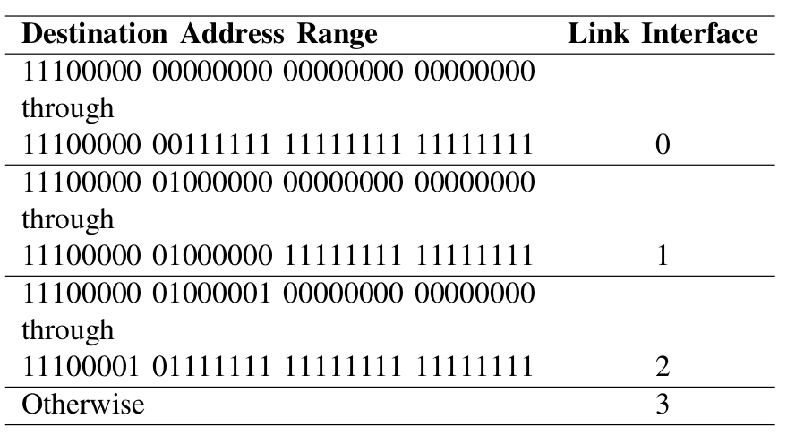
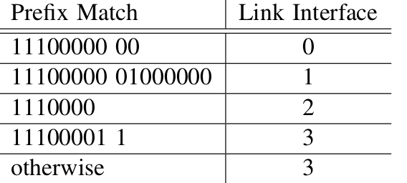
homework 3, Problem 1

Slide 6
homework 3, Problem 4
A
B
C
D
E
  Q11. Given the following sequence of routing update messages, fill in the table for the routing entries for reaching A at each event, where the notation B → C indicates that node B sent a routing update to node C.
Event | B |  | C |  | D |  | E
 | cost | nexthop | cost | nexthop | cost | nexthop | cost | nexthop
 | 1 | A | 2 | B | 2 | B | 3 | D
Node A down | ◎ | - | 2 | B | 2 | B | 3 | D
C → B
B→ D
D→ E
E→ D
D → B
B → C
C → B
B → D

Slide 7
Data link layer
Protocol
  Functions of data link layer
  MAC address, ARP
  Ethernet, 802.11 frame format, 802.11 frame types
  CSMA/CD, CSMA/CA, virtual carrier sensing (when?)
    When will collisions occur? Why exponential backoff?
    Inter-frame spacing
  Difference between hubs & switches
  Composition of WLAN
Algorithm
  Self-learning on switches

Slide 8
Security
Symmetric key vs public key cryptography
  Basic idea behind RSA algorithm
  Needs for KDC and CA
Digital signature using pubic key cryptography
Message integrity using hash function or digest
Authentication using symmetric key and public key cryptography
  Why do the naïve ones fail?
Security attacks & counter-measures
  Mapping, IP spoofing, packet sniffering, DOS
  Ingress filter, firewall, ARP, IP traceback
SSL: how is authentication done and how is session key set up
802.11i: 1) why WEP failed 2) crypto mechanism involved (public key crypto, share key crypto, nonce)
-
+
+
-
K (K (m)) = m
=
K (K (m))
B
B
B
B

Slide 9
Good luck
Please remember to fill in teaching evaluation!

