Slide 1
CPU scheduling
Rong Zheng

Slide 2
Overview
Why scheduling?
Non-preemptive vs Preemptive policies
  FCFS, SJF, Round robin, multilevel queues with feedback, guaranteed scheduling

Slide 3
Short-term, mid-term, long-term scheduler
Running
Exit
Terminated
Get CPU
System request
Admit process
Interrupt
New
Ready
Waiting
Completion
Activate
Deactivate
Deactivate
Suspended
Ready
Suspended
Waiting
Completion
Long-term scheduler: admission control
Mid-term scheduler: who gets to be loaded in memory
Short-term scheduler: who (in ready queue) gets to be executed

Slide 4
Scheduling Metrics
Waiting time: Waiting time is the sum of the periods spent waiting in the ready queue.
Turnaround time: The interval from the time of submission of a process to the time of completion is the turnaround time.
The sum of the periods spent waiting to get into memory, waiting in the ready queue, executing on the CPU, and doing I/O.
Response time (interactive processes): the time from the submission of a request until the first response is produced.
Throughput: number of jobs completed per unit of time
  Throughput related to turningaround time, but not same thing:
Notes:
What does CPU scheduling have to do with efficient use of the disk?
A lot! Have to have the CPU to make a disk request
Fairness: Minimize # of angry phone calls? Minimize my response time?

Slide 5
Criteria of A Good scheduling policy
Maximize throughput/utilization
Minimize response time, waiting time
  Throughput related to response time, but not same thing
No starvation
  Starvation happens whenever some ready processes never get CPU time
Be fair
  How to measure fairness
Tradeoff exists

Slide 6
Different types of policies
A non-preemptive CPU scheduler will never remove the CPU from a running process
  Will wait until the process releases the CPU because i) It issues a system call, or ii) It terminates
  Obsolete
A preemptive CPU scheduler can temporarily return a running process to the ready queue whenever another process requires that CPU in a more urgent fashion
  Has been waiting for too long
  Has higher priority

Slide 7
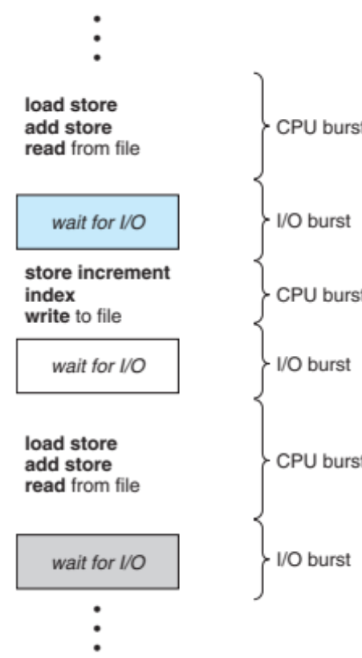
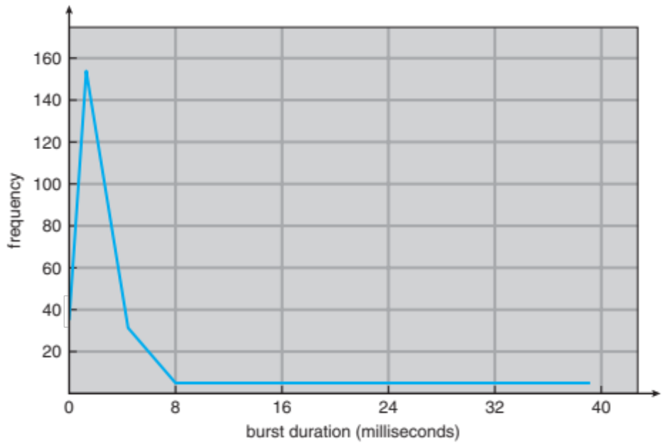
Job execution
  With time slicing, thread may be forced to give up CPU before finishing current CPU burst. Length of slices?

Slide 8

First- Come First-Served (FCFS)
Simplest and easiest to implement
  Uses a FIFO (First-in-first-out) queue
Previously for non-preemptive scheduling
Example: single cashier grocery store
Process Burst Time
P₁ 24
P₂ 3
P₃ 3

Slide 9
FCFS
Suppose processes arrive in the order: P1 , P2 , P3
Waiting time for P1 = 0; P2 = 24; P3 = 27
Average waiting time: (0 + 24 + 27)/3 = 17
Average completion time: (24 + 27 + 30)/3 = 27
Convoy effect: short process behind long process
P₁
P₂
P₃
0
24
27
30

Slide 10
FCFS (cont’d)
Suppose processes arrive in the order: P2, P1 , P3
Waiting time? P1 = 6; P2 = 0; P3 = 3
Average waiting time? 3
Average completion time? (3+6+30)/3 = 13
Good to schedule to shorter jobs first
P₂
P₃
P₁
0
3
6
30

Slide 11
Shortest job first (SJF)
Gives the CPU to the process requesting the least amount of CPU time
  Will reduce average wait
  Must know ahead of time how much CPU time each process needs
  Provably achieving shortest waiting time among non-preemptive policies
  Need to know the execution time of processes ahead of time – not realistic!

Slide 12
Round robin
All processes have the same priority
Similar to FCFS but processes only get the CPU for a fixed amount of time T_{CPU}
  Time slice or time quantum
Processes that exceed their time slice return to the end of the ready queue
The choice of is T_{CPU} important
  Large → FCFS
  Small → Too much context switch overhead

Slide 13
Example of RR
Process Burst Time Remaining Time
P₁ 53 53
P₂ 8 8
P₃ 68 68
P₄ 24 24
RR schedule

Slide 14
Example of RR
Process Burst Time Remaining Time
P₁ 53 33
P₂ 8 8
P₃ 68 68
P₄ 24 24
RR schedule
P₁
0
20

Slide 15
Example of RR
Process Burst Time Remaining Time
P₁ 53 33
P₂ 8 0
P₃ 68 68
P₄ 24 24
RR schedule
P₁
P₂
0
20
28

Slide 16
Example of RR
Process Burst Time Remaining Time
P₁ 53 33
P₂ 8 0
P₃ 68 48
P₄ 24 24
RR schedule
P₁
P₂
P₃
0
20
28
48

Slide 17
Example of RR
Process Burst Time Remaining Time
P₁ 53 33
P₂ 8 0
P₃ 68 48
P₄ 24 4
RR schedule
P₁
P₂
P₃
P₄
0
20
28
48
68

Slide 18
Example of RR
Process Burst Time Remaining Time
P₁ 53 0
P₂ 8 0
P₃ 68 0
P₄ 24 0
RR schedule
P₁
P₂
P₃
P₄
P₁
P₃
P₄
P₁
P₃
P₃
0
20
28
48
68
88
108
112
125
145
153

Slide 19
RR with Quantum = 20
P₁
P₂
P₃
P₄
P₁
P₃
P₄
P₁
P₃
P₃
0
20
28
48
68
88
108
112
125
145
153
Waiting time for P1=(68-20)+(112-88)=72 P2=(20-0)=20
P3=(28-0)+(88-48)+(125-108)=85
P4=(48-0)+(108-68)=88
Average waiting time = (72+20+85+88)/4=66¼
Average completion time = (125+28+153+112)/4 = 104½

Slide 20
with Different Time Quantum
P₂
[8]
P₄
[24]
P₁
[53]
P₃
[68]
Best FCFS:
0
8
32
85
153
Quantum
P₁
P₂
P₃
P₄
Average
Wait
Time
Best FCFS
32
0
85
8
31¼
Completion
Time
Best FCFS
85
8
153
32
69½

Slide 21
with Different Time Quantum
P₃
[68]
P₁
[53]
P₄
[24]
P₂
[8]
Worst FCFS:
0
68
121
145
153
Quantum
P₁
P₂
P₃
P₄
Average
Wait
Time
Best FCFS
32
0
85
8
31¼
Worst FCFS
68
145
0
121
83½
Completion
Time
Best FCFS
85
8
153
32
69½
Worst FCFS
121
153
68
145
121¾

Slide 22
with Different Time Quantum
P₃
[68]
P₁
[53]
P₄
[24]
P₂
[8]
Worst FCFS:
0
68
121
145
153
Quantum
P₁
P₂
P₃
P₄
Average
P₁
P₂
P₃
P₄
P₁
P₃
P₄
P₁
P₃
P₄
P₁
P₃
P₁
P₃
P₁
P₃
P₁
P₃
P₃
P₃
Wait
Time
Best FCFS
32
0
85
8
31¼
Q = 1
84
22
85
57
62
0
8
16
24
32
40
48
56
64
72
80
88
96
104
112
120
128
133
141
149
153
Q = 5
82
20
85
58
61¼
Q = 8
80
8
85
56
57¼
Q = 10
82
10
85
68
61¼
Q = 20
72
20
85
88
66¼
Worst FCFS
68
145
0
121
83½
Completion
Time
Best FCFS
85
8
153
32
69½
Q = 1
137
30
153
81
100½
Q = 5
135
28
153
82
99½
Q = 8
133
16
153
80
95½
Q = 10
135
18
153
92
99½
Q = 20
125
28
153
112
104½
Worst FCFS
121
153
68
145
121¾

Slide 23
In reality
P₀
CS
P₁
CS
P₂
CS
P₃
CS
P₄
The completion time is long with context switches
  More harmful to long jobs
Choice of slices:
  Typical time slice today is between 10ms – 100ms
  Typical context-switching overhead is 0.1ms – 1ms
  Roughly 1% overhead due to context-switching

Slide 24
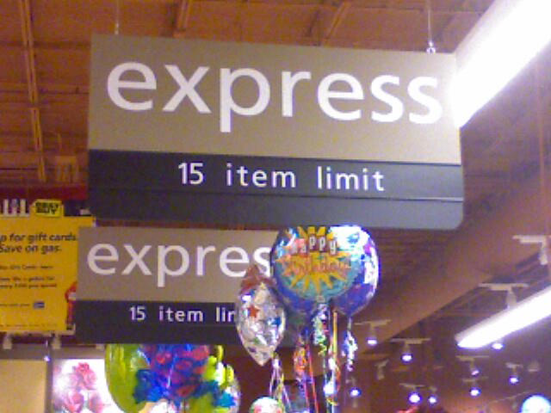
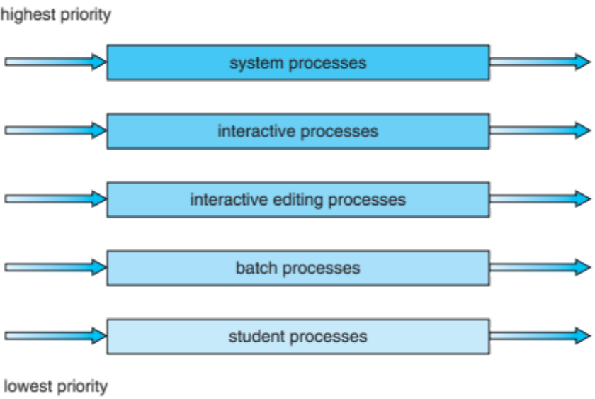
Multilevel queues with Priority
Distinguish among
  Interactive processes – High priority
  I/O-bound processes – Medium priority
    Require small amounts of CPU time
  CPU-bound processes – Low priority
    Require large amounts of CPU time (number crunching)
One queue per priority
  Different quantum for each queue
Allow higher priority processes to take CPU away from lower priority processes
How do we know which is which?
What about starvation?

Slide 25
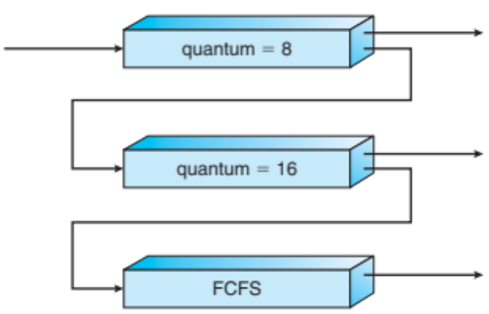
Multi-Level Feedback Scheduling
Long-Running
Compute tasks
demoted to
low priority
Use past behavior to predict future
  First used in Cambridge Time Sharing System (CTSS)
  Multiple queues, each with a different priority
    Higher priority queues often considered “foreground” tasks
  Each queue has its own scheduling algorithm
    e.g., foreground – RR, background – FCFS
    Sometimes multiple RR priorities with quantum increasing exponentially (highest:1ms, next:2ms, next: 4ms, etc.)
Adjust each job’s priority as follows (details vary)
  Job starts in highest priority queue
  If timeout expires, drop one level
  If timeout doesn’t expire, push up one level (or to top)

Slide 26
Multi-processor scheduling
Multi-processor on a single machine or on different machines (clusters)
  Process affinity: avoid moving data around
  Load balancing
  Power consumption

Slide 27
Scheduling in Linux
Traditionally
  Multi-level feedback queue
  RR within each queue
Modern implementation
  Processes can be assigned one of three priority levels: Real Time (highest), Kernel, or Time Shared (lowest)
  Time shared processes use multi-level feedback queue
  Priority levels of time-shared processes can be adjusted (relatively) via nice command
  For SMP, support process affinity and load balancing

Slide 28
Real-time scheduling

Slide 29
Real-time systems
Systems whose correctness depends on their temporal aspects as well as their functional aspects
  Control systems, automotive …
Performance measure
  Timeliness on timing constraints (deadlines)
  Speed/average case performance are less significant.
Key property
  Predictability on timing constraints
Hard vs soft real-time systems

Slide 30
Real-Time Workload
Job (unit of work)
  a computation, a file read, a message transmission, etc
Attributes
  Resources required to make progress
  Timing parameters
Absolute deadline
Released
Execution time
Relative deadline

Slide 31
Real-Time Task
Task : a sequence of similar jobs
  Periodic task (p,e)
    Its jobs repeat regularly
    Period p = inter-release time (0 < p)
    Execution time e = maximum execution time (0 < e < p)
    Utilization U = e/p
0
5
10
15

Slide 32
Rate Monotonic
Optimal static-priority scheduling
It assigns priority according to period
A task with a shorter period has a higher priority
Executes a job with the shortest period
T₁
(4,1)
T₂
(5,2)
5
10
15
T₃
(7,2)
5
10
15

Slide 33
RM (Rate Monotonic)
Executes a job with the shortest period
T₁
(4,1)
T₂
(5,2)
5
10
15
T₃
(7,2)
5
10
15

Slide 34
RM (Rate Monotonic)
Executes a job with the shortest period
Deadline Miss !
T₁
(4,1)
T₂
(5,2)
5
10
15
T₃
(7,2)
5
10
15

Slide 35
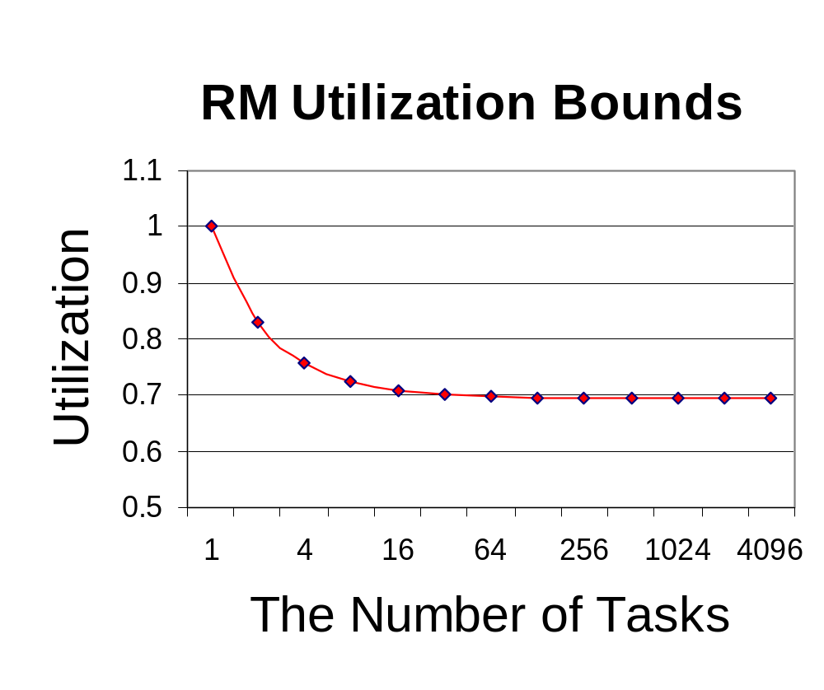
RM – Utilization Bound
Real-time system is schedulable under RM if
∑C_{i}/T_{i} ≤ n (2^{1/n}-1)
C_{i} is the computation time (work load), T_{i} is the period

Slide 36
EDF (Earliest Deadline First)
Optimal dynamic priority scheduling
A task with a shorter deadline has a higher priority
Executes a job with the earliest deadline
T₁
(4,1)
T₂
(5,2)
5
10
15
T₃
(7,2)
5
10
15

Slide 37
EDF (Earliest Deadline First)
Executes a job with the earliest deadline
T₁
(4,1)
T₂
(5,2)
5
10
15
T₃
(7,2)
5
10
15

Slide 38
EDF (Earliest Deadline First)
Executes a job with the earliest deadline
T₁
(4,1)
T₂
(5,2)
5
10
15
T₃
(7,2)
5
10
15

Slide 39
EDF (Earliest Deadline First)
Executes a job with the earliest deadline
T₁
(4,1)
T₂
(5,2)
5
10
15
T₃
(7,2)
5
10
15

Slide 40
EDF (Earliest Deadline First)
Optimal scheduling algorithm
  if there is a schedule for a set of real-time tasks,
  EDF can schedule it.
T₁
(4,1)
T₂
(5,2)
5
10
15
T₃
(7,2)
5
10
15

Slide 41
EDF – Utilization Bound
Real-time system is schedulable under EDF if and only if
∑C_{i}/T_{i} ≤ 1
Liu & Layland,
“Scheduling algorithms for multi-programming in a hard-real-time environment”, Journal of ACM, 1973.

Slide 42
Summary
Scheduling matters when resource is tight
  CPU, I/O, network bandwidth
  Preemptive vs non-preemptive
  Burst time known or unknown
  Hard vs soft real-time
  Typically tradeoff in fairness, utilization and real-timeliness
Response time
100%
Utilization

Slide 43
Comparison
 | Utilization (throughput) | Response time | Fairness
FCFS | 100% | High | Good
SJF | 100% | Shortest | Poor
RR | 100% | Medium | Good
Multi-level priority with feedback | 100% | Short | Good
RM | ∑C_{i}/T_{i} ≤ n (2^{1/n}-1) | - | -
EDF | 100% | - | -

