Slide 1
CAS3SH3 Final Review

Slide 2
The Final
Tue 28th, 7pm, IWC3
closed book, closed note
Non-comprehensive: memory management, storage & file system
Types of questions: multiple choice, long answers
You can bring McMaster standard calculator; no Internet-enabled devices
All-in-one slides on course page
Office hrs: (April 6 – 10th, 20th – 24th)
  Tue. 4 – 6pm, Wed. 10 – 3pm; By appt other time
  Please resolve all grading related issues by April 24th
  >= 85 -- A; > 90 – A⁺
  Note: out of town April 13th – 17th

Slide 3
Materials covered since midterm
Memory management
Storage and file systems
Two key aspects
Data structure
  What
  Where: in memory/cache/register, on disk
Algorithms

Slide 4
Memory Management
Understand the distinctions between virtual (logical) address space and physical address space
Understand different approaches to memory management: contiguous vs. non-contiguous, fixed vs variable size partitions, segmentation, paging. Pros and cons of each approach
What are external fragmentation and internal fragmentation?
Segmentation: segmentation table, how to translate from virtual address to physical address? when errors occur?
Virtual
Address
offset
>
Seg #
Offset
Error
Base0
Limit0
V
Base1
Limit1
V
Base2
Limit2
V
Base2
Limit2
V
Base3
Limit3
N
+
Physical
Address
Base4
Limit4
V
Base5
Limit5
N
Base6
Limit6
N
Base7
Limit7
V
Check Valid
Access
Error

Slide 5
Memory Management
Paging: page table, page table entry, how to translate from virtual address to physical address? when errors occur?
Special bits in PTE
Impacts of page size
Virtual Address:
Virtual
Page #
Offset
PageTablePtr
page #0
V,R
Physical
Page #
Offset
page #1
V,R
page #1
V,R
page #2
V,R,W
Physical Address
PageTableSize
>
page #3
V,R,W
Check Perm
Access
Error
page #4
N
page #5
V,R,W
Access
Error

Slide 6
Paging (cont’d)
TLB, multilevel paging, inverted page table, combing paging with segmentation
  Pros and cons
Compute the size of page table(s) and the maximum size of logical address space of 32-bit and 64-bit systems
 | Advantages | Disadvantages
Segmentation | Fast context switching: Segment mapping maintained by CPU | External fragmentation
Paging (single-level page) | No external fragmentation, fast easy allocation | Large table size ~ virtual memory
Paged segmentation | Table size ~ # of pages in virtual memory, fast easy allocation | Multiple memory references per page access
Two-level pages
Inverted page table | Table size ~ # of pages in physical memory | Lookup time If combined with hash table, two memory lookups

Slide 7
Virtual memory
Swap file/partition on disk (in raw, no file system)
Understand the needs for on-demand paging
Valid bit in PTE to indicate whether a page in memory
Page faults
  Type of pages faults: compulsory misses, policy misses, capacity misses
  Cost of page faults
  Steps in handling page faults
Understanding the notions of temporal and spatial locality, and their implication on page replacement policies and working sets
Page replacement policies (FCFS, OPT, LRU, 2nd chance, clock algorithm)
  Given a reference sequence, can determine the # of page faults
  Belady’s anomaly
Working sets: the definition, how to compute working sets, how to avoid thrashing

Slide 8
Types of page faults & remedies
Bag of tricks
Prefetching
Tracking workset
Swapping processes
Page replacement algorithms
Copy-on-write
Capacity misses
Compulsory misses
Policy misses

Slide 9
Storage and File Systems
Organization of magnetic disks
Average access time of magnetic disk
Disk addressing: organize sectors into blocks and use logical block address (LBA)
Disk scheduling:
  Goal: minimizing seek time
  Policies: FIFO, SSTF, SCAN, C-SCAN, C-LOOK
Disk management [file systems]:
  Formatting in two steps: 1) partitioning 2) making file system (not applicable for raw disk partitioning)
  Boot sequence: BIOS, master boot record (locate boot partition), volume boot record (loading OS)
Swap space [memory management]

Slide 10
Storage
Understand MTF, MTR and MTDL
  Able to determine MTF, MTDL for simple schemes such as mirroring
Redundant array of inexpensive (independent) disks (RAID)
  Mirroring, stripling, parity, (7, 4) hamming code
  Error detection vs error correction; bit level vs. block level stripling
  Different RAID configuration

Slide 11
File systems
Directory
  what is stored in directory: (file name, FCB block) organized as a linear array or hash table
  How are directories organized: tree, acyclic graphs
  How to locate a file “/home/me/file1”? (starting from the root directory, find the FCB corresponding to the subdirectories and finally the file)
  Recently accessed directories cached in memory
Files: abstract data type, contiguous logical space (to users)
  File operations: read, write, open, close, …
  FCB
  Disk allocation and translation: contiguous allocation, linked allocation, index allocation
  The maximum size of file is determined by the allocation schemes

Slide 12
File systems
In memory and on-disk data structure
  What happens when creating, opening, reading a file?
In memory | on-disk
Mount table Directory cache system-wide open-file table per-process open file table (PCB) Buffers for file system blocks | MBR Boot control block Volume control block Directory structures FCB and data blocks of each files

Slide 13
Discussion
In paging, the physical address can be computed by adding the physical page # and the offset (false)
  Adding → appending
Consider the use of multilevel paging. Suppose a page table in each level can be no larger than 4096 Byte, and the size of each entry in the page table is 4 Byte. With 32-bit logical address space, a) what is the minimum # of levels needed if the page size is 4096 Byte, and b) how many physical memory references are needed for each logical memory reference if no TLB is used.
  (a) 2³²/2¹² = 2²⁰ → 2 levels
  (b) # of memory reference = # of levels + 1
The following bits are typically kept in a page table entry: valid bit, read-only bit, use bit, reference bit, and dirty bit.
  use bit is the same as reference bit

Slide 14
Discussions
Consider the following memory references 2 1 4 2 5 2 1 6 5. Suppose only 3 physical frames in the memory. The number of page faults generated by FIFO (including compulsory PFs) is, ______The number of page faults generated by OPT is, ______The number of page faults generated by LRU is, ______The number of page faults generated by the clock algorithm is, ______
2 | 2 | 2 | 5 | 5 | 5 | 6 | 6
 | 1 | 1 | 1 | 2 | 2 | 2 | 5
 |  | 4 | 4 | 4 | 1 | 1 | 1
FIFO
2 | 2 | 2 | 2 | 6
 | 1 | 1 | 1 | 1
 |  | 4 | 5 | 5
OPT

Slide 15
2 1 4 2 5 2 1 6 5
2 | 2 | 2 | 2 | 2 | 2 | 5
 | 1 | 1 | 5 | 5 | 6 | 6
 |  | 4 | 4 | 1 | 1 | 1
LRU
Clock
2
u: 0
2
u: 1
2
u: 1
2
u: 0
2
u: 0
1
u: 0
1
u: 0
5
u: 0
1
u: 0
4
u: 0
4
u: 0
4
u: 0
2
u: 1
2
u: 0
2
u: 0
5
u: 0
6
u: 0
6
u: 0
1
u: 0
1
u: 0
5
u: 0

Slide 16
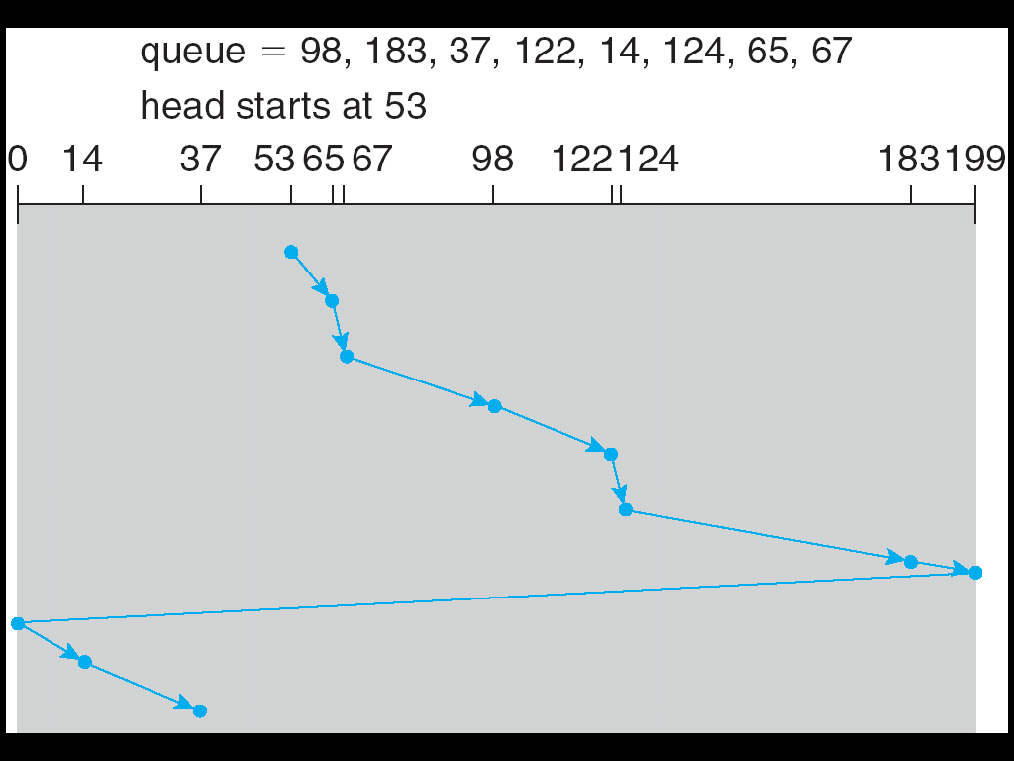
C-SCAN
Notes:
(199 – 53) + (199-0) + (37-0) = 382

Slide 17
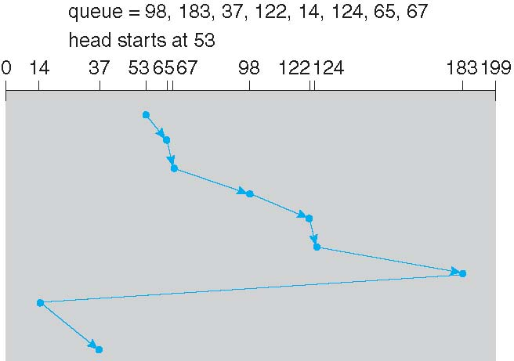
C-LOOK
Notes:
(183-53)+(183-14)+(37-14) = 336

Slide 18
Good luck
Please remember to fill in teaching evaluation!

