Slide 1
CAS3SH3 Midterm Review

Slide 2
The midterm
50 min, Friday, Feb 27th
Materials through CPU scheduling
closed book, closed note
Types of questions: True & False, short questions
You can bring McMaster standard calculator; no Internet-enabled devices
All-in-one slides on course page
Office hrs on 24th will be from 3:30 – 4:30, 5:30 – 6:30pm

Slide 3
Materials covered so far
Introduction to OS
  Basic functions of OS: process management, memory management, CPU scheduling, storage management, protection and security
  Types of kernels (Monolithic (micro-kernel), modular kernel) and their advantaged and disadvantages; examples of OS supporting each types of kernels
  Types of interrupts, purpose of interrupts [process management, synchronization, CPU scheduling]

Slide 4
Process management
Understand the difference between process and program
  Processes are programs in action
Characteristics of process address space [memory management]
  When allocated? what is stored?
Process states
  Understand each state and transition conditions [synchronization, CPU, scheduling, memory management]

Slide 5
Running
Exit
Terminated
Get CPU
System request
Admit process
Interrupt
New
Ready
Waiting
Completion
Activate
Deactivate
Deactivate
Suspended
Ready
Suspended
Waiting
Completion

Slide 6
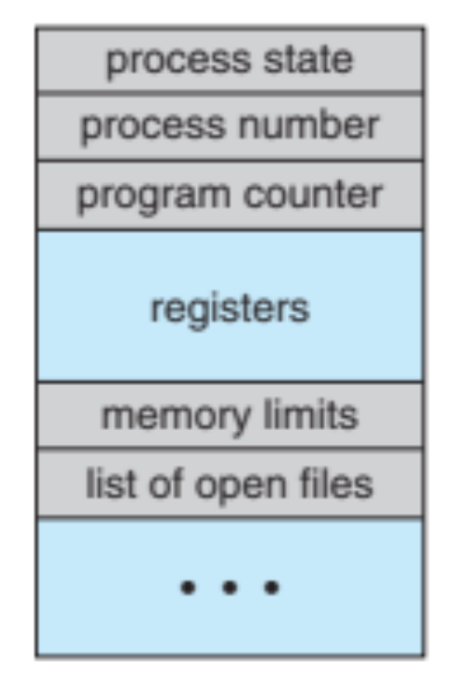
Process management
Process control block (PCB)
  What is stored in PCB?
Context switch
  What happens during context switch?
Process creation
  Understand fork(), exec() in Unix/Linux (why fork is expensive?)
Process termination
  What resources are released/destroyed at process termination
  Child & parent processes

Slide 7
Process management
Cooperating processes
  Mechanisms for cooperation: shared memory and message passing
  Types of message passing: blocking vs non-blocking; symmetric vs asymmetric, direct vs indirect
Thread
  Difference between threads and processes
  Advantages and disadvantage of threads
  Thread control block
  Thread life cycle
  Kernel and user thread; mapping

Slide 8
Synchronization
What is race condition? what causes race condition? deadlock? starvation?
Definition of critical section
Requirement for synchronization: mutual exclusion, progress, no starvation, no (short) busy wait

Slide 9
How to realize synchronization
Produce-consumer as a canonical example
Use enabling and disable interrupt
  Understand two implementations (how to avoid busy wait)
Use test&set
  Understand two implementations
Use mutex lock (why isn’t it good?)
Use semaphore, P(), V()
  Two different uses of semaphores (mutual exclusion & scheduling constraints)
Use monitor, conditional variables
  Mesa style vs hoare style (why “while” not “if”)
Programs
Shared Programs
Higher-level
API
Locks Semaphores Monitors Send/Receive
Hardware
Load/Store Disable Ints Test&Set Comp&Swap

Slide 10
How to realize synchronization
Expectations:
understand priority inversion, dead lock in dining philosophers problem, race condition in producer & consumer
given a piece of code, can reason about whether it contains race condition, deadlock, starvation, busy wait
Use the primitives to enable synchronization

Slide 11
CPU scheduling
Non-preemptive scheduling: FCFS, SJF
Preemptive scheduling: RR, priority scheduling, multi-level feedback queues, RM, EDF
Understand the effects of quantum size in RR
Expectations:
Given a scheduling policy and the collection of the processes (tasks), be able to determine the order of execution, and compute the (avg) waiting time, (avg) completion time, utilization of the processor

Slide 12
 | Utilization (throughput) | Response time | Fairness
FCFS | 100% | High | Good
SJF | 100% | Shortest | Poor
RR | 100% | Medium | Good
Priority | 100% | - | Poor
Multi-level priority with feedback | 100% | Short | Good
RM | ∑C_{i}/T_{i} ≤ n (2^{1/n}-1) | - | -
EDF | 100% | - | -

Slide 13
Exercise on CPU Scheduling
Consider three processes P1, P2, P3 becoming ready at time 0, 9.5, 12 and with a burst time 15, 10, 5
  Sketch the order of execution of the processes under FCFS, SJF and RR with quantum size 5
  Compute the average waiting time and completion time of the above scheduling policies.

Slide 14
Consider three processes P1, P2, P3 becoming ready at time 0, 9.5, 12 and with a burst time 15, 10, 5
  Sketch the order of execution of the processes under FCFS, SJF and RR with quantum size 5
  Compute the average waiting time and completion time of the above scheduling policies.
FCFS
P1
P2
P3
0
15
25
30

Slide 15
Consider three processes P1, P2, P3 becoming ready at time 0, 9.5, 12 and with a burst time 15, 10, 5
  Sketch the order of execution of the processes under FCFS, SJF and RR with quantum size 5
  Compute the average waiting time and completion time of the above scheduling policies.
SJF
P1
P3
P2
0
15
20
30

Slide 16
Consider three processes P1, P2, P3 becoming ready at time 0, 9.5, 12 and with a burst time 15, 10, 5
  Sketch the order of execution of the processes under FCFS, SJF and RR with quantum size 5
  Compute the average waiting time and completion time of the above scheduling policies.
RR with quantum size 5
P1
P1
P2
P1
P3
P2
0
5
10
15
20
25
30

