Slide 1
Process Synchronization
Readings: Chapter 5

Slide 2
Issues in coopering processes and Threads – data sharing
Shared Memory
  Two or more processes share a part of their address space
  Incorrect results whenever two processes (or two threads of a process) modify the same data at the same time
Thread 1
Stack 1
Process P
Stack 2
same
Thread 2
Process Q
Address Space
Heap
Global Data
Code

Slide 3
Example 1: Producer - Consumer
count – # of items in the buffer, shared variable
Producer
while (count == BUFFER.SIZE)
; // do nothing
// add an item to the buffer buffer[in] = item;
in = (in + 1) % BUFFER.SIZE;
++count;
Consumer
while (count == 0)
; // do nothing
// remove an item from the buffer
item = buffer[out];
out = (out + 1) % BUFFER.SIZE;
--count;

Slide 4
Race condition
count++ could be implemented as
register1 = count
register1 = register1 + 1
count = register1
count-- could be implemented as
register2 = count
register2 = register2 - 1
count = register2
Consider this execution interleaving with “count = 5” initially:
  T0: producer execute register1 = count {register1 = 5}
  T1: producer execute register1 = register1 + 1 {register1 = 6}
  T2: consumer execute register2 = count {register2 = 5}
  T3: consumer execute register2 = register2 - 1 {register2 = 4}
  T4: producer execute count = register1 {count = 6 }
  T5: consumer execute count = register2 {count = 4}
count++ and count-- are not atomic operations!

Slide 5
Example 2: Banking problem
Speed up server by using multiple threads (one per request)
  Can use multi-processor, or overlap comp and I/O
Requests proceeds to completion, blocking as required:
Deposit(acctId, amount) {
acct = GetAccount(actId); /* May use disk I/O */
acct->balance += amount;
StoreAccount(acct); /* Involves disk I/O */
}
Unfortunately, shared state can get corrupted:
Thread 1 Thread 2
load r1, acct->balance
load r1, acct->balance
add r1, amount2
store r1, acct->balance
add r1, amount1
store r1, acct->balance

Slide 6






Example 2: Dinning Philosopher’s problem
First suggested by Dijkstra in 1971
  Philosophers eat/think
  Eating needs 2 chopsticks
  Pick one chopstick at a time
Deadlock may occur!

Slide 7
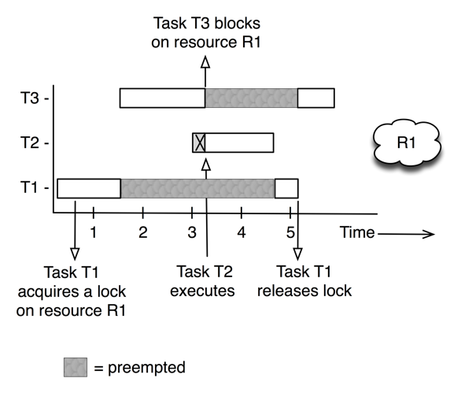
Example 3: Sojourner Rover
Mars Pathfinder, a NASA space probe landed a robot, the Sojourner rover, on Mars in 1997
Shortly after the Sojourner began operating, it started to experience frequent computer resets.
Priority: T3 > T2 > T1
Problem: T3 may be blocked for a long period of time
Solution: priority inheritance

Slide 8
Definitions
Synchronization: using atomic operations to ensure cooperation between threads
  For now, only loads and stores are atomic
Critical Section: piece of code that only one thread can execute at once
Mutual Exclusion: ensuring that only one thread executes critical section
  One thread excludes the other while doing its task
  Critical section and mutual exclusion are two ways of describing the same thing

Slide 9
Requirements
Mutual exclusion: No two processes may be simultaneously into their critical sections for the same shared data
Progress: No process should be prevented to enter its critical section when no other process is inside its own critical section for the same shared data
No starvation: No process should have to wait forever to enter a critical section
Starvation with progress?

Slide 10

Motivation: “Too much milk”
Great thing about OS’s – analogy between problems in OS and problems in real life
  Help you understand real life problems better
  But, computers are much stupider than people
Example: People need to coordinate:
Time
Person A
Person B
3:00
Look in Fridge. Out of milk
3:05
Leave for store
3:10
Arrive at store
Look in Fridge. Out of milk
3:15
Buy milk
Leave for store
3:20
Arrive home, put milk away
Arrive at store
3:25
Buy milk
3:30
Arrive home, put milk away
Notes:
You’re sitting in class, hot day, milk does a body good. Go home, no milk, so go to store
Roommate leaves class late because prof is more long-winded than I am. Has same idea, but result is too much milk!
Problem: two cooperating threads, not cooperating properly

Slide 11



Lock
Prevents someone from doing something
  Lock before entering critical section and
  before accessing shared data
  Unlock when leaving, after accessing shared data
  Wait if locked
    Important idea: all synchronization involves waiting
Example: fix the milk problem by putting a lock on refrigerator
  Lock it and take key if you are going to go buy milk
  Fixes too much (coarse granularity): roommate angry if only wants orange juice
  Of Course – We don’t know how to make a lock yet
#$@%@#$@

Slide 12
Too Much Milk: Correctness Properties
Need to be careful about correctness of concurrent programs, since non-deterministic
  Always write down desired behavior first
  Impulse is to start coding first, then when it doesn’t work, pull hair out
  Instead, think first, then code
What are the correctness properties for the “Too much milk” problem?
  Never more than one person buys
  Someone buys if needed
Restrict ourselves to use only atomic load and store operations as building blocks

Slide 13

Too Much Milk: Solution #1
Use a note to avoid buying too much milk:
  Leave a note before buying (kind of “lock”)
  Remove note after buying (kind of “unlock”)
  Don’t buy if note (wait)
Suppose a computer tries this (remember, only memory read/write are atomic):
  if (noMilk) {
  if (noNote) {
  leave Note;
  buy milk;
  remove note;
  }
  }
Result?

Slide 14
Too Much Milk: Solution #1
Still too much milk but only occasionally!
Thread A Thread B
if (noMilk)
if (noNote) {
if (noMilk)
if (noNote) {
leave Note;
buy milk;
remove note;
}
}
leave Note;
buy milk;
Thread can get context switched after checking milk and note but before leaving note!
Solution makes problem worse since fails intermittently
  Makes it really hard to debug…
  Must work despite what the thread dispatcher does!
Check and setting are not atomic

Slide 15

Too Much Milk: Solution #1½
Clearly the Note is not quite blocking enough
  Let’s try to fix this by placing note first
Another try at previous solution:
  leave Note;
  if (noMilk) {
  if (noNote) {
  buy milk;
  }
  }
  remove Note;
What happens here?
  Well, with human, probably nothing bad
  With computer: no one ever buys milk

Slide 16
Too Much Milk Solution #2
How about labeled notes?
  Now we can leave note before checking
Algorithm looks like this:
Thread A Thread B
leave note A; leave note B;
if (noNote B) { if (noNote A) {
if (noMilk) { if (noMilk) {
buy Milk; buy Milk;
} }
} }
remove note A; remove note B;
Does this work?

Slide 17
Too Much Milk Solution #2
Possible for neither thread to buy milk!
Thread A Thread B
leave note A;
leave note B;
if (noNote A) {
if (noMilk) {
buy Milk;
}
}
if (noNote B) {
if (noMilk) {
buy Milk;
…
remove note B;
Really insidious:
  Unlikely that this would happen, but will at worse possible time

Slide 18

Too Much Milk Solution #2: problem!
I’m not getting milk, You’re not getting milk
This kind of lockup is called “starvation!”

Slide 19
Too Much Milk Solution #3
Here is a possible two-note solution:
Thread A Thread B
leave note A; leave note B;
while (note B) {\\X if (noNote A) {\\Y
do nothing; if (noMilk) {
} buy milk;
if (noMilk) { }
buy milk; }
} remove note B;
remove note A;
Does this work? Yes. Both can guarantee that:
  It is safe to buy, or
  Other will buy, ok to quit
At X:
  if no note B, safe for A to buy,
  otherwise wait to find out what will happen
At Y:
  if no note A, safe for B to buy
  Otherwise, A is either buying or waiting for B to quit

Slide 20
Solution #3 discussion
Our solution protects a single “Critical-Section” piece of code for each thread:
if (noMilk) {
buy milk;
}
Solution #3 works, but it’s really unsatisfactory
  Really complex – even for this simple an example
    Hard to convince yourself that this really works
  A’s code is different from B’s – what if lots of threads?
    Code would have to be slightly different for each thread
  While A is waiting, it is consuming CPU time
    This is called “busy-waiting”
There’s a better way
  Have hardware provide better (higher-level) primitives than atomic load and store
  Build even higher-level programming abstractions on this new hardware support

Slide 21
High-Level Picture
The abstraction of threads is good:
  Maintains sequential execution model
  Allows simple parallelism to overlap I/O and computation
Unfortunately, still too complicated to access state shared between threads
  Consider “too much milk” example
  Implementing a concurrent program with only loads and stores would be tricky and error-prone
We’ll implement higher-level operations on top of atomic operations provided by hardware
  Develop a “synchronization toolbox”
  Explore some common programming paradigms

Slide 22
Too Much Milk: Solution #4
Suppose we have some sort of implementation of a lock (more in a moment)
  Lock.Acquire() – wait until lock is free, then grab
  Lock.Release() – unlock, waking up anyone waiting
  These must be atomic operations – if two threads are waiting for the lock, only one succeeds to grab the lock
Then, our milk problem is easy:
milklock.Acquire();
if (nomilk)
buy milk;
milklock.Release();
Once again, section of code between Acquire() and Release() called a “Critical Section”

Slide 23
How to Implement Lock?
Lock: prevents someone from accessing something
  Lock before entering critical section (e.g., before accessing shared data)
  Unlock when leaving, after accessing shared data
  Wait if locked
    Important idea: all synchronization involves waiting
    Should sleep if waiting for long time

Slide 24
Roadmap
How to implement Acquire() and Release()
By disabling/enabling interrupt
  A bad implementation
  A better implementation
Using atomic read/write
  A bad implementation that may busy wait a long time
  A better implementation
A more sophisticated lock – semaphore
A safer implementation – monitor and conditional variable
Programs
Shared Programs
Higher-level
API
Locks Semaphores Monitors Send/Receive
Hardware
Load/Store Disable Ints Test&Set Comp&Swap

Slide 25
Naïve use of Interrupt Enable/Disable
How can we build multi-instruction atomic operations?
  Recall: dispatcher gets control in two ways.
    Internal: Thread does something to relinquish the CPU
    External: Interrupts cause dispatcher to take CPU
  On a uniprocessor, can avoid context-switching by:
    Avoiding internal events
    Preventing external events by disabling interrupts
Consequently, naïve Implementation of locks:
LockAcquire { disable Ints; }
LockRelease { enable Ints; }

Slide 26
Naïve use of Interrupt Enable/Disable: Problems
Can’t let user do this! Consider following:
    LockAcquire();
    While(TRUE) {;}
Real-Time system—no guarantees on timing!
  Critical Sections might be arbitrarily long

Slide 27
Better Implementation of Locks by Disabling Interrupts
Key idea: maintain a lock variable and impose mutual exclusion only during operations on that variable
int value = FREE;
Acquire() {
disable interrupts;
if (value == BUSY) {
put thread on wait queue;
Go to sleep();
// Enable interrupts?
} else {
value = BUSY;
}
enable interrupts;
}
Release() {
disable interrupts;
if (anyone on wait queue) {
take thread off wait queue
Put at front of ready queue
} else {
value = FREE;
}
enable interrupts;
}
Notes:
when is “enable interrupts” called?

Slide 28
New Lock Implementation: Discussion
Disable interrupts: avoid interrupting between checking and setting lock value
  Otherwise two threads could think that they both have lock
Note: unlike previous solution, critical section very short
  User of lock can take as long as they like in their own critical section
  Critical interrupts taken in time
Acquire() {
disable interrupts;
if (value == BUSY) {
put thread on wait queue;
Go to sleep();
// Enable interrupts?
} else {
value = BUSY;
}
enable interrupts;
}
Critical
Section

Slide 29
Interrupt re-enable in going to sleep
What about re-enabling ints when going to sleep?
Before putting thread on the wait queue?
  Release can check the queue and not wake up thread
After putting the thread on the wait queue
  Release puts the thread on the ready queue, but the thread still thinks it needs to go to sleep
Want to put it after sleep(). But, how?
Acquire() {
disable interrupts;
if (value == BUSY) {
put thread on wait queue;
go to sleep();
} else {
value = BUSY;
}
enable interrupts;
}
Enable Position
Enable Position
Enable Position

Slide 30
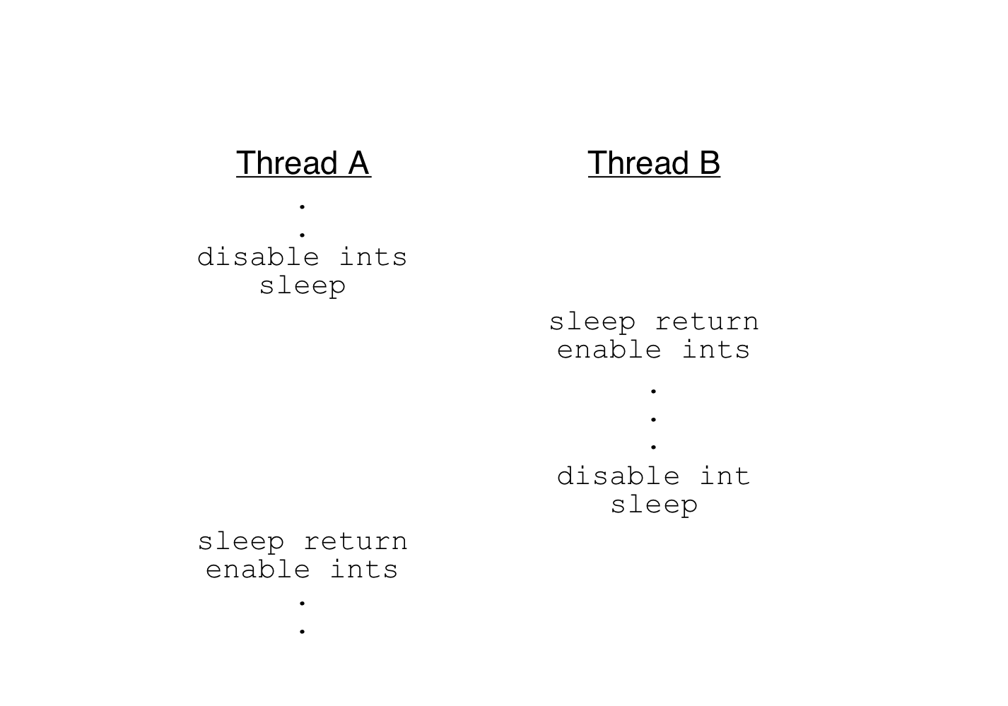
How to Re-enable After Sleep()?
Since ints are disabled when you call sleep:
  Responsibility of the next thread to re-enable ints
  When the sleeping thread wakes up, returns to acquire and re-enables interrupts
context
switch
context
switch

Slide 31
nachos.thread.lock
public class Lock {
/**
* Allocate a new lock. The lock will initially be <i>free</i>.
*/
public Lock() {}
/**
* Atomically acquire this lock. The current thread must not already hold this lock
*/
public void acquire() {
Lib.assertTrue(!isHeldByCurrentThread());
boolean intStatus = Machine.interrupt().disable();
KThread thread = KThread.currentThread();
if (lockHolder != null) {
waitQueue.waitForAccess(thread);
KThread.sleep();
} else {
waitQueue.acquire(thread);
lockHolder = thread;
}
Lib.assertTrue(lockHolder == thread);
Machine.interrupt().restore(intStatus);
}

Slide 32
nachos.thread.lock
/**
* Atomically release this lock, allowing other threads to acquire it.
*/
public void release() {
Lib.assertTrue(isHeldByCurrentThread());
boolean intStatus = Machine.interrupt().disable();
if ((lockHolder = waitQueue.nextThread()) != null)
lockHolder.ready();
Machine.interrupt().restore(intStatus);
}

Slide 33
Roadmap
How to implement Acquire() and Release()
By disabling/enabling interrupt
  A bad implementation
  A better implementation
Using atomic read/write
  A bad implementation that may busy wait a long time
  A better implementation
A more sophisticated lock – semaphore
A safer implementation – monitor and conditional variable
Programs
Shared Programs
Higher-level
API
Locks Semaphores Monitors Send/Receive
Hardware
Load/Store Disable Ints Test&Set Comp&Swap

Slide 34
Atomic Read-Modify-Write instructions
Problems with interrupt-based lock solution:
  Can’t leave lock implementation to users
  Doesn’t work well on multiprocessor
    Disabling interrupts on all processors requires messages and would be very time consuming
Alternative: atomic instruction sequences
  These instructions read a value from memory and write a new value atomically
  Hardware is responsible for implementing this correctly
  Unlike disabling interrupts, can be used on both uniprocessors and multiprocessors

Slide 35
Examples of Read-Modify-Write
test&set (&address) { /* most architectures */
result = M[address];
M[address] = 1;
return result;
}
swap (&address, register) { /* x86 */
temp = M[address];
M[address] = register;
register = temp;
}
compare&swap (&address, reg1, reg2) { /* 68000 */
if (reg1 == M[address]) {
M[address] = reg2;
return success;
} else {
return failure;
}
}
Notes:
reg1 = false
reg2 = true
compare&swap(&address, reg1, reg2)

Slide 36
Implementing Locks with test&set
test&set (&address) {
result = M[address];
M[address] = 1;
return result;
}
Simple solution:
int value = 0; // Free
Acquire() {
while (test&set(value)); // while busy
}
Release() {
value = 0;
}
Simple explanation:
  If lock is free, test&set reads 0 and sets value=1, so lock is now busy. It returns 0 so while exits
  If lock is busy, test&set reads 1 and sets value=1 (no change). It returns 1, so while loop continues
  When we set value = 0, someone else can get lock

Slide 37
Problem: Busy-Waiting for Lock
Positives for this solution
  Machine can receive interrupts
  User code can use this lock
  Works on a multiprocessor
Negatives
  Inefficient: busy-waiting thread will consume cycles waiting
  Waiting thread may take cycles away from thread holding lock!
  Priority Inversion: If busy-waiting thread has higher priority than thread holding lock no progress!
Priority Inversion problem with original Martian rover
For semaphores and monitors, waiting thread may wait for an arbitrary length of time!
  Even if OK for locks, definitely not ok for other primitives
  Project/exam solutions should not have busy-waiting!
Notes:
Martian rover

Slide 38
Better Locks using test&set
Can we build test&set locks without busy-waiting?
  Can’t entirely, but can minimize!
  Idea: only busy-wait to atomically check lock value
Note: sleep has to be sure to reset the guard variable
int guard = 0;
int value = FREE;
Acquire() {
// Short busy-wait time
while (test&set(guard));
if (value == BUSY) {
put thread on wait queue;
go to sleep() & guard = 0;
} else {
value = BUSY;
guard = 0;
}
}
Release() {
// Short busy-wait time
while (test&set(guard));
if anyone on wait queue {
take thread off wait queue
Place on ready queue;
} else {
value = FREE;
}
guard = 0;
Notes:
Why introduce another variable?
how to impl lock with the other atomic operation?

Slide 39
Locks using test&set vs. Interrupts
Compare to “disable interrupt” solution
Basically replace
  disable interrupts → while (test&set(guard));
  enable interrupts → guard = 0;
int value = FREE;
Acquire() {
disable interrupts;
if (value == BUSY) {
put thread on wait queue;
Go to sleep();
// Enable interrupts?
} else {
value = BUSY;
}
enable interrupts;
}
Release() {
disable interrupts;
if (anyone on wait queue) {
take thread off wait queue
Place on ready queue;
} else {
value = FREE;
}
enable interrupts;
}

Slide 40
Producer-consumer with Mutex lock
Producer
Consumer
void *Producer()
{
int i, produced=0;
for(i=0;i<100000;i++)
{
pthread_mutex_lock(&mVar);
if(count < BUFFERSIZE) {
buffer[in] = '@';
in = (in + 1)% BUFFERSIZE;
count++;
produced++;
}
pthread_mutex_unlock(&mVar);
}
printf("total produced = %d\n", produced);
}
Buffer

Slide 41
Producer-consumer with Mutex lock
void *Consumer()
{
int i, consumed = 0;
for(i=0;i<100000;i++){
pthread_mutex_lock(&mVar);
if(count>0)
{
out = (out+1)%BUFFERSIZE;
--count;
printf("Consumer: count = %d\n", count);
}
pthread_mutex_unlock(&mVar);
}
}

Slide 42
Roadmap
How to implement Acquire() and Release()
By disabling/enabling interrupt
  A bad implementation
  A better implementation
Using atomic read/write
  A bad implementation that may busy wait a long time
  A better implementation
A more sophisticated lock – semaphore
A safer implementation – monitor and conditional variable
Programs
Shared Programs
Higher-level
API
Locks Semaphores Monitors Send/Receive
Hardware
Load/Store Disable Ints Test&Set Comp&Swap

Slide 43

Semaphores
Semaphores are a kind of generalized locks
  First defined by Dijkstra in late 60s
  Main synchronization primitive used in original UNIX
Definition: a Semaphore has a non-negative integer value and supports the following two operations:
  P(): an atomic operation that waits for semaphore to become positive, then decrements it by 1
    Think of this as the wait() operation
  V(): an atomic operation that increments the semaphore by 1, waking up a waiting P, if any
    This of this as the signal() operation
  Note that P() stands for “proberen” (to test) and V() stands for “verhogen” (to increment) in Dutch

Slide 44

Semaphores Like Integers Except
Semaphores are like integers, except
  No negative values
  Only operations allowed are P and V – can’t read or write value, except to set it initially
  Operations must be atomic
    Two P’s together can’t decrement value below zero
    Similarly, thread going to sleep in P won’t miss wakeup from V – even if they both happen at same time
Semaphore from railway analogy
  Here is a semaphore initialized to 2 for resource control:
Value=2
Value=1
Value=0
Value=1
Value=0
Value=2

Slide 45
Two Uses of Semaphores
Mutual Exclusion (initial value = 1)
  Also called “Binary Semaphore”.
  Can be used for mutual exclusion:
    semaphore.P();
    // Critical section goes here
    semaphore.V();
Scheduling Constraints (initial value = 0)
  Allow thread 1 to wait for a signal from thread 2, i.e., thread 2 schedules thread 1 when a given constrained is satisfied
  Example: suppose you had to implement ThreadJoin which must wait for thread to terminiate:
    Initial value of semaphore = 0
    ThreadJoin {
    semaphore.P();
    }
    ThreadFinish {
    semaphore.V();
    }

Slide 46
nachos.thread.semaphore
public class Semaphore {
/**
* Allocate a new semaphore.
* @param initialValue the initial value of this semaphore.
*/
public Semaphore(int initialValue) {
value = initialValue;
}
/**
* Atomically wait for this semaphore to become non-zero and decrement it.
*/
public void P() {
boolean intStatus = Machine.interrupt().disable();
if (value == 0) {
waitQueue.waitForAccess(KThread.currentThread());
KThread.sleep();
} else {
value--;
}
Machine.interrupt().restore(intStatus);
}

Slide 47
nachos.thread.semaphore
public void V() {
boolean intStatus = Machine.interrupt().disable();
KThread thread = waitQueue.nextThread();
if (thread != null) {
thread.ready();
} else {
value++;
}
Machine.interrupt().restore(intStatus);
}

Slide 48
Producer-consumer using semaphore
Problem Definition
  Producer puts things into a shared buffer
  Consumer takes them out
  Need synchronization to coordinate producer/consumer
Correctness Constraints:
  Consumer must wait for producer to fill slots, if empty (scheduling constraint)
  Producer must wait for consumer to make room in buffer, if all full (scheduling constraint)
  Only one thread can manipulate buffer queue at a time (mutual exclusion)

Slide 49
Correctness constraints for solution
General rule of thumb: Use a separate semaphore for each constraint
  Semaphore full; // producer’s constraint
  Semaphore empty;// consumer’s constraint
  Semaphore mutex; // mutual exclusion
Initial values?

Slide 50
Full Solution to Bounded Buffer
Semaphore empty = 0; // Initially, buffer empty
Semaphore full = bufSize; // Initially, buffszeempty slots
Semaphore mutex = 1; // No one using machine
Producer(item) {
full.P(); // Wait until space
mutex.P(); // Wait until machine free
Enqueue(item);
mutex.V();
empty.V(); // Tell consumers there is
// more coke
}
Consumer() {
empty.P(); // Check if there’s a coke
mutex.P(); // Wait until machine free
item = Dequeue();
mutex.V();
full.V(); // tell producer need more
return item;
}

Slide 51
Discussion about Solution
Decrease # of empty slots
Increase # of occupied slots
Why asymmetry?
  Producer does: full.P(), empty.V()
  Consumer does: empty.P(), full.V()
Decrease # of occupied slots
Increase # of empty slots
Notes:
????

Slide 52
Discussion about Solution
Producer(item) {
mutex.P();
full.P();
Enqueue(item);
mutex.V();
empty.V();
}
Consumer() {
empty.P();
mutex.P(); item = Dequeue();
mutex.V();
full.V();
return item;
}
Is order of P’s important?
  Yes! Can cause deadlock
Is order of V’s important?
  No, except that it might affect scheduling efficiency
What if we have 2 producers or 2 consumers?
  Do we need to change anything?
Notes:
if buffer is full to start with being full → deadlock

Slide 53
Another example of Deadlock using semaphore
Thread 1
cond1.P()
cond2.P()
…
cond2.V()
cond1.V()
Thread 2
cond2.P()
cond1.P()
…
cond1.V()
cond2.V()
T1
T2
Notes:
With both initial value of 1; similar to dinning philosopher’s problem

Slide 54
Monitors and Condition Variables
Semaphores are a huge step up; just think of trying to do the bounded buffer with only loads and stores
Problem is that semaphores are dual purposed:
  They are used for both mutex and scheduling constraints
  Example: the fact that flipping of P’s in bounded buffer gives deadlock is not immediately obvious. How do you prove correctness to someone?

Slide 55
Motivation for Monitors and Condition Variables
Cleaner idea: Use locks for mutual exclusion and condition variables for scheduling constraints
Monitor: a lock and zero or more condition variables for managing concurrent access to shared data
  Some languages like Java provide this natively
  Most others use actual locks and condition variables

Slide 56
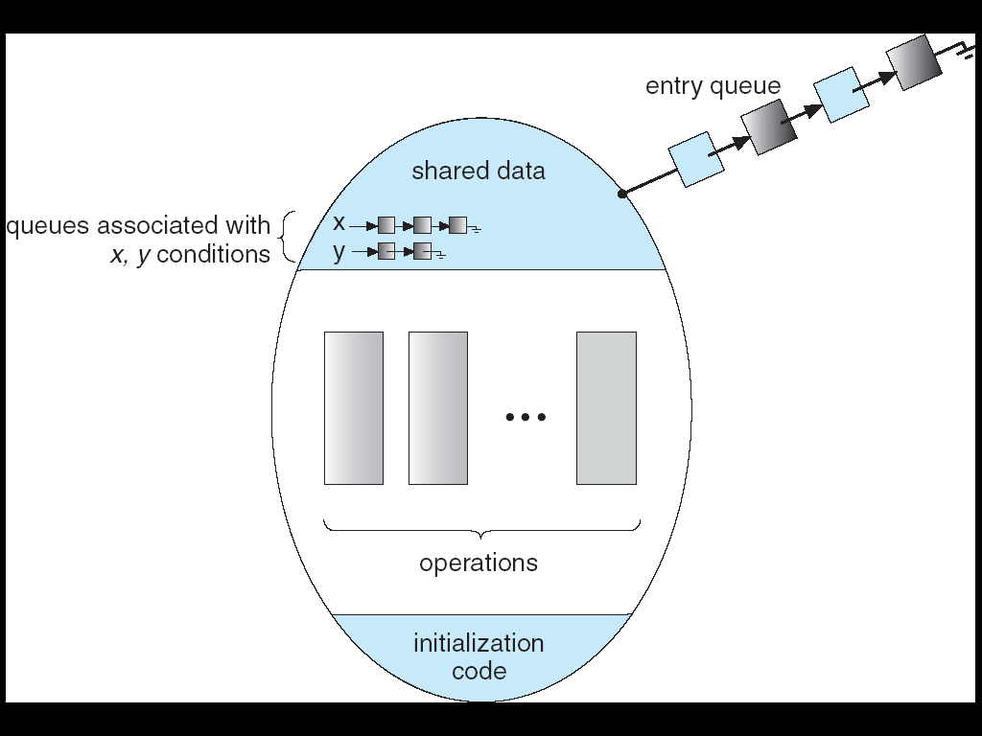
Monitor with Condition Variables
Lock: the lock provides mutual exclusion to shared data
  Always acquire before accessing shared data structure
  Always release after finishing with shared data
  Lock initially free
Condition Variable: a queue of threads waiting for something inside a critical section
  Key idea: make it possible to go to sleep inside critical section by atomically releasing lock at time we go to sleep

Slide 57
Simple Monitor Example
Here is an (infinite) synchronized queue
Lock lock;
Queue queue;
AddToQueue(item) {
lock.Acquire(); // Lock shared data
queue.enqueue(item); // Add item
lock.Release(); // Release Lock
}
RemoveFromQueue() {
lock.Acquire(); // Lock shared data
item = queue.dequeue();// Get next item or null
lock.Release(); // Release Lock
return(item); // Might return null
}
Not very interesting use of “Monitor”
  It only uses a lock with no condition variables
  Cannot put consumer to sleep if no work!

Slide 58
Condition Variables
Condition Variable: a queue of threads waiting for something inside a critical section
  Key idea: allow sleeping inside critical section by atomically releasing lock at time we go to sleep
  Contrast to semaphores: Can’t wait inside critical section
Operations:
  Wait(&lock): Atomically release lock and go to sleep. Re-acquire lock later, before returning.
  Signal(): Wake up one waiter, if any
  Broadcast(): Wake up all waiters
Rule: Must hold lock when doing condition variable operations!

Slide 59
Complete Monitor Example (with condition variable)
Here is an (infinite) synchronized queue
Lock lock;
Condition dataready;
Queue queue;
AddToQueue(item) {
lock.Acquire(); // Get Lock
queue.enqueue(item); // Add item
dataready.signal(); // Signal any waiters
lock.Release(); // Release Lock
}
RemoveFromQueue() {
lock.Acquire(); // Get Lock
while (queue.isEmpty()) {
dataready.wait(&lock); // If nothing, sleep
}
item = queue.dequeue(); // Get next item
lock.Release(); // Release Lock
return(item);
}

Slide 60
Mesa vs. Hoare monitors
Need to be careful about precise definition of signal and wait. Consider a piece of our dequeue code:
while (queue.isEmpty()) {
dataready.wait(&lock); // If nothing, sleep
}
item = queue.dequeue(); // Get next item
  Why didn’t we do this?
if (queue.isEmpty()) {
dataready.wait(&lock); // If nothing, sleep
}
item = queue.dequeue(); // Get next item
Answer: depends on the type of scheduling
  Hoare-style
  Mesa-style

Slide 61
Hoare monitors
Signaler gives up lock, CPU to waiter; waiter runs immediately
Waiter gives up lock, processor back to signaler when it exits critical section or if it waits again
Most textbooks
…
lock.Acquire()
…
dataready.signal();
…
lock.Release();
Lock.Acquire()
…
if (queue.isEmpty()) {
dataready.wait(&lock);
}
…
lock.Release();
Lock, CPU
Lock, CPU

Slide 62
Mesa monitors
Signaler keeps lock and processor
Waiter placed on a local “e” queue for the monitor
Practically, need to check condition again after wait
Most real operating systems (and Nachos!)
Put waiting thread on ready queue
…
lock.Acquire()
…
dataready.signal();
…
lock.Release();
Lock.Acquire()
…
while (queue.isEmpty()) {
dataready.wait(&lock);
}
…
lock.Release();
schedule waiting thread

Slide 63
nachos.threads.Condition
public class Condition {
/**
* Allocate a new condition variable.
*
* @param conditionLock
* the lock associated with this condition variable. The current
* thread must hold this lock whenever it uses <tt>sleep()</tt>,
* <tt>wake()</tt>, or <tt>wakeAll()</tt>.
*/
public Condition(Lock conditionLock) {
this.conditionLock = conditionLock;
waitQueue = new LinkedList<Semaphore>();
}

Slide 64
nachos.threads.Condition
/* sleep(): atomically release the lock and relinkquish the CPU until woken; then reacquire the lock.*/
public void sleep() { Lib.assertTrue(conditionLock.isHeldByCurrentThread());
Semaphore waiter = new Semaphore(0);
waitQueue.add(waiter);
conditionLock.release();
waiter.P();
conditionLock.acquire();
}

Slide 65
nachos.threads.Condition
/**
* Wake up at most one thread sleeping on this condition variable. The
* current thread must hold the associated lock.
*/
public void wake() {
Lib.assertTrue(conditionLock.isHeldByCurrentThread());
if (!waitQueue.isEmpty())
((Semaphore) waitQueue.removeFirst()).V();
}
public void wakeAll() {
Lib.assertTrue(conditionLock.isHeldByCurrentThread());
while (!waitQueue.isEmpty())
wake();
}

Slide 66
Producer-consumer using condition Variable
void *Producer()
{
int i, produced=0;
for(i=0;i<100000;i++) {
pthread_mutex_lock(&mVar);
while (count==BUFFERSIZE)
pthread_cond_wait(&Buffer_Not_Full,&mVar);
buffer[count++]='@';
pthread_cond_signal(&Buffer_Not_Empty);
pthread_mutex_unlock(&mVar);
}
}

Slide 67
void *Consumer()
{
int i, consumed = 0;
for(i=0;i<100000;i++){
pthread_mutex_lock(&mVar);
while(count==0)
pthread_cond_wait(&Buffer_Not_Empty,&mVar);
out = (out+1)%BUFFERSIZE;
count--;
pthread_cond_signal(&Buffer_Not_Full);
pthread_mutex_unlock(&mVar);
}
}

Slide 68
Dinning Philosopher
Correctness condition:
mutual exclusion: no more than one person can have access to one chopstick
progress: no deadlock
no starvation
Note that philosophers alternate between eating & thinking

Slide 69
Using semaphore
semaphore chopstick[5];
do {
wait(chopstick[i]);
wait(chopstick[(i+1) % 5]);
...
/* eat for awhile */
...
signal(chopstick[i]);
signal(chopstick[(i+1) % 5]);
...
/* think for awhile */
...
} while (true);

Slide 70
Using Monitor
One philosopher picks two chopsticks only when both of them are available
monitor DiningPhilosophers {
enum {THINKING, HUNGRY, EATING} state[5];
condition self[5];
void pickup(int i) {
state[i] = HUNGRY;
test(i);
if (state[i] != EATING)
self[i].wait();
}
void putdown(int i) {
state[i] = THINKING;
test((i + 4) % 5);
test((i + 1) % 5);
}

Slide 71
void test(int i) {
if ((state[(i + 4) % 5] != EATING) && (state[i] == HUNGRY) && (state[(i + 1) % 5] != EATING)) {
state[i] = EATING;
self[i].wake();
}
}
initialization code() {
for (int i = 0; i < 5; i++)
state[i] = THINKING;
}
}

Slide 72
Correct?
1
2
0
3
4
Notes:
1 eating , 4 eating -> 1 finishes first -> 2 eating -> 4 finished -> 0 eating -> 0 finished -> 4 eating -> 2 finished -> 1 eating … (3 never gets to eat)

Slide 73
1
1
1
2
2
2
0
0
0
3
3
4
3
4
4
1
1
1
2
2
2
0
0
0
3
3
4
3
4
4
1
2
0
4
3
Notes:
need resource hierarchy -> partial order to the resources, lower # fork first then higher # fork
allow conversations among the philosophers

Slide 74
Comparison
Lock, semaphore, monitor can all be used for achieving mutual exclusion of critical section
Semaphore and condition variables useful for scheduling/synchronization among multiple processes
  If implemented using Lock will have to use BUSY WAIT
  Semaphore is good for multiple resources

Slide 75
Summary
Programs
Shared Programs
Higher-level
API
Locks Semaphores Monitors Send/Receive
Hardware
Load/Store Disable Ints Test&Set Comp&Swap

