Slide 1
Operating Systems
Rong Zheng
Disclaimer: Many materials used in the slides are adopted from those of other colleagues

Slide 2
Goal of This Course
Learn how “systems” work
Main challenges in building systems
Principles of system design, i.e., how to address these challenges
Learn how to apply these principles to building systems

Slide 3
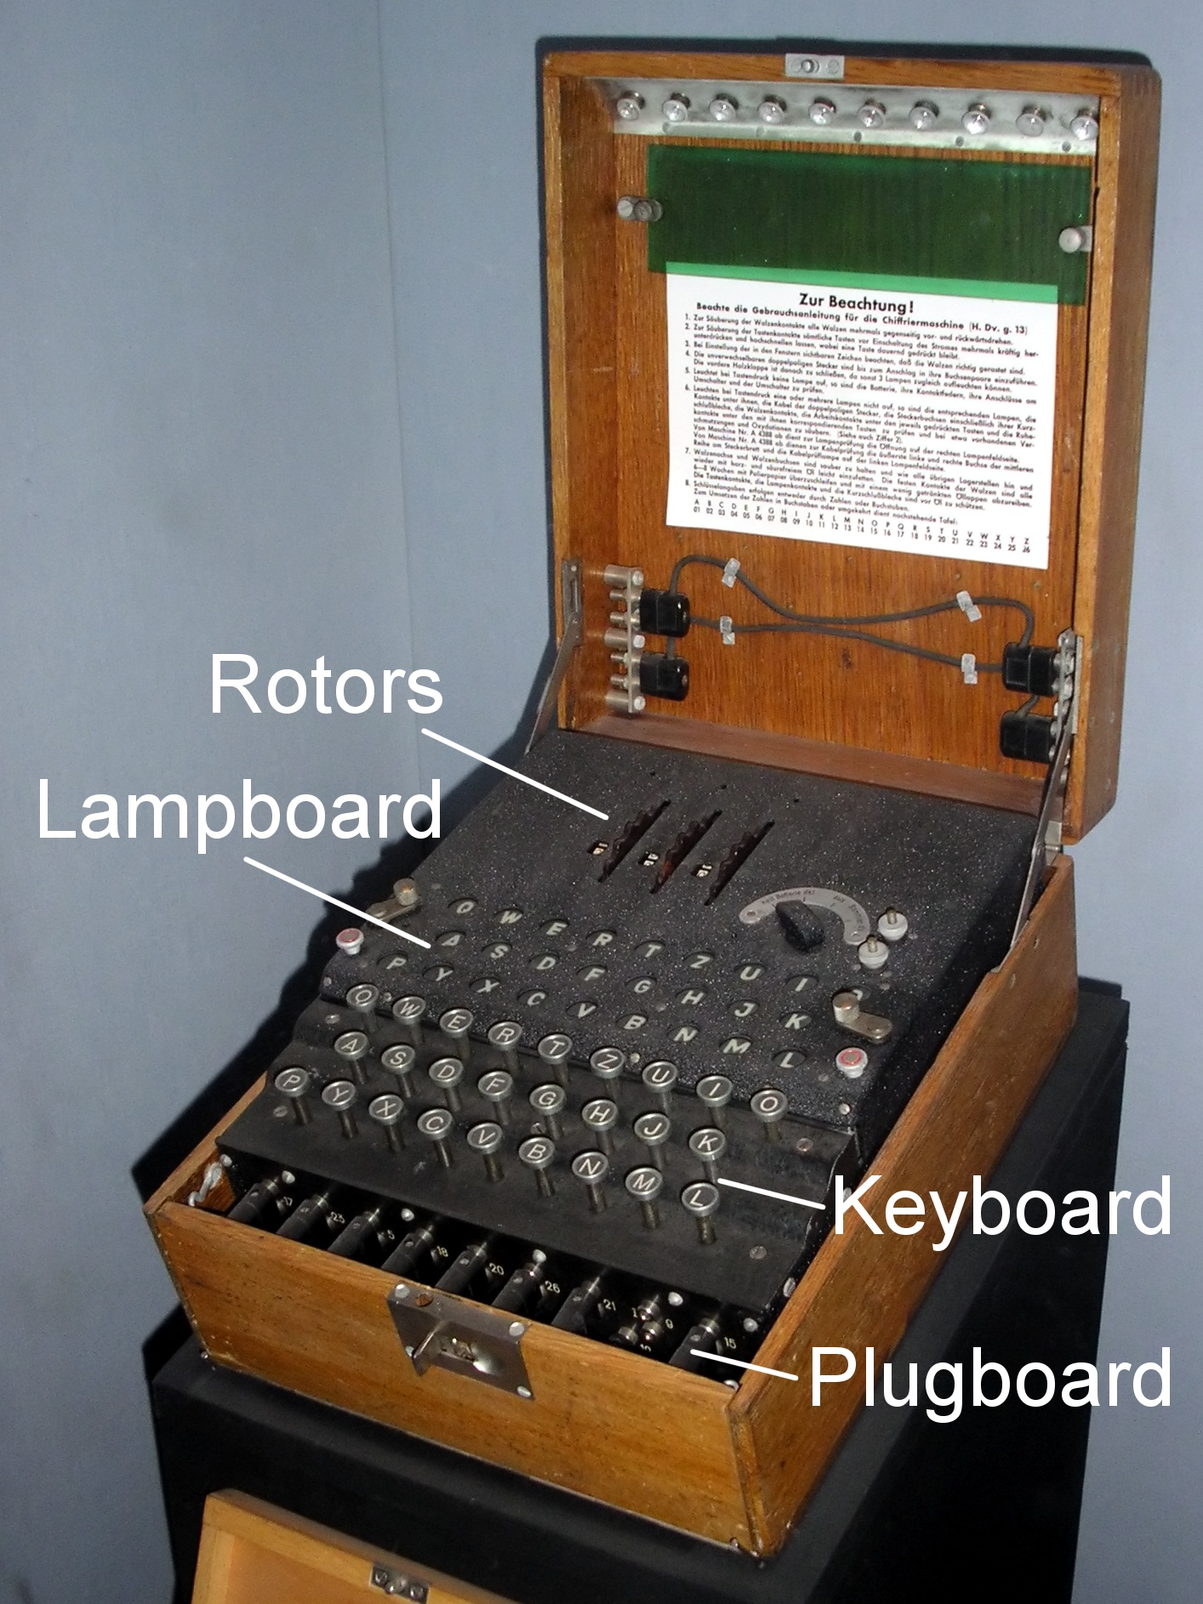
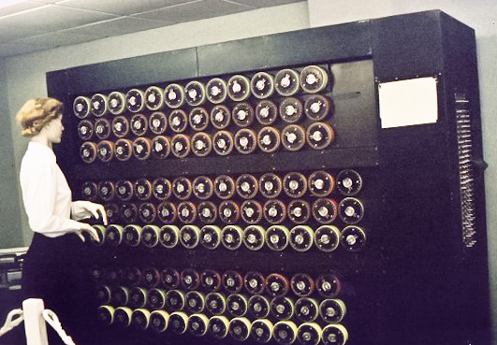
What Do Turing’s BOMBE machine and today’s computer have in common?
Notes:
Each of the rotating drums simulates the action of an Enigma rotor. There are 36 Enigma-equivalents and, on the right-hand end of the middle row, three indicator drums. John Harper led the "Phoenix" team that built this.^{[1]} It was officially switched on by the Duke of Kent, patron of the British Computer Society on 17 July 2008.

Slide 4
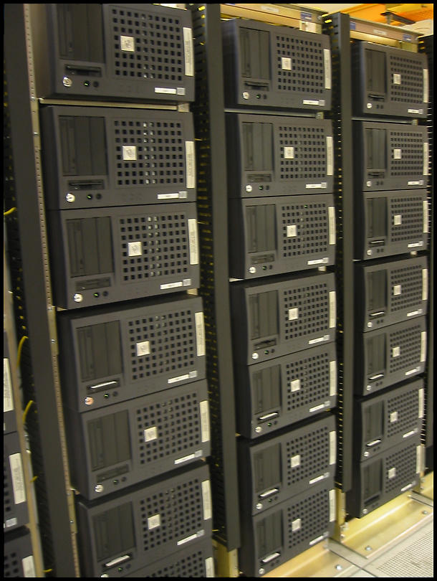
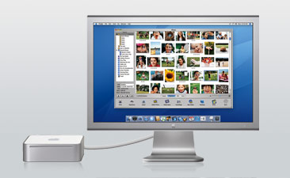
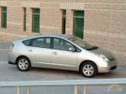
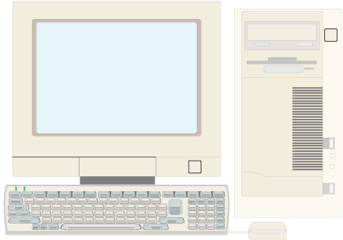
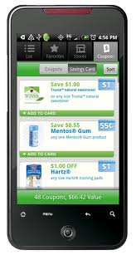
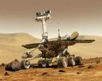
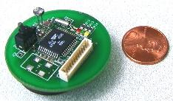
Computing Devices Everywhere
Notes:
What’s the largest single use of microprocessors? Not computers – Embedded computers (10 billion versus 400 million)
Example: Cellphones. Second largest? Automobiles.

Slide 5
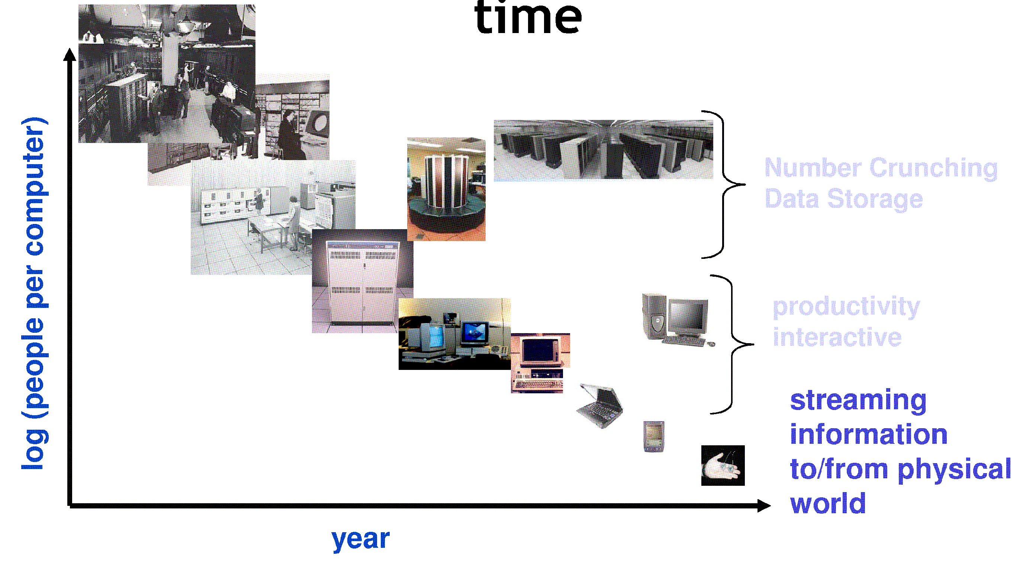
People-to-CPU Ratio Over Time
Today: Multiple CPUs/person!
  Approaching 100s?
Notes:
Change the system design: the way they are used.

Slide 6
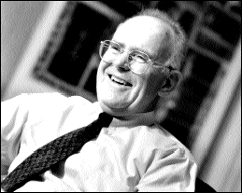
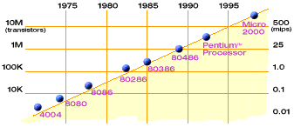
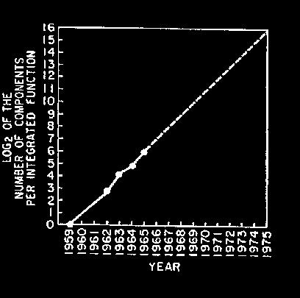
Technology Trends: Moore’s Law
Moore’s Law
2X transistors/Chip Every 1.5 years
Called “Moore’s Law”
Gordon Moore (co-founder of Intel) predicted in 1965 that the transistor density of semiconductor chips would double roughly every 18 months.
Microprocessors have become smaller, denser, and more powerful.

Slide 7
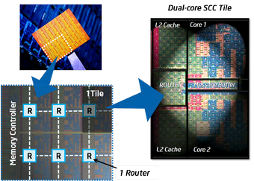
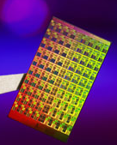
ManyCore Chips
Intel 80-core multicore chip (Feb 2007)
  80 simple cores
  Two FP-engines / core
  Mesh-like network
  100 million transistors
Intel Single-Chip Cloud
Computer (August 2010)
  24 “tiles” with two cores/tile
  24-router mesh network
  4 DDR3 memory controllers
  Hardware support for message-passing
“ManyCore” refers to many processors/chip
  64? 128? Hard to say exact boundary
How to program these?
  Use 2 CPUs for video/audio
  Use 1 for word processor, 1 for browser
  76 for virus checking???
Parallelism must be exploited at all levels

Slide 8
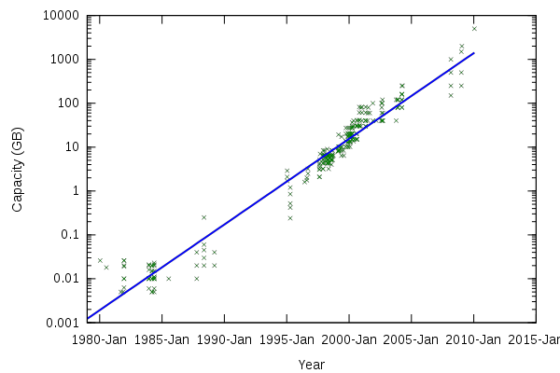
Storage Capacity
Retail hard disk capacity in GB
(source: http://www.digitaltonto.com/2011/our-emergent-digital-future/ )

Slide 9
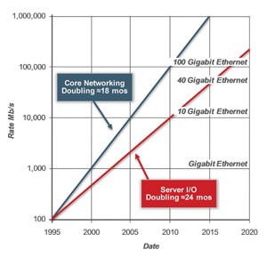
Network Capacity
(source: http://www.ospmag.com/issue/article/Time-Is-Not-Always-On-Our-Side )

Slide 10
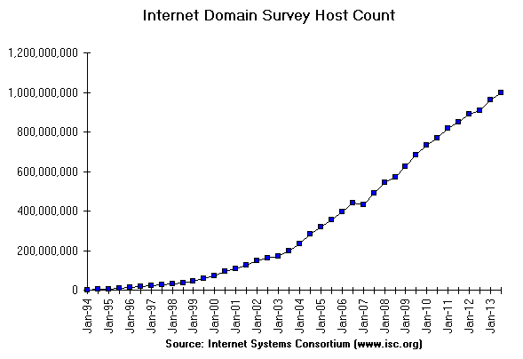
Internet Scale: .96 Billion Hosts
996,230,757
July 2013
https://www.isc.org/solutions/survey

Slide 11
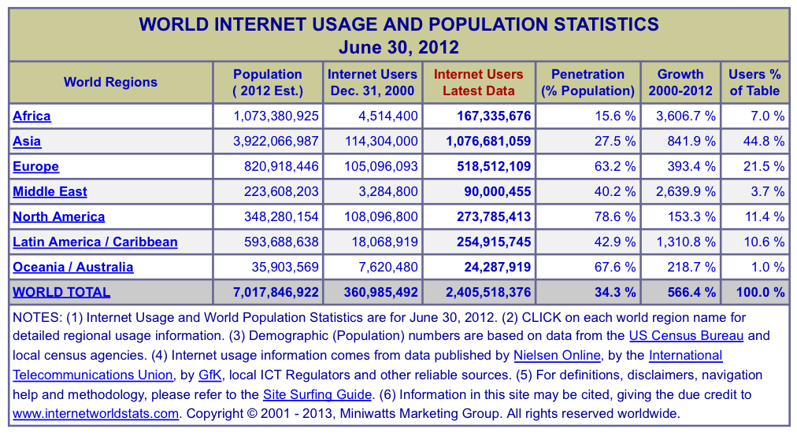
Internet Scale: ~2.5 Billion Users!
(source: http://www.internetworldstats.com/stats.htm)

Slide 12
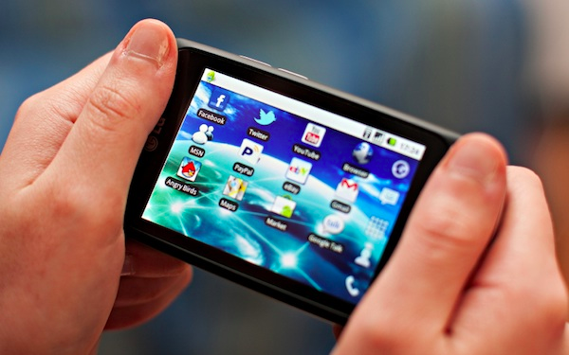
Not Only PCs connected to the Internet
Smartphone shipments now exceed PC shipments!
2011 shipments:
  487M smartphones
  414M PC clients
    210M notebooks
    112M desktops
    63M tablets
  25M smart TVs
4 billion phones in the world → smartphone over next decade

Slide 13
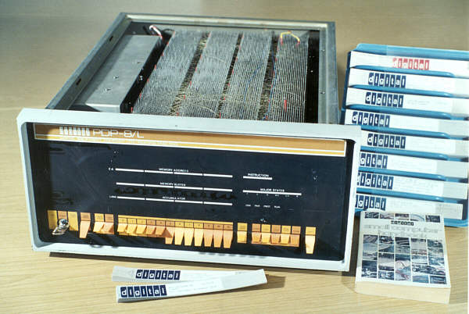
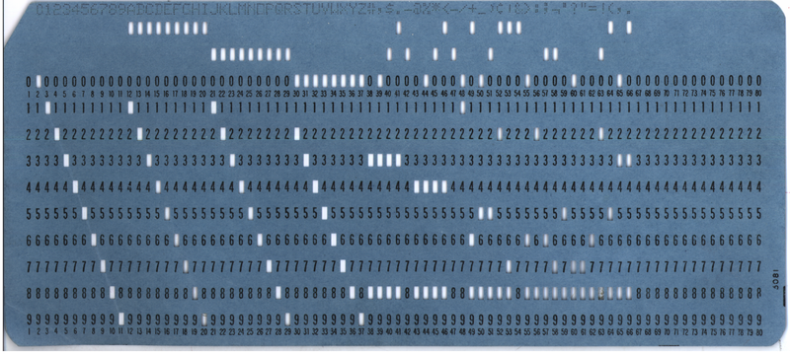
Question
How to program/manage such complexity?
Abstractions!

Slide 14
The instructor
Rong Zheng
Office: ITB 121
Office hr: Tue. 4:30 – 6:30pm
Research areas:
  Mobile & pervasive computing
  Wireless networking

Slide 15
The TAs
Ala Shaabana (shaabaa@mcmaster.ca)
  January
Yuanhao Yu (yhyu.mail@gmail.com)
  Feburary
Qiang Xu (xuq22@mcmaster.ca)
  March
TAs will be present during all lab sessions (starting next week)
Attendance of lab sessions NOT required

Slide 16
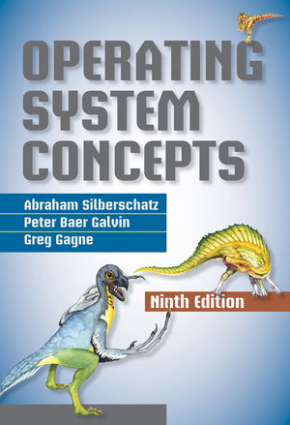
Course Materials
  Textbook: A. Silberschatz, P. Gavin and G. Gagne, Operating Systems Concepts, 9th edition, Wiley & Sons
  Nachos tutorial:
  http://www.cas.mcmaster.ca/~rzheng/Nachos_Tutorial/
  Course webpage http://www.cas.mcmaster.ca/~rzheng/course/CAS3SH3w15/
    All course materials (lecture notes, tutorials, projects)
    Announcement
  Avenue to Learn
    Exercise
    Group enrollment
    Announcement

Slide 17
Scope of the Course
Process management
Synchronization
Memory management
File system & I/O
Advanced topics

Slide 18
Course Organization
Lectures
Tutorials
  Online materials
Lab sessions
  Not mandatory
  TAs will be around to answer questions

Slide 19
Markings
4 programming assignments (10, 10, 10, 15%)
  One bonus programming assignment 10%
Exercise (10%)
  Avenue
Midterm (20%)
  In class
Final (25%, not-comphrensive)
Curved. To get an A in the class (>=85%)

Slide 20
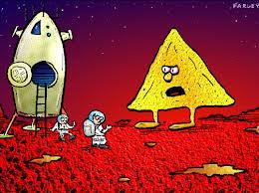
Programming Assignments
Nachos (Not Another Complete Heuristic Operating System) 5.0j
An instructional OS ported to Java
To understand abstract “concepts” introduced in the lectures
To implement key building blocks of OS
Yes, you do need to know how to program in Java!

Slide 21
Programming Assignments
Project 1 individually
Project 2 – 4 in groups (maximum 4 students)
  Group sign up via Avenue
  Self-enrollment via avenue finalized by the end of the 2nd week
  Changes discouraged and should be approved by the instructor
Use SVN set up by dept sysadmin
Two phrases: (design) questions and code submission
Autograder codes will be provided for testing
In some projects, you may need to develop your own test cases/codes
More details will be provided by the TAs during lab sessions

Slide 22


Work with your Team Mates
Regular code review meetings
Pair programming
Alert the instructor problems earlier on

Slide 23
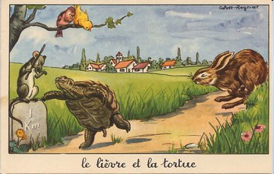
The hare and the turtle

Slide 24


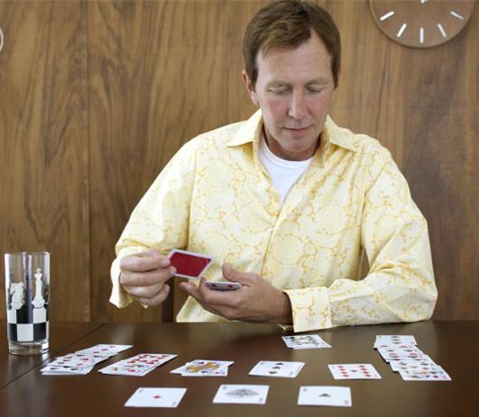
Behaving in the classroom
Non course-related activities such as answering their phones, browsing the web or playing solitaire are discouraged
X
X
X

Slide 25
Questions?
Email rzheng@mcmaster.ca with subject title “3SH3”

Slide 26
The Real Introduction to OS
What is Operating System?
Types of OS
History of OS

Slide 27
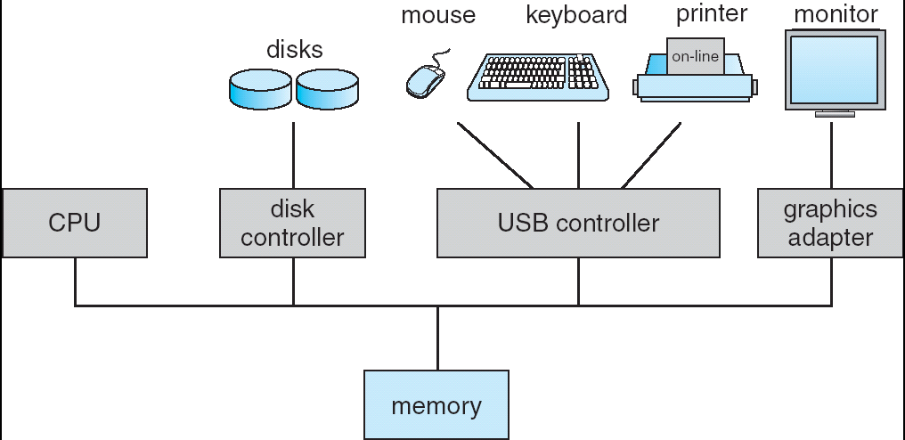
Computer System Organization
One or more CPUs, device controllers connect through common bus providing access to shared memory
Concurrent execution of CPUs and devices competing for memory cycles

Slide 28
Challenge: Scale and Dynamic Range
Enormous scale, heterogeneity, and dynamic range:
  CPU: sensor motes → GPUs
    Cores: one → 100s [2-orders of magnitude variation]
    Clusters: few machines → 10,000s machines [4 orders of mag.]
  Network: Inter-core networks → Internet
    Latency: nanosecs → secs (satellite) [9 orders of mag.]
    Bandwidth: Kbps → Gbps [6 orders of mag.]
    …
  Storage: caches → disks
    Size: MB → TB [6 orders of mag.]
    Access time: few nanosecs → millisecs [6 orders of mag.]

Slide 29
How do We Tame Complexity?
Every piece of computer hardware different
  Different CPU
    Pentium, ARM, PowerPC, ColdFire
  Different amounts of memory, disk, …
  Different types of devices
    Mice, keyboards, sensors, cameras, fingerprint readers, touch screen
  Different networking environment
    Cable, DSL, Wireless, …
Questions:
  Does the programmer need to write a single program that performs many independent activities?
  Does every program have to be altered for every piece of hardware?
  Does a faulty program crash everything?

Slide 30


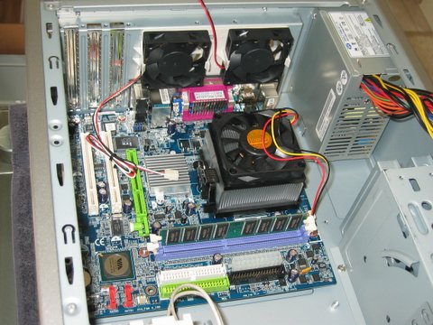
What is an operating system?
“What stands between the user and the bare machine”

Slide 31
What is an operating system?
The basic software required to operate a computer.
Silberschatz and Gavin: “An OS is Similar to a government”
  Begs the question: does a government do anything useful by itself?
OS as a Traffic Cop:
  Manages all resources
  Settles conflicting requests for resources
  Prevent errors and improper use of the computer
OS as a facilitator (“useful” abstractions):
  Provides facilities/services that everyone needs
  Standard libraries, windowing systems
  Make application programming easier, faster, less error-prone

Slide 32
What Belongs to OS
Loose definition: what shipped by the vendor
More strictly,
Kernel
  Part that stays in main memory
  Controls the execution of all other programs
Other programs interact with it through
system calls

Slide 33
What Do not belong to OS
All user programs
  Compilers, spreadsheets, word processors, and so forth
Most utility programs
  mkdir is a user program calling mkdir()
The command language interpreter
  Anyone can write his/her UNIX shell

Slide 34
Is Web Browser Part of OS?
In 1998, the United States Federal Government charged Microsoft with anti-trust violations. One of the the complaints was that Microsoft had "bundled" its Internet Explorer (IE) web browser with its Windows operating system (OS).
In its defense, Microsoft asserted that the web browser was, in fact, part of the operating system. Therefore, it made no sense to talk of bundling the browser; it was in the natural order of things that an OS vendor would include a browser in their product.
In the end, Microsoft was found to be a monopoly, but received only minimal sanctions…

Slide 35
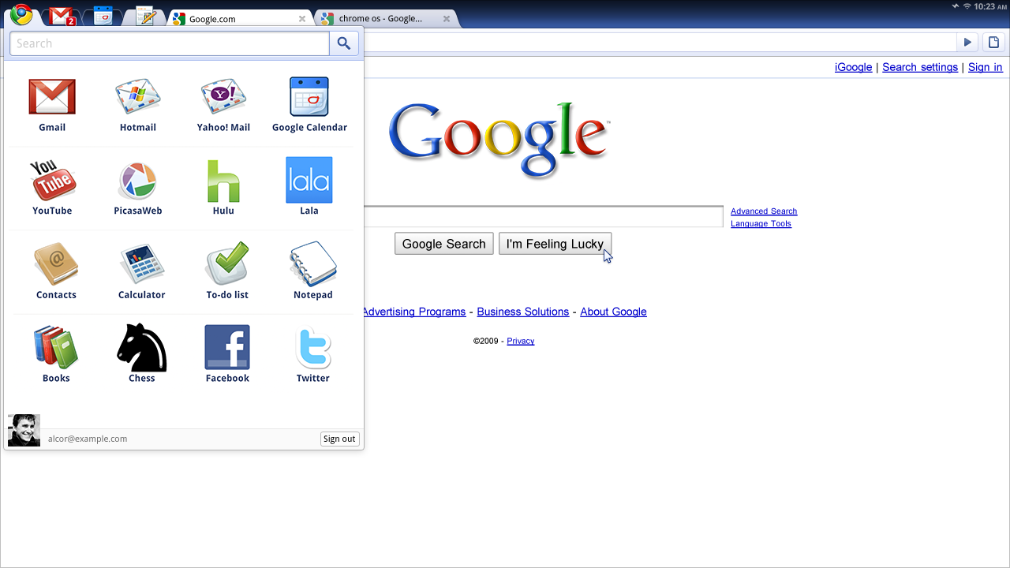
Wait! What about CHromE OS?

Slide 36
What Belongs to OS
Loose definition: what shipped by the vendor
More strictly,
Kernel
  Part that stays in main memory
  Controls the execution of all other programs
Other programs interact with it through
system calls

Slide 37
Different Types of Kernels
Monolithic kernel
  All kernel functions share the same address space
  This includes devices drivers and other kernel extensions
Monolithic kernel
Terminal, device and memory controllers

Slide 38
Micro-Kernel (MacH)
A reaction against “bloated” monolithic kernels
  Hard to manage, extend, debug and secure
Key idea is making kernel smaller by delegating non-essential tasks to trusted user-level servers
  Same idea as subcontracting
Microkernel keeps doing what cannot be delegated
User program
Trusted server
Small
microkernel
Notes:
The communication in microkernels is done via message passing. Only the very important parts like IPC(Inter process Communication), basic scheduler, basic memory handling, basic I/O primitives etc., are put into the kernel.

Slide 39
Modular kernels (Linux, windows)
Modules are object files whose contents can be linked to—and unlinked from—the kernel at any time
  Run inside the kernel address space
  Used to add to the kernel device drivers for new devices
Extensibility:
  Can add new features the kernel
  In many cases, the process is completely transparent to the user
Lack of performance penalty:
  Modules run in the kernel address space
Low reliability

Slide 40
A Comparison
Unix
safe
fast
Mach
Linux/Windows
extensible

Slide 41
Key Functions of OS
To provide a better user interface
To manage the system resources
To protect users’ programs and data
2
3
1
1
2
3
2
1
3
Time
Phase 1
Phase 2
Phase 3

Slide 42
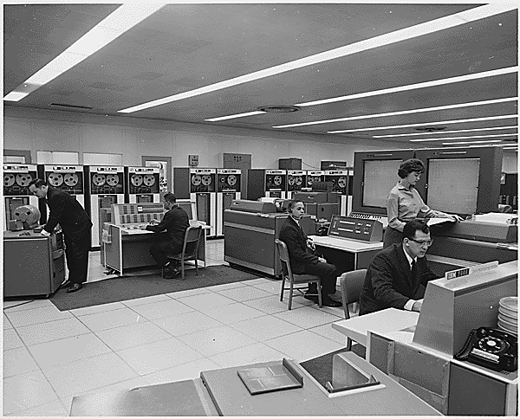
Phase1 : Hardware Expensive, Human Cheap
Hardware: main frames
Representative OS:
  Eniac, … Multics
Focus: how to get the computation job done
  Uniprogramming
"I think there is a world market for maybe five computers." -- Thomas Watson, chairman of IBM, 1943

Slide 43
Phase1 : Hardware Expensive, Human Cheap
Bach systems: Allow users to submit a batches of requests to be processed in sequence
Include a command language specifying what to do with the inputs
  Compile
  Execute and so forth

Slide 44
Phase 2: Hardware Cheaper, Human expensive
Hardware: PCs, Workstations
Representative OS:
  MSDOS, Windows, UNIX, Linux etc.
Focus: Increase the utilization of resources and user friendliness
  From interactive systems through consoles to graphical user interfaces (GUI)
  Multiprogramming, time sharing for managing resources
  Dual (kernel/user) mode separation, memory management unit

Slide 45
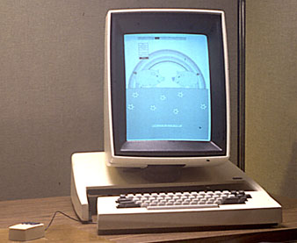
The Xerox Alto

Slide 46
Coincidentally, XEROX is also inventor of
Laser printing
Ethernet
The GUI paradigm/mouse
Object-oriented programming (Smalltalk)
Ubiquitous computing

Slide 47
Gap between Access of memory/STORAGE Hierarchy
Level | Device | Access Time
1 | Fastest registers (2 GHz CPU) | 0.5 ns
2 | Main memory | 10-70 ns
3 | SSD | 0.1ms
4 | Secondary storage (disk) | 7 ms
5 | Mass storage (CD-ROM) | a few s

Slide 48
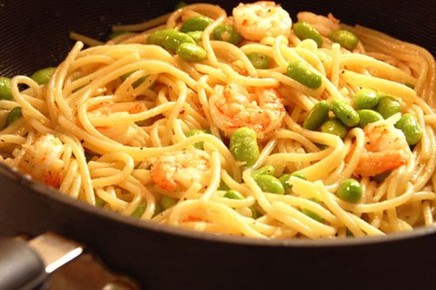
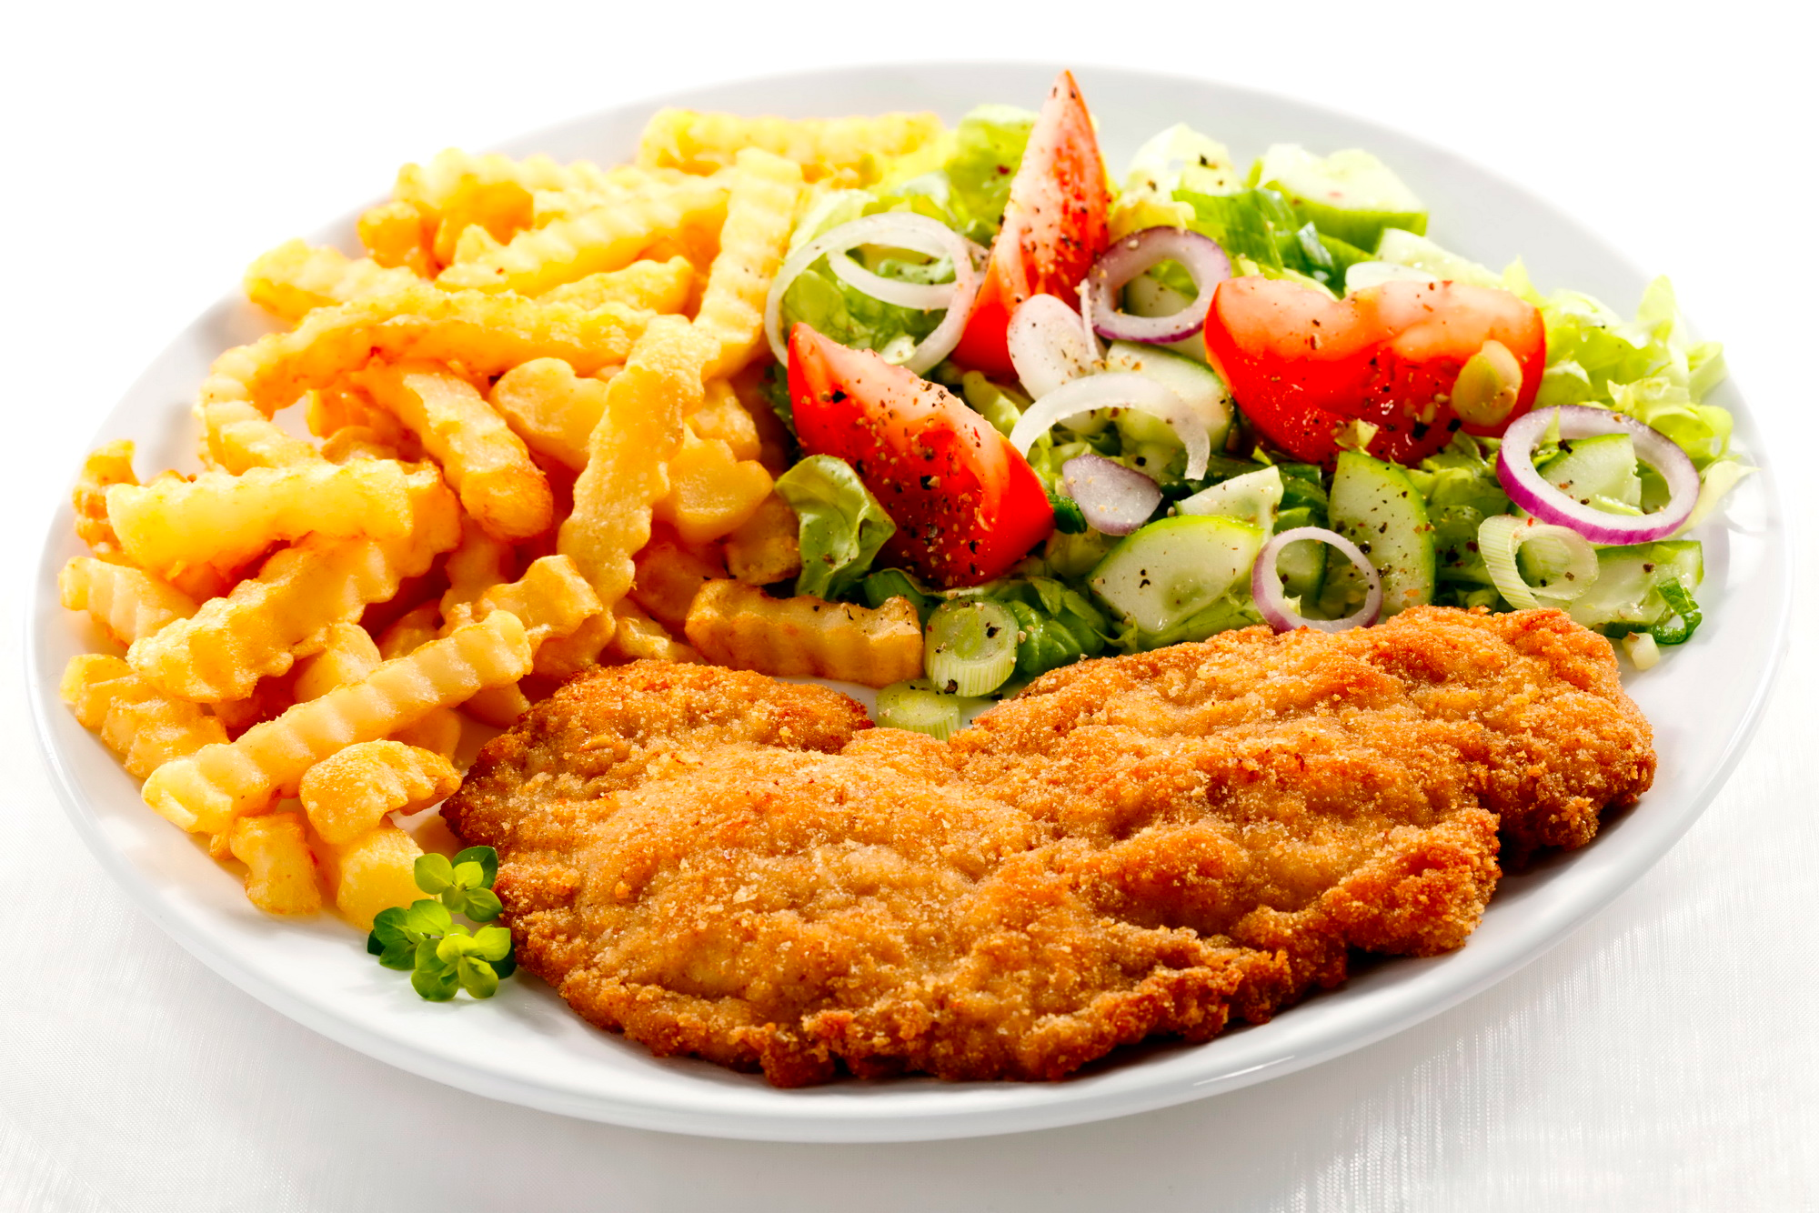
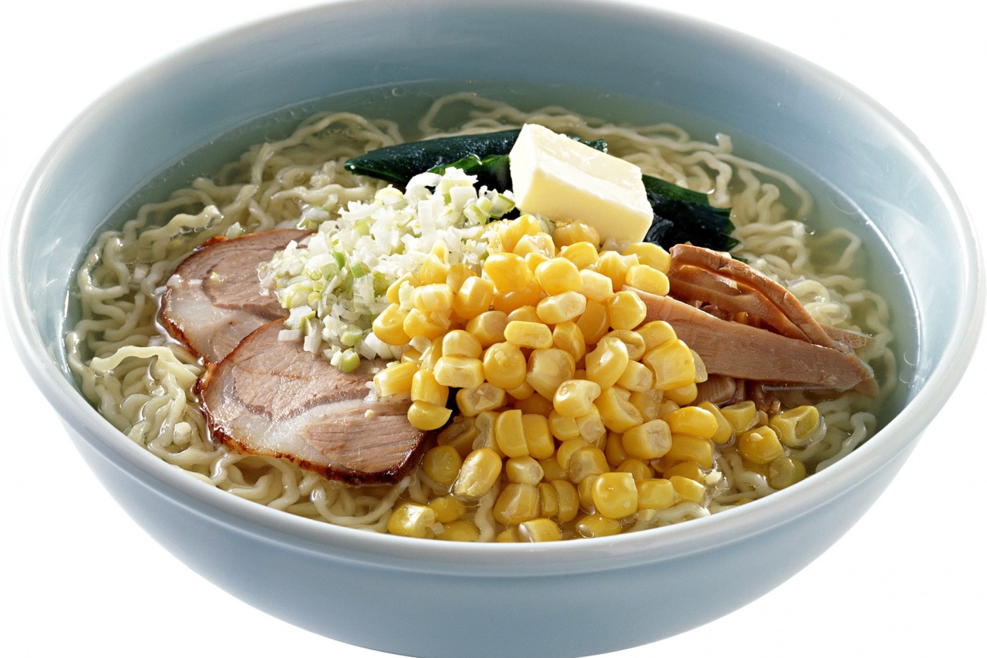
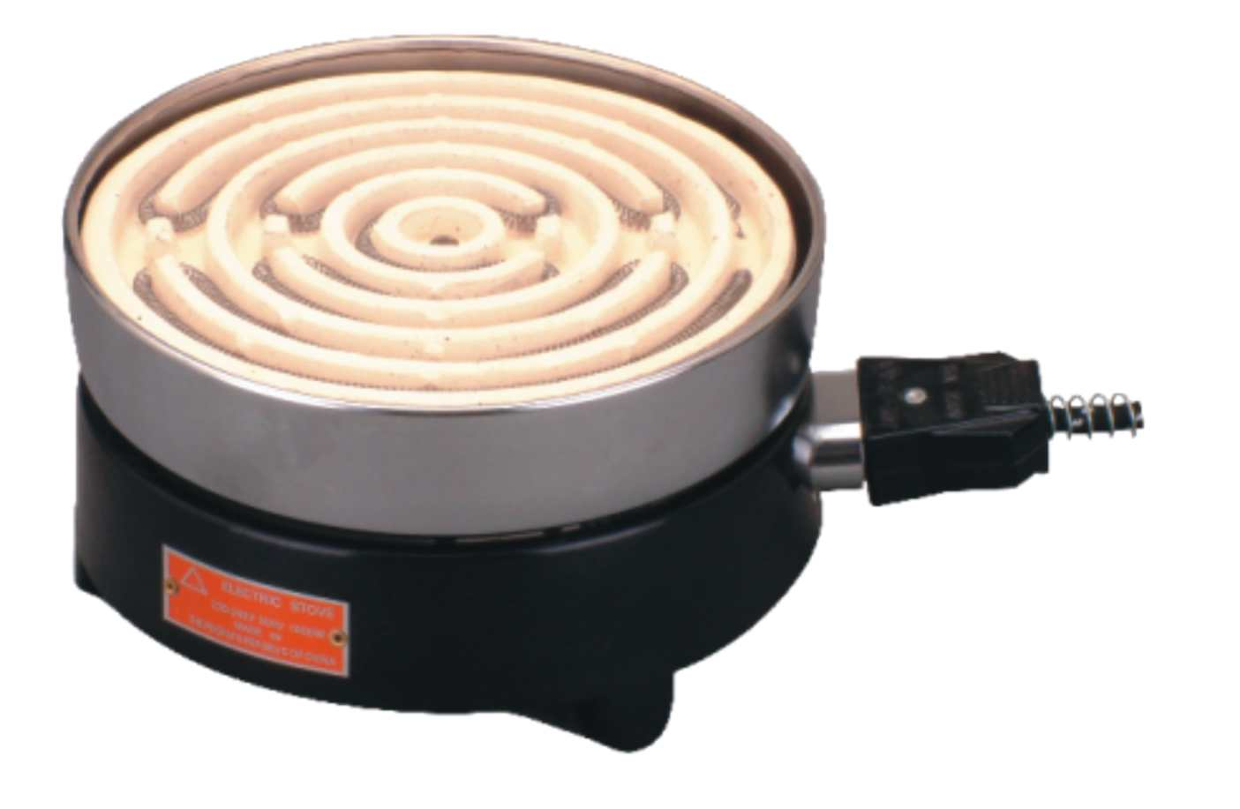
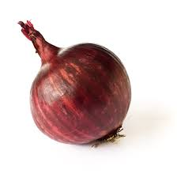
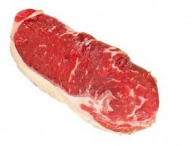
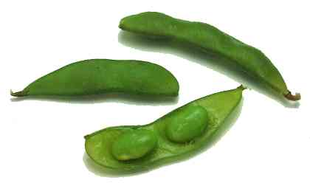
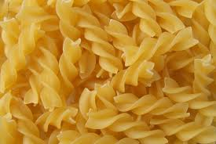
an analogy
Consider a busy restaurant with only one stove
dish 1
dish 2
dish 3
Ingredients

Slide 49
How to maximize the profit
Maximize the utilization of the stove
  Take multiple orders at a time – multiple processes
  Buy the ingredients in bulk from store (save time from multiple trips to the store (remote storage)) – block read, prefetching
  Prepare the ingredients ahead of time – caching
  Interleaving orders that take time to cook and that take time to prepare – pipelining
  Serve VIP’s order first – scheduling
  Bring out multiple dishes together – delayed write
Buy more stoves – multiprocessor, multicore

Slide 50
Multiprogramming is at the CORE of Modern OS design
Advantages
  Many applications use the peripherals much more than the CPU
  Multiprogramming was invented to keep the CPU busy
  User may initiate multiple tasks and expect short response time for GUI related processes
Multiprogramming allows:
  Time sharing: CPU divides its time among multiple processes, e.g., one tenth of a second on a program, then another tenth of a second on another one and so forth (this does not work with our kitchen analogy!)
  When waiting for I/O operations, other programs can utilize the CPU
Both are accomplished through interrupts

Slide 51
Interrupts
Request to interrupt the flow of execution the CPU
Detected by the CPU hardware
  After it has executed the current instruction
  Before it starts the next instruction
Types of interrupts:
  I/O completion interrupts: Notify the OS that an I/O operation has completed,
  Timer interrupts: Notify the OS that a task has exceeded its quantum of CPU time
  Traps: Notify the OS of a program error (division by zero, illegal op code, illegal operand address, ...) or a hardware failure
  System calls: Notify OS that the running task wants to submit a request to the OS

Slide 52
Disabling Interrupts
We can disable interrupts
OS does it before performing short critical tasks that cannot be interrupted
  Works only for single-threaded kernels
User tasks should be prevented from doing it
  Too dangerous

Slide 53
Protection
In supporting multiprogramming, we need to prevent programs from interfering one another and protect users’ data
  Access control
  Privileged instructions
  Memory protection
User Process
X
Kernel

Slide 54
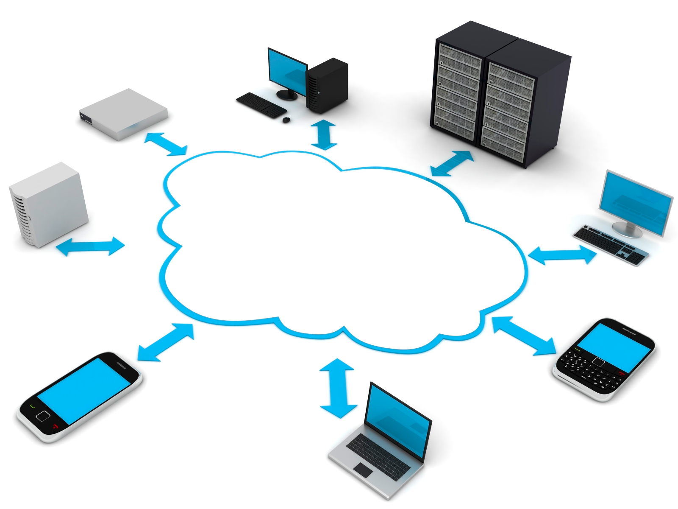
Phase 3: Hardware Really Cheap, Human Very Expense
Hardware: tablets, phones, smart sensors etc.
Representative OS: iOS, android, window phone, (VMs)
Focus: energy consumption, manageability, reliability, user experiences, ubiquitous connectivity
Cloud

Slide 55
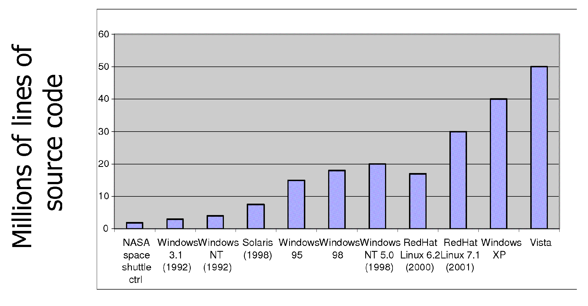
Rome was not BUILT in ONE Day

Slide 56
OS Archaeology
Because of the cost of developing an OS from scratch, most modern OSes have a long lineage:
Multics → AT&T Unix → BSD Unix → Ultrix, SunOS, NetBSD,…
Mach (micro-kernel) + BSD → NextStep → XNU →
Apple OSX, iphone iOS
Linux → Android OS
CP/M → QDOS → MS-DOS → Windows 3.1 → NT → 95 → 98 → 2000 → XP → Vista → 7 → 8 → phone → …
Linux → RedHat, Ubuntu, Fedora, Debian, Suse,…
http://www.antipope.org/charlie/blog-static/2013/12/metaphor-for-the-day.html
Notes:
Multics: MIT, GE, Bell Labs, 1969
Revolutionary but “bloated” at 135kB
Famous “failures”: Multics, Mach, NextStep: innovative but too flawed to succeed.
Microsoft established itself by writing an OS to compete with CP/M which IBM couldn’t negotiate with its author. They instead bought QDOS from a small code author who had written it from the CP/M manual.
Interestingly, there were some other OSes that didn’t have such a long lineage (e.g. IBM OS/2)

