Slide 1
Review of Commonly USED Data structures in OS

Slide 2
Needs for efficient data structure
Storage complexity & Computation complexity matter
Consider the problem of scheduling tasks according to their priority on CPU
New tasks upon arrival, need to be inserted to the queue of pending tasks
Every 100ms, find the task of the highest priority
May need to update the priority of existing tasks at run time
…

Slide 3

Linked Lists
Used in process management, CPU scheduling, file systems
A sequence of nodes consisting of <data, pointer(s)>
Singly linked list
struct list_el {
int val;
struct list_el * next;
};
Singly linked list in C
public class LinkedList<E>
Linked list in Java

Slide 4
Linked Lists (cont’d)
Consider a linked list of size n
Storage space?
Cost of inserting a new element at a position x?
Cost of deleting an existing element?
Forward traversal?
Reverse traversal?

Slide 5
Doubly linked list
struct list_el {
void *val;
struct list_el * prev;
struct list_el * next;
};
Singly linked list in C
public class LinkedList<E>
Linked list in Java

Slide 6
Doubly-Linked Lists (cont’d)
Consider a doubly-linked list of size n
Storage space?
Cost of inserting a new element at a position x?
Cost of deleting an existing element?
Forward traversal?
Reverse traversal?

Slide 7
(mIN-)Heap
Useful in CPU scheduling (e.g., priority queues)
The key of parents always no greater than their children
Storage space?
Find-min
Insertion
Delete-min
3
5
4
26
25
12
15
29
45
35
31
21
14
Binary minimum heap

Slide 8
(max-)Heap (Cont’d) – delete min
3
14
5
4
5
4
26
25
12
15
26
25
12
15
29
45
35
31
21
14
29
45
35
31
21
Find smaller of the two children & swap
4
4
5
14
5
12
26
25
12
15
26
25
14
15
29
45
35
31
21
29
45
35
31
21

Slide 9
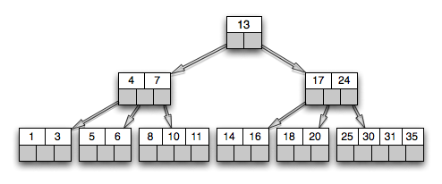
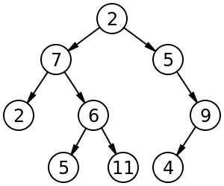
B-tree
Used mostly in storage & file systems
internal (non-leaf) nodes can be have a variable # of child nodes in some pre-defined range
B-tree of order 5
Each node has at most 5 children
(k-1) keys for k children
All leaves at the same level
Binary tree

Slide 10
B-tree (cont’d)
Finding 14
B-tree of n nodes
Space complexity?
Search
Insert
Delete
Insert 21

Slide 11
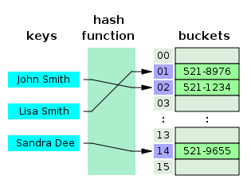
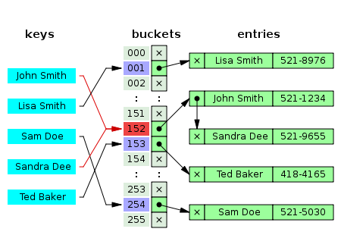
Hash Table
Used in memory management
<key, value> pairs
Search & storage in O(1), except
when collision occurs
One solution to hash collision is to use separate chaining

Slide 12
Process management
Readings: Chapter 3 - 4

Slide 13
Overview
Processes
States of a process
Operations on processes
  fork() , exec(), kill (), signal()
Cooperating Processes
  pipes
Threads and lightweight processes

Slide 14
PROCESSES
A process is a program executing a given sequential computation.
  An active entity unlike a program
  Think of the difference between a recipe in a cookbook and the activity of a cook preparing a dish according to the recipe!
There are many quasi-synonyms for process:
  Job (very old programmers still use it)
  Task
  Program (strongly deprecated)

Slide 15
Processes and programs (I)
Can have one program and many processes
  When several users execute the same program (text editor, compiler, and so forth) at the same time, each execution of the program constitutes a separate process
  A program that forks another sequential computation gives birth to a new process.

Slide 16
Processes and programs (II)
Can have one process and two—or more—programs
  A process that performs an exec() call replaces the program it was executing
shell
ls

Slide 17
Importance of processes
Processes are the basic entities managed by the operating system
  OS provides to each process the illusion it has the whole machine for itself
  Each process has a dedicated address space

Slide 18
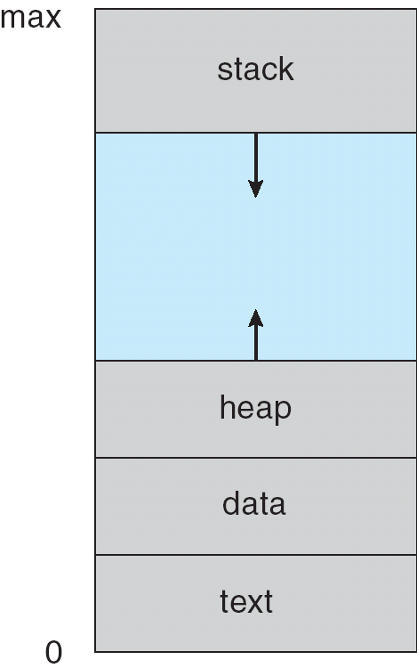
The process address space
Set of main memory locations allocated to the process
  Other processes cannot access them
  Process cannot access address spaces of other processes
A process address space is the playpen or the sandbox of its owner
  Process address space is contiguous
Notes:
maximum address space for a process is 32 bit x86_64 architecture maximum addressable memory is 4GB. 3GB for code and data segment; for 64-bit, it appears to be implementation dependence. in some cases, 2^48
heap: dynamically allocated; stack for function calls

Slide 19
PROCESS STATES
Processes go repeatedly through several stages during their execution
  Waiting to get into main memory
  Waiting for the CPU
  Running
  Waiting for the completion of a system call

Slide 20
State diagram
Exit
Running
Terminated
Get CPU
System request
Interrupt
New
Ready
Waiting
Admit process
Completion

Slide 21
Process arrival
New process
  Starts in NEW state
  Gets allocated a Process Control Block (PCB) and main memory
  Is put in the READY state waiting for CPU time

Slide 22
The ready state
AKA the ready queue
Contains all processes waiting for the CPU
Organized as a priority queue
Processes leave the priority queue when they get some CPU time
  Move then to the RUNNING state

Slide 23
The running state (I)
A process in the running state has exclusive use of the CPU until
  It terminates and goes to the TERMINATED state
  It does a system call and goes to the WAITING state
  It is interrupted and returns to the READY state

Slide 24
The running state (II)
Processes are forced to relinquish the CPU and return to the READY state when
  A higher-priority process arrives in the ready queue and preempts the running process
    Get out, I’m more urgent than you!
  A timer interrupt indicates that the process has exceeded its time slice of CPU time

Slide 25
The waiting state (I)
Contains all processes waiting for the completion of a system request:
  I/O operation
  Any other system call
Process is said to be waiting, blocked or even sleeping (UNIX slang)

Slide 26
The waiting state (II)
A system call that does not require callers to wait until its completion is said to be non-blocking
  Calling processes are immediately returned to the READY state
The waiting state is organized as a
set of queues
  One queue per device, OS resource

Slide 27
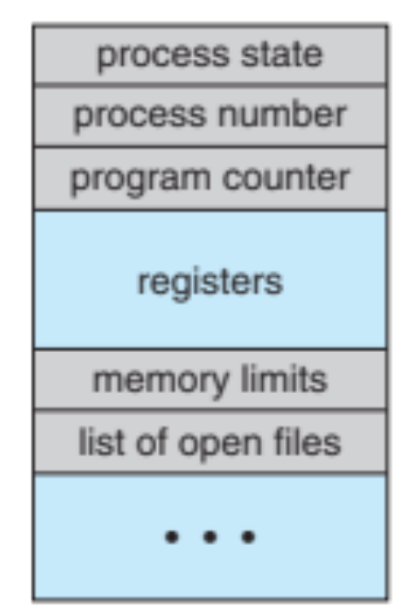
The process control block (I)
Contains all the information associated with a specific process:
  Process identification (pid), argument vector, ...
    UNIX pids are unique integers
  Process state (new, ready, running, …),
  CPU scheduling information
    Process priority, processors on which the process can run, ...,

Slide 28
The process control block (II)
  Program counter and other CPU registers including the Program Status Word (PSW),
  Memory management information
    Very system specific,
  Accounting information
    CPU time used, system time used, ...
  I/O status information (list of opened files, allocated devices, ...)
Notes:
memory management informaiton includes the value of base and limit registers, the page table or the segmental tables.

Slide 29
The process table
System-wide table containing
  Process identification (pid), argument vector, ...
  Process current state
  Process parents
  Process priority and other CPU scheduling information
  A pointer to the executable machine code of a process
Notes:
ps -e -f

Slide 30
Swapping
Whenever the system is very loaded, we might want to expel from main memory or swap out
  Low priority processes
  Processes that have been waiting for a long time for an external event
These processes are said to be swapped out or suspended.

Slide 31
How it works
Exit
Running
Terminated
Get CPU
System request
Interrupt
Admit process
New
Ready
Waiting
Completion
Activate
Deactivate
Deactivate
Suspended
Ready
Suspended
Waiting
Completion

Slide 32
Suspended processes
Suspended processes
  Do not reside in main memory
  Continue to be included in the process table
Can distinguish between two types of suspended processes:
  Waiting for the completion of some request (waiting_suspended)
  Ready to run (ready_suspended).

Slide 33
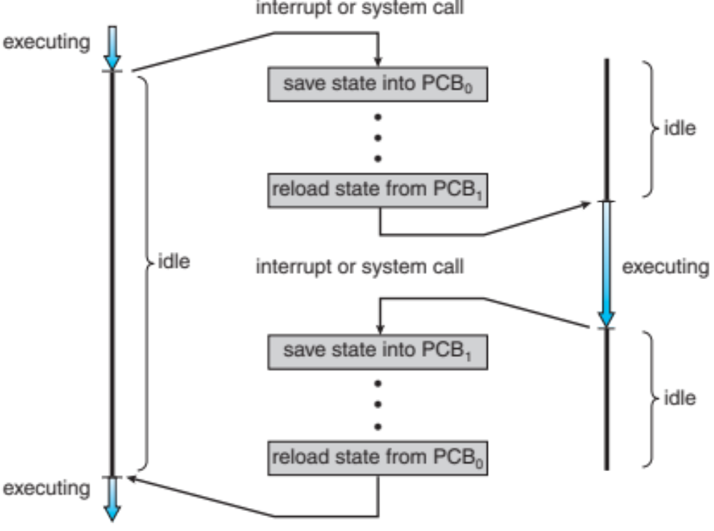
Context Switching
When one process is running on a CPU and another needs to run on the same CPU, we need to switch between the processes
This is called a context switch (or a “state” save and “state” restore)

Slide 34
Context Switching
The last step of a context switch is typically to load the program counter for the process that is about to run
Context switch has a time cost
  Dependent on hardware (e.g., # of machine registers)
  Not executing user processes during the time a context switch is occurring
Notes:
typical context switching time is tens of microsecond (depending on the size of the working set)

Slide 35
OPERATIONS ON PROCESSES
Process creation
  fork()
  exec()
  The argument vector
Process deletion
  kill()
  signal()

