Slide 1
OPERATIONS ON PROCESSES
Process creation
  fork()
  exec()
  The argument vector
Process deletion
  kill()
  signal()

Slide 2
Process creation
Two basic system calls
  fork() creates a carbon-copy of calling process sharing its opened files
  exec () overwrites the contents of the process address space with the contents of an executable file

Slide 3
fork()
The first process of a system is created when the system is booted
  e.g., init()
All other processes are forked by another process (parent process)
  They are said to be children of the process that created them.
When a process forks, OS creates an identical copy of forking process with
  a new address space
  a new PCB
The only resources shared by the parent and the child process are the opened files

Slide 4
Fork()
fork() call returns twice!
  Once in address space of child process
    Function return value is 0 in child
  Once in address space of parent process
    Function return value is process ID of child in parent

Slide 5
fork() Illustrated
Parent:
fork()
returns
PID of
child
fork()
Child:
fork()
returns
0
fork()
opened files

Slide 6
First example
The program
#include <sys/types.h>
#include <stdio.h>
#include <unistd.h>
int main() {
pid_t pid = fork();
if (pid < 0) { /* error occurred */
fprintf(stderr, "Fork Failed");
return 1;
}
printf("pid = %d, Hello world!\n", pid);
return 0;
}

Slide 7
How it works
…
fork();
printf();
…
…
fork();
printf();
…

Slide 8
Second example
#include <sys/types.h>
#include <stdio.h>
#include <unistd.h>
int main() {
pid_t pid = fork();
if (pid < 0) { /* error occurred */
fprintf(stderr, "Fork Failed");
return 1;
}
pid_t pid1 = fork();
printf("Hello world!\n");
return 0;
}
how many processes?

Slide 9
How it works
…
F
F
P
…
…
F;
F
P
…
…
F;
F
P
…
…
F;
F
P
…

Slide 10
Distinguishing Child and parent processes
#include <sys/types.h>
#include <stdio.h>
#include <unistd.h>
int main() {
pid_t pid;
/* fork a child process */
pid = fork();
if (pid < 0) { /* error occurred */
fprintf(stderr, "Fork Failed");
return 1;
} else if (pid == 0) { /* child process */
printf(“I am a child\n”);
} else { /* parent process */
/* parent will wait for the child to complete */
wait(NULL);
printf("Child Complete\n");
}
return 0;
}
fork()
  return 0 in child process; return PID of the child in the parent
wait()
  Waits for the completion of any child

Slide 11
Wait()
wait() used to wait for the state changes in a child of the calling process
  Blocked until a child changes its status
UNIX keeps in its process table all processes that have terminated but their parents have not yet waited for their termination
  They are called zombie processes

Slide 12
exec
Whole set of exec() system calls
Most interesting are
  execv(pathname, argv)
  execve(pathname, argv, envp)
  execvp(filename, argv)
All exec() calls perform the same basic tasks
  Erase current address space of process
  Load specified executable
  execlp(const char *file, const char *arg0, ... /*, (char *)0 */);

Slide 13
Putting everything together
#include <sys/types.h>
#include <stdio.h>
#include <unistd.h>
int main() {
pid_t pid;
/* fork a child process */
pid = fork();
if (pid < 0) { /* error occurred */
fprintf(stderr, "Fork Failed");
return 1;
} else if (pid == 0) { /* child process */
execlp("/bin/ls", "ls", "-l", NULL);
} else { /* parent process */
/* parent will wait for the child to complete */
wait(NULL);
printf("Child Complete\n");
}
return 0;
}

Slide 14
Observations
Mechanism is quite costly
  fork() makes a complete copy of parent address space
    very costly in a virtual memory system
  exec() thrashes that address space
Berkeley UNIX introduced cheaper vfork()
  Shares the parent address space until the child does an exec()

Slide 15
Process Termination
When do processes terminate?
  exit(), “running off end”, invalid operations, other process kills it
Resources must be de-allocated
  E.g., PCB, open files
  Memory (address space) that is in use (if no other threads)
What happens when parent dies?
  Children can die (“cascading termination”)
  Children can remain executing
What happens when a child terminates
  Parent may be notified

Slide 16
Examples of Process Termination
Unix-ish systems (e.g., Mac OS X, Linux)
  E.g., process calls _exit() or exit() itself, or another process calls kill(pid, SIGKILL)
  Parent: Child terminating sends SIGCHLD signal to parent (does not terminate parent)
  Children: of terminating process are inherited by process 1, “init” (BUT, children terminate on Unix!)
Windows system
  e.g., ExitProcess called by the process or another process calls TerminateProcess with a handle to the process
  Children: child processes continue to run
Notes:
Not talking about threads here.
http://msdn.microsoft.com/en-us/library/ms686722%28v=vs.85%29.aspx
Process groups on Unix systems
http://www.win.tue.nl/~aeb/linux/lk/lk-10.html
On Windows, I’m not sure what happens to the parent process when the child dies; I’m assuming the parent process continues
_exit is the system call; exit is the library call. From the _exit man (2) page: “Most C programs call the library routine exit(3), which flushes buffers,
closes streams, unlinks temporary files, etc., before calling _exit().”

Slide 17
Parent dies before Child
#include <sys/types.h>
#include <stdio.h>
#include <unistd.h>
int main() {
pid_t pid;
/* fork a child process */
pid = fork();
if (pid < 0) { /* error occurred */
fprintf(stderr, "Fork Failed");
return 1;
} else if (pid == 0) { /* child process */
sleep(10);
printf("Child terminating\n");
} else { /* parent process */
printf("Press enter to continue in parent\n");
getchar();
}
return 0;
}

Slide 18
COOPERATING PROCESSES
Any process that does not share data with any other process is independent”
Processes that share data are cooperating
Why cooperation?
  Software engineering issues
    Sometimes it is natural to divide a problem into multiple processes
    Often, the parts of a program need to cooperate
    Modularity
  Run-time issues
    Computational speedups (e.g., multiple CPU’s)
    Convenience (e.g., printing in background)

Slide 19
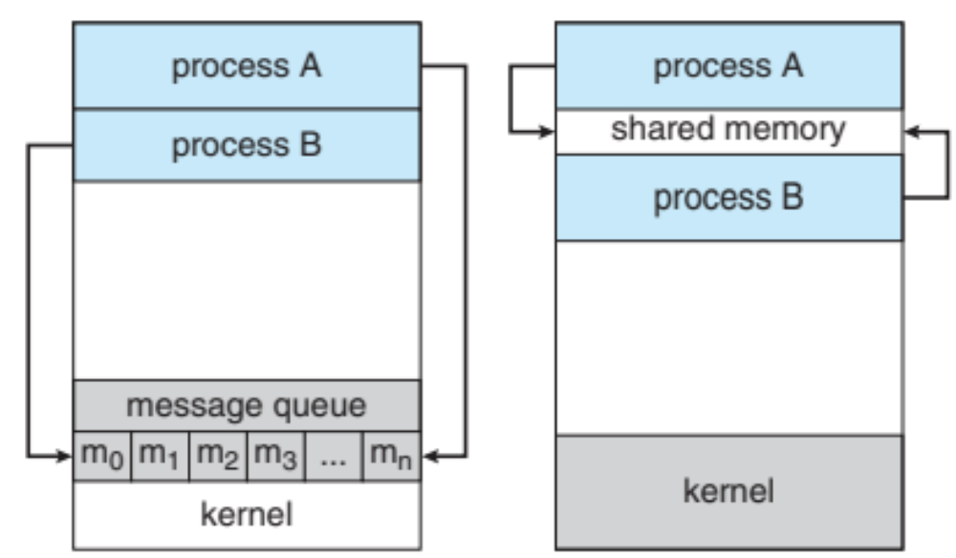
Mechanisms
Shared memory
Message passing
Message passing
Shared memory

Slide 20
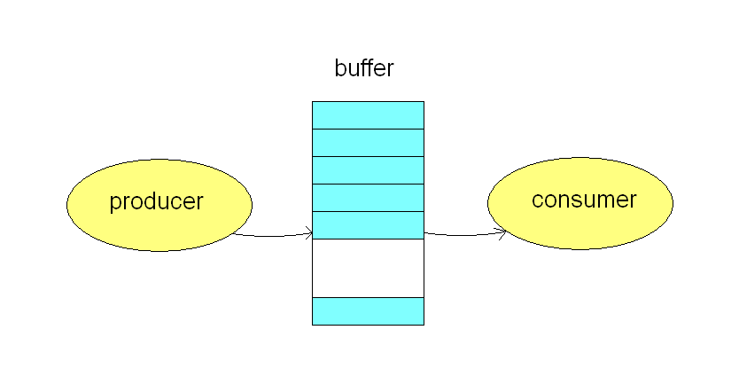
Shared memory
OS provides the abstraction of shared memory
Programmers need to handle the communication explicitly
Producer-consumer
  Requires synchronization

Slide 21
Message Passing
Process 1
int main() {
  Message m;
  Send(P2, m);
}
Process 2
int main() {
  Message m;
  m = Receive(P1, m);
}

Slide 22
Styles of Message Passing
Send/Receive calls
Blocking (synchronous)
  “Rendezvous”
    Send blocks until receiver executes Receive
    Receive blocks until there is a message
  Fixed-length queue
    Sender blocks if queue is full
    Rendezvous uses a fixed-length queue, length = 0
Non-blocking (asynchronous)
  Send buffers message, so Receiver will pick it up later
    Needs an ‘unbounded’ message queue
  Receiver gets a message or an indication of no message (e.g., NULL)

Slide 23
Direct Message Passing: Use Identifier of Process
Direct/symmetric
  Both sender and receiver name a process
  Send(P, message) // send to process P
  Receive(Q, message) // receive from process Q
Direct/asymmetric
  Send(P, message) // send to process P
  Receive(&id, message) // id gets set to sender
Notes:
In the direct/symmetric case this is sort of like using radio communication; In order to get a message from you, I have to tune into a particular radio frequency. You also have to tune into that same radio frequency to send.
The direct/asymmetric case is like sending a letter. Receiver doesn’t need to have address of sender.

Slide 24
Mailboxes: Indirect Message Passing
Process 2
int main() {
  Message m;
  m = Receive(“mbox”);
}
Process 1
int main() {
  Message m;
  Send(“mbox”, m);
}
mailbox “mbox”

Slide 25
Mailboxes: Indirect Message Passing
Neither sender or receiver or receiver knows process ID of the other; use a mailbox instead
  E.g., using sockets in UNIX or Windows, and ports in Mach
Mailboxes have names or identifiers
Also have Send/Receive system calls
  Processes Send messages to mailboxes
  Receiver checks mailbox for messages using Receive
Mailboxes have owners
  E.g., owner may be creating process, or O/S
  Pass privileges to other processes
    e.g., rights to ports in Mach can be sent to other processes
  Children may automatically share privileges
Notes:
Windows sockets (winsock)
http://msdn.microsoft.com/en-us/library/ms740673%28v=vs.85%29.aspx

Slide 26
Pipes
UNIX pipes are a shell construct:
  ls -alg | more
Standard output of program at left (producer) becomes the standard input of program at right (consumer).

Slide 27
Hydraulic analogy
a | b | c
std input
a
b
c
std output

Slide 28
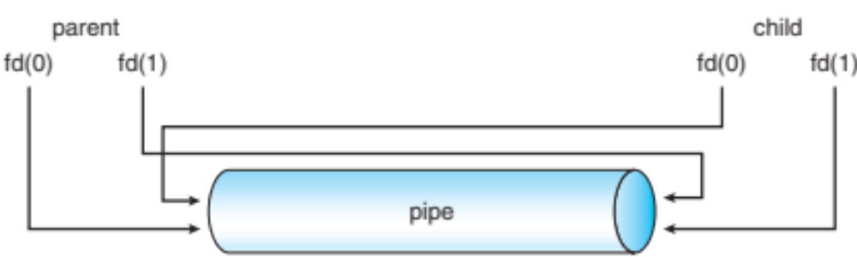
The pipe() system call
To create a pipe between two processes
    int pd[2];
    pipe(pd);
System call creates two new file descriptors:
  pd[0] that can be used to read from pd
  pd[1] that can be used to write to the pd
Also returns an error code

Slide 29
Remote Procedure Call
Process 1
int main() {
// Invoke method
// on Process 2
Method1();
}
Process 2
Method1()
Method2()
…

Slide 30
Remote Procedure Calls (RPC)
Look like regular function calls to caller
  But, RPC invocation from a ‘client’ causes a method to be invoked on a remote ‘server’
  Remote ‘server’ process provides implementation and processing of method
  Client side interface has to pack (“marshal”) arguments and requested operation type into a message & send to remote server
Can have blocking or non-blocking semantics

Slide 31
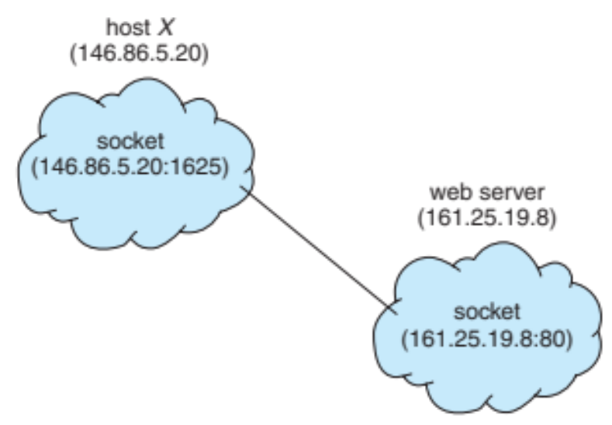
Client-server systems
Sockets
Servers run on well-defined ports
A socket uniquely identified by <src_ip, src_port, dst_ip, dst_port>

Slide 32
Servers
Single threaded server:
  Processes one request at a time
for (;;) {
receive(&client, request);
process_request(...);
send (client, reply);
} // for

Slide 33
A tricky question
What does a server do when it does not process client requests?
Possible answers:
  Nothing
  It busy waits for client requests
  It sleeps
    WAITING state is sometimes called sleep state

Slide 34
The problem
Most client requests involve disk accesses
  File servers
  Authentications servers
When this happens, the server remains in the WAITING state
  Cannot handle other customers’ requests

Slide 35
A first solution
int pid;
for (;;) {
receive(&client, request);
if ((pid = fork())== 0) {
process_request(...);
send (client, reply);
_exit(0); // done
} // if
} // for

Slide 36
The good and the bad news
The good news:
  Server can now handle several user requests in parallel
The bad news:
  fork() is a very expensive system call

Slide 37
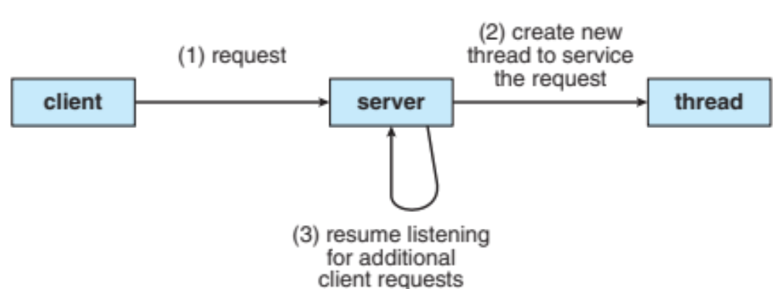
A better solution
Provide a faster mechanism for creating cheaper processes:
  Threads
Threads share the address space of their parent
  No need to create a new address space
    Most expensive step of fork() system call

Slide 38
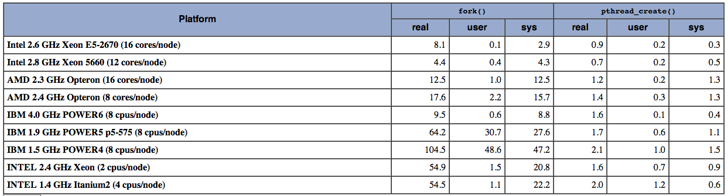
A comparison between Fork & pthread_create()
~10 times faster

Slide 39
Is it not dangerous?
To some extent because
  No memory protection inside an address space
  Lightweight processes can now interfere with each other
But
  All lightweight process code is written by the same team
  Synchronization

Slide 40
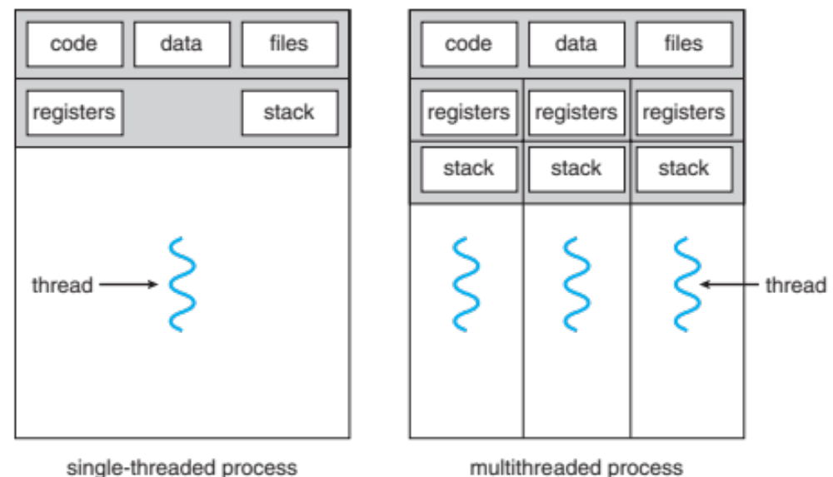
General Concept
A thread
  Does not have its own address space
  Shares it with its parent and other peer threads in the same address space (task)
Each thread has a program counter, a set of registers and its own stack.
  Everything else is shared

Slide 41
Examples of multithreaded programs
Embedded systems
  Elevators, Planes, Medical systems, Wristwatches
  Single Program, concurrent operations
Most modern OS kernels
  Internally concurrent because have to deal with concurrent requests by multiple users
  But no protection needed within kernel
Database Servers
  Access to shared data by many concurrent users
  Also background utility processing must be done
Notes:
DB servers very important – provide “shared data” view to users.
Many users can read/write at once – how is consistency managed?

Slide 42
Examples of multithreaded programs (con’t)
Network Servers
  Concurrent requests from network
  Again, single program, multiple concurrent operations
  File server, Web server, and airline reservation systems
Parallel Programming (More than one physical CPU)
  Split program into multiple threads for parallelism
  This is called Multiprocessing

Slide 43
Classification
Real operating systems have either
  One or many processes
  One or many threads per process
One
Many
# of process:
# threads
/process:
One
MS/DOS, early Macintosh
Traditional UNIX
Many
Embedded systems (Geoworks, VxWorks, etc)
Mach, OS/2, HP-UX, Win NT to 8, Solaris, OS X, Android, iOS

Slide 44
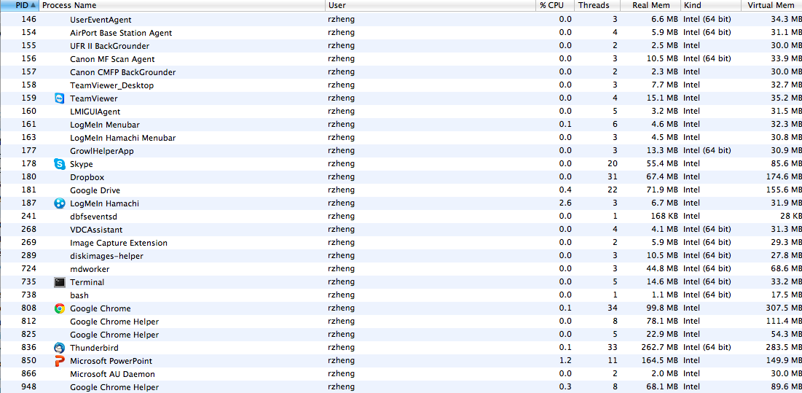

Slide 45
Memory Footprint of Two-Thread Example
If we stopped this program and examined it with a debugger, we would see
  Two sets of CPU registers
  Two sets of Stacks
Stack 1
Stack 2
Address Space
Heap
Global Data
Code

Slide 46
Per Thread State
Each Thread has a Thread Control Block (TCB)
  Execution State: CPU registers, program counter (PC), pointer to stack (SP)
  Scheduling info: state, priority, CPU time
  Various Pointers (for implementing scheduling queues)
  Pointer to enclosing process (PCB)
  Etc (add stuff as you find a need)
OS Keeps track of TCBs in protected memory
  In Array, or Linked List, or …

Slide 47
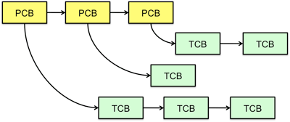
Multithreaded Processes
PCB points to multiple TCBs:
Switching threads within a process is a simple thread switch
Switching threads across processes requires changes to memory and I/O address tables.

Slide 48
Thread Lifecycle
As a thread executes, it changes state:
  new: The thread is being created
  ready: The thread is waiting to run
  running: Instructions are being executed
  waiting: Thread waiting for some event to occur
  terminated: The thread has finished execution
“Active” threads are represented by their TCBs
  TCBs organized into queues based on their state

Slide 49
Implementation
Thread can either be
  Kernel supported:
    Mach, Linux, Windows NT and after
  User-level:
    Pthread library, Java thread

Slide 50
Kernel-Supported Threads
Managed by the kernel through system calls
One process table entry per thread
Kernel can allocate several processors to a single multithreaded process
Supported by Mach, Linux, Windows NT and more recent systems
Switching between two threads in the same processes involves a system call
  Results in two context switches

Slide 51
User-Level Threads
User-level threads are managed by procedures within the task address space
  The thread library
One process table entry per process/address space
  Kernel is not even aware that process is multithreaded
No performance penalty: Switching between two threads of the same task is done cheaply within the task
Programming issue:
  Each time a thread does a blocking system call, kernel will move the whole process to the waiting state
    It does not know better
  Programmer must use non-blocking system calls
    Can be nasty

Slide 52
User-Level Threads
sleep(5);
Kernel
Process wants to sleep for 5 seconds:
Let us move it to the waiting state

Slide 53
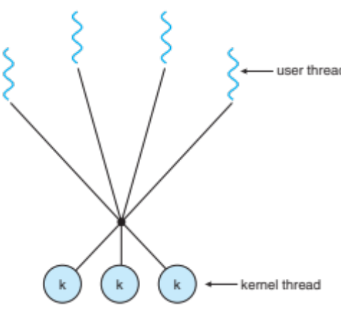
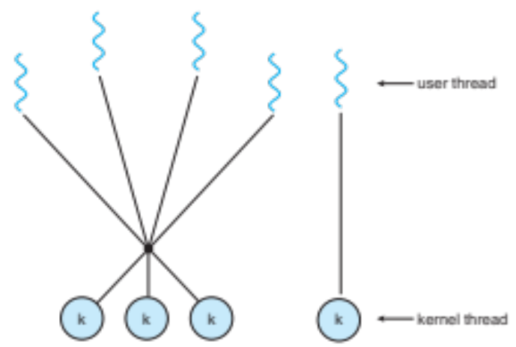
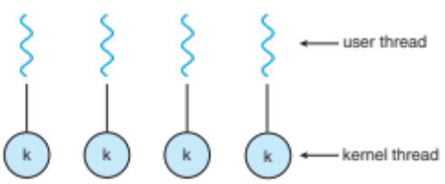
Mapping between Kernel and User level threads
One-to-one
Many-to-one
Hybrid model

Slide 54
POSIX Threads
POSIX threads, or pthreads, are standardized programming interface
Ported to various Unix and Windows systems (Pthreads-win32).
On Linux, pthread library implements the 1:1 model
Function names start with “pthread_”
Calls tend to have a complex syntax : over 100 methods and data types

Slide 55
An Example
#include <pthread.h>
#include <stdio.h>
#include <stdlib.h>
#define NUM_THREADS 5
void *PrintHello(void *threadid)
{
long tid;
tid = (long)threadid;
printf("Hello World! It's me, thread #%ld!\n", tid);
pthread_exit(NULL);
}
int main(int argc, char *argv[])
{
pthread_t threads[NUM_THREADS];
int rc;
long t;
for(t=0;t<NUM_THREADS;t++){
printf("In main: creating thread %ld\n", t);
rc = pthread_create(&threads[t], NULL, PrintHello, (void *)t);
if (rc){
printf("ERROR; return code from pthread_create() is %d\n", rc);
exit(-1);
}
}
/* Last thing that main() should do */
pthread_exit(NULL);
}

Slide 56
Summary
Goals:
Multiprogramming: Run multiple applications concurrently
Protection: Don’t want a bad application to crash system!
Solution:
Process: unit of execution and allocation
Virtual Machine abstraction: give process illusion it owns machine (i.e., CPU, Memory, and IO device multiplexing)
Challenge:
Process creation & switching expensive
Need concurrency within same app (e.g., web server)
Solution:
Thread: Decouple allocation and execution
Run multiple threads within same process
Notes:
Multiprogramming: Older idea than multi-tasking, run jobs concurrently (load several into memory), but not necessarily “interactively”.

