Slide 1
Activity Recognition and Monitoring using Wearable Sensors and Smart Phones

Slide 2
Outline
Activity recognition applications
Under the hood of activity recognition
Existing activity recognition systems
Further design considerations

Slide 3
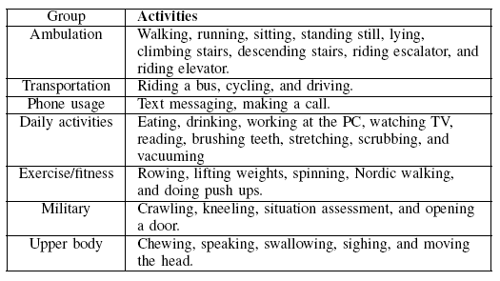
Activity Recognition (AR)
AR identifies the activity a user performs
  Running, walking, sitting …
  Provides important context in addition to locations
  Dedicated sensors or smart phones

Slide 4
End-user Applications
Fitness tracking
  Distance traveled
  Intensity and duration of activity
  Calories burned
Health monitoring
  Allows long-term monitoring and diagnosis using continuously generated data, e.g., Parkinson disease
    Changes in behavior patterns can be telling
  Positive feedback to ratify behaviors, e.g., reducing hyperactivity via feedback actigraph
Fall detection

Slide 5
End-user Applications
Context-aware behavior
  Customized device behavior, e.g.,
    Playing different kinds of music based on the activity level
    Changing display fonts based on moving speed
  Manage device resource based on user activities, e.g., reduce GPS sampling interval when users are stationary
Home and work automation

Slide 6
Third-party Applications
Targeted advertising
  Inferring interest categories, e.g., a person visits Chinese restaurants a lot (but not working there)
  Adapting to present context, e.g., when and how to display ads based on user activities
Corporate management and accounting
  Mandatory AR, e.g., monitoring whereabout and activities of hospital staffs
  Voluntary AR, e.g., car insurance tied to driving behavior

Slide 7
Applications for Crowds and Groups
Enhancing traditional social networks, e.g., uploading activity information such as jogging
Discovery friends based on common activities in close proximity
Tag places based on activities or detect changes

Slide 8
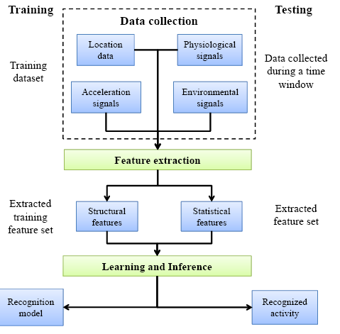
Basic AR System Diagram

Slide 9
Attributes and Sensors
Environmental attributes
  Temperature, humidity, audio level …
  Providing contextual information
Acceleration
  Triaxial accelerometers
  > 90% accuracy for ambulatory activities
  Eating, tooth brushing, and working on a computer more difficult to distinguish, and is dependent on the location of the sensor
Location
Physiological signals: vital signs

Slide 10
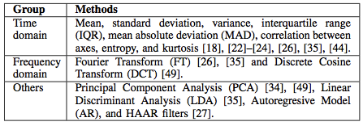
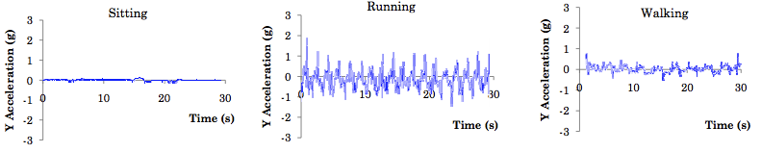
Feature Extraction
Acceleration

Slide 11
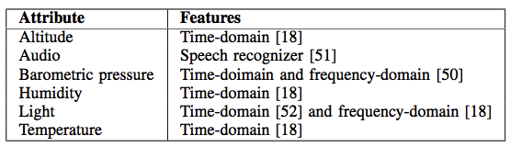
Environment variables

Slide 12
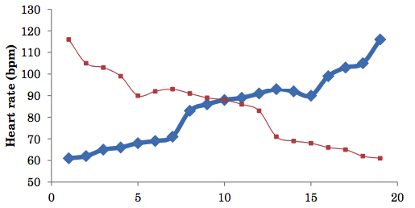
Vital signals
Structural features better capture the “trend”
  E.g., Coefficients of fitting polynomial

Slide 13
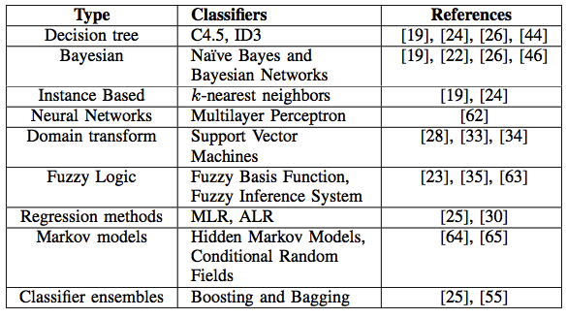
Classification
Supervised classification
Semi-supervised classification

Slide 14
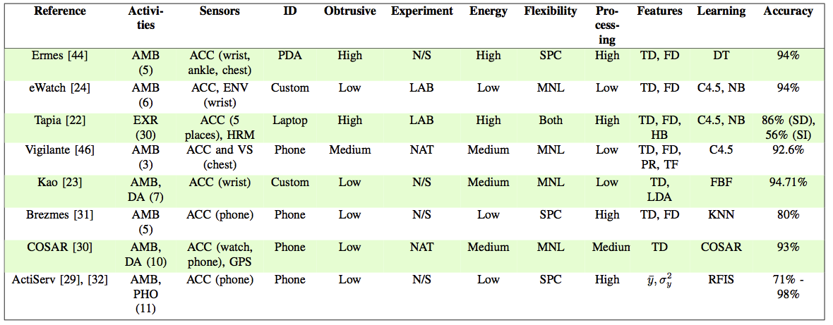
Supervised Online AR Systems
Online classification of activities

Slide 15
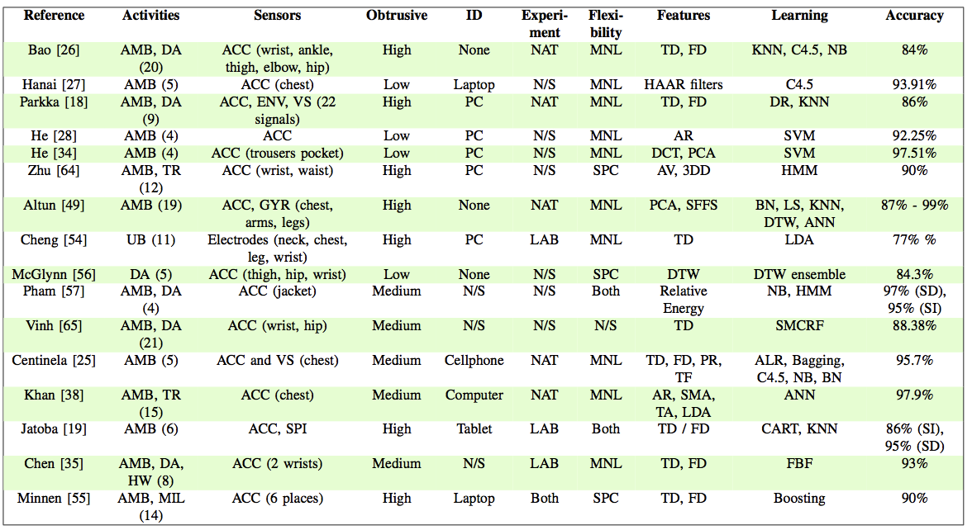
Supervised Offline AR Systems
Gathered data analyzed offline
  Applications: calorie burned over a day

Slide 16
System Issues on Implementing AR in Smart Phones
Multiple sensors on a single platform have different characteristics/requirements
  Accelerometer sensitive to orientation but incurs little computation costs
  Acoustic sensor robust to positions but has high computation cost to process
  GPS has high energy cost for continuous sensing
Modular design allowing incorporation of new signal processing algorithms
Flexible programming model in building new applications

Slide 17
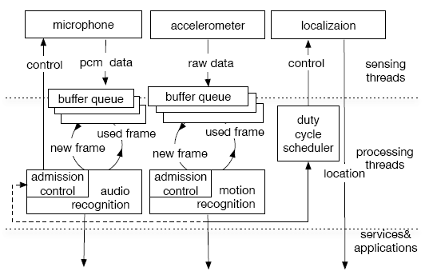
Jigsaw – A continuous sensing engine

Slide 18
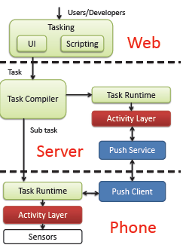
Code in the air (CITA)
Tasking framework: developers write task scripts and compile to server and mobile codes
Activity layer: high level abstraction allowing activity composition such as isBiking
Push service: communicates between devices & server

Slide 19
Activity Composition
Support AND, OR, NOT
Event A WITHIN xx sec
Event A for xx sec
Event A next B
Ex: Alice wants her phone to be silent if she is in meeting room with her colleague Bob or Alex
If Alice in the meeting room
Bob is the meeting room and Alex is in the meeting room

Slide 20
Challenges and Opportunities
“Open” problems:
Individual characteristics (age, gender, height, weight…) affects the accuracy of AR
Concurrent/overlapping movements
Composite activities: playing tennis
Interesting directions:
Collective activity recognition
Prediction of future activities

Slide 21
Reference
J. Lockhart, T. Pulickal, and G. Weiss, Applications of Mobile Activity Recognition
Oscar D. Lara and Miguel A. Labrador, A Survey on Human Activity Recognition using Wearable Sensors
Hong Lu,Jun Yang Zhigang Liu Nicholas D. Lane, Tanzeem Choudhury,Andrew T. Campbell, The Jigsaw Continuous Sensing Engine for Mobile Phone Applications
Lenin Ravindranath, Arvind Thiagarajan, Hari Balakrishnan, and Samuel Madden, Code In The Air: Simplifying Sensing and Coordination Tasks on Smartphones

