Slide 1
Windows Phone 7 and Windows Azure
Development Tutorial
COSC7388 Fall 2012
Huy Nguyen

Slide 2
What you should know in advance
Object-Oriented Programming
C# programming language and Microsoft Visual Studio IDE
Basic knowledge on using smart phones
If you need to learn C# and VS, take a look at
  http://www.csharpcourse.com/
  http://www.learnvisualstudio.net/

Slide 3
Agenda
Windows Phone 7 development introduction
  Getting started with WP 7
  Building a WP app
  Silverlight controls and integration services
  Tons of demos
Windows Azure platform
  What is Windows Azure?
  Project Hawaii
  Building WP application with Windows Azure
  Miscellaneous

Slide 4
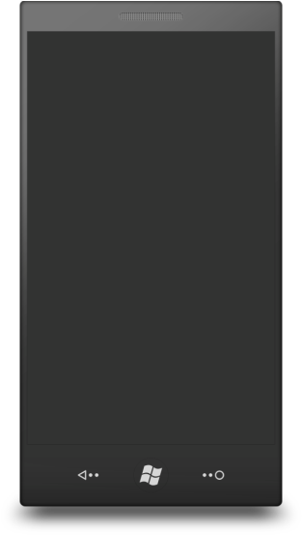
Hardware foundation (WP 7.0)
Capacitive touch
4 or more contact points
800
Sensors
A-GPS, Accelerometer, Compass, Light, Proximity,
Camera
5 mega pixels or more
Multimedia
Common detailed specs, Codec acceleration
Memory
256MB RAM or more, 8GB Flash or more
GPU
DirectX 9 acceleration
CPU
Qualcomm MSM8x55 800Mhz or higher
Hardware buttons | Back, Start, Search
480

Slide 5
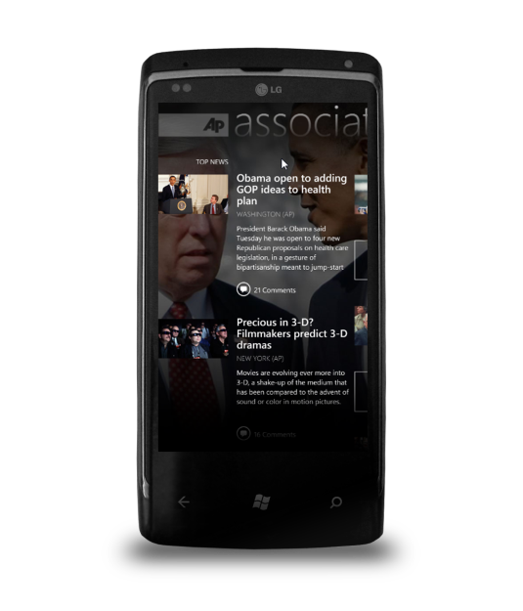



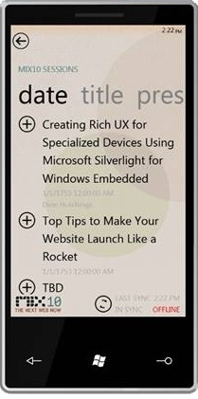

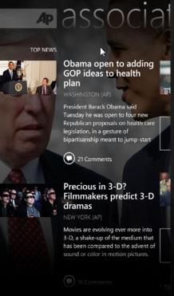

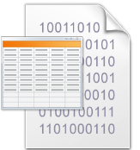

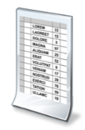



WP development process
Tools
Phone Emulator
Windows Phone
device
Samples
Documentation
Guides
Community
Packaging and Verification Tools
Packaging &
Verification Tools
myapp.xap
Windows Phone
Emulator

Slide 6
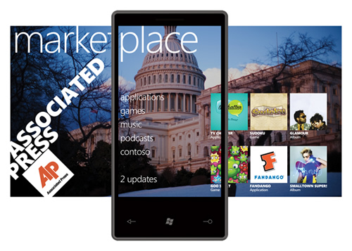
Using Microsoft Marketplace
Similar to Google Play or Apple App Store
To publish apps, you need to
reg as a developer
Costs $99 per year
  Unlimited fee apps
  Up to 5 free apps ($20 each additional)
  Student can signup for free via Dreamspark
  Revenue sharing – 30/70

Slide 7



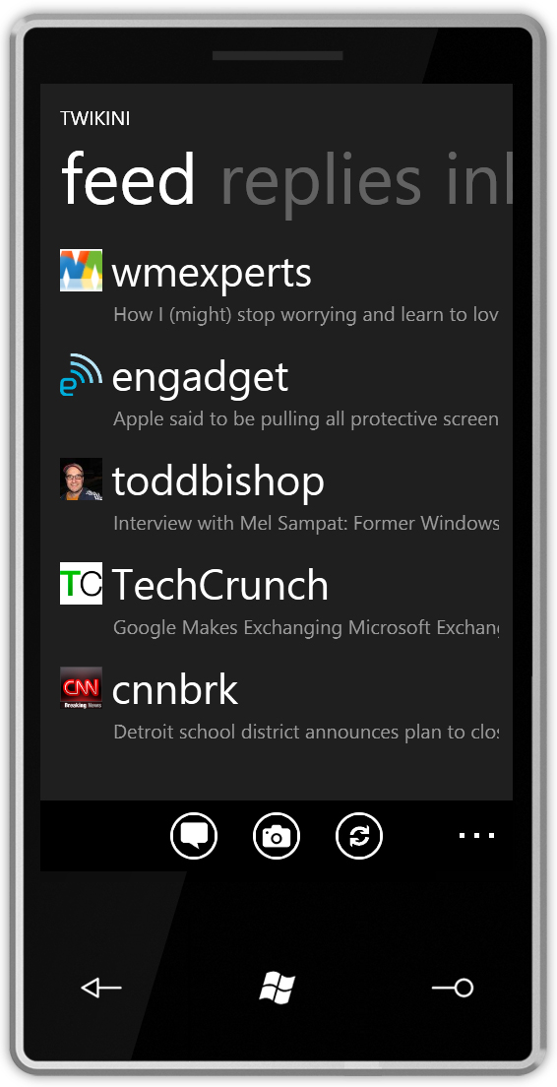
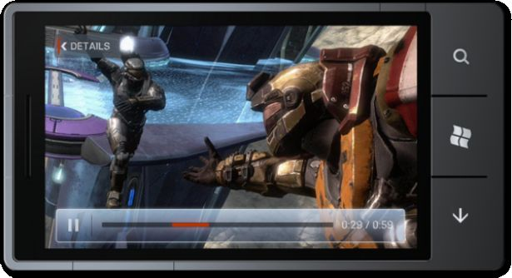
Two flavors of applications
Modern XAML/event-driven application UI framework
Rapid creation of visually
stunning apps
Metro-themed UI
controls
HTML/JavaScript
500,000 developers
spanning Windows
and web
High performance game framework
Rapid creation of multi-screen
2D and 3D games
Rich content pipeline
Mature, robust, widely adopted technology
spanning
Xbox 360,
Windows,
and Zune

Slide 8
Things to remember …
You are developing for a small device
  Decisions you make about your application can have an impact on user experience and phone battery life
The power is amazing for such a small device
  But it is not the same as a desktop or laptop
Always test your app on real devices (not on your emulator powered by an i7 CPU)
Code clean and code smart

Slide 9
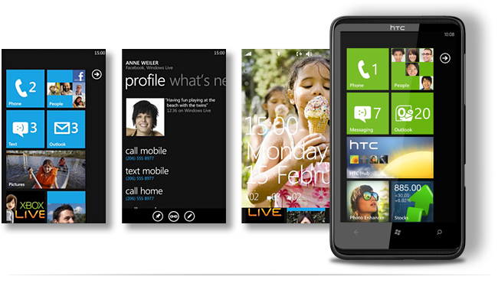
Building a WP application

Slide 10
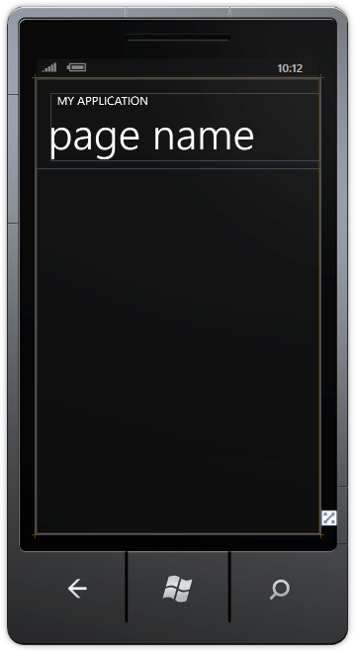
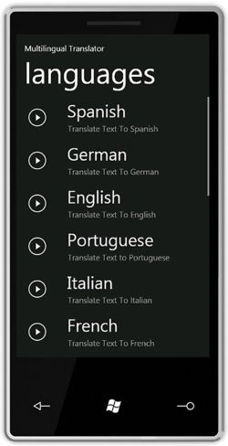
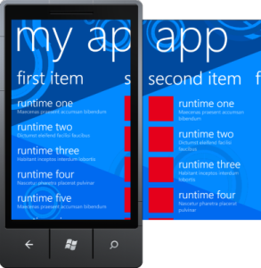

Silverlight project types
Windows Phone Application – a basic single page application
Windows Phone Databound Application – using List and Navigation controls
Windows Phone Panorama Application – support panorama mode
Windows Phone Class Library – a library for shared logic with no pre-build UI

Slide 11
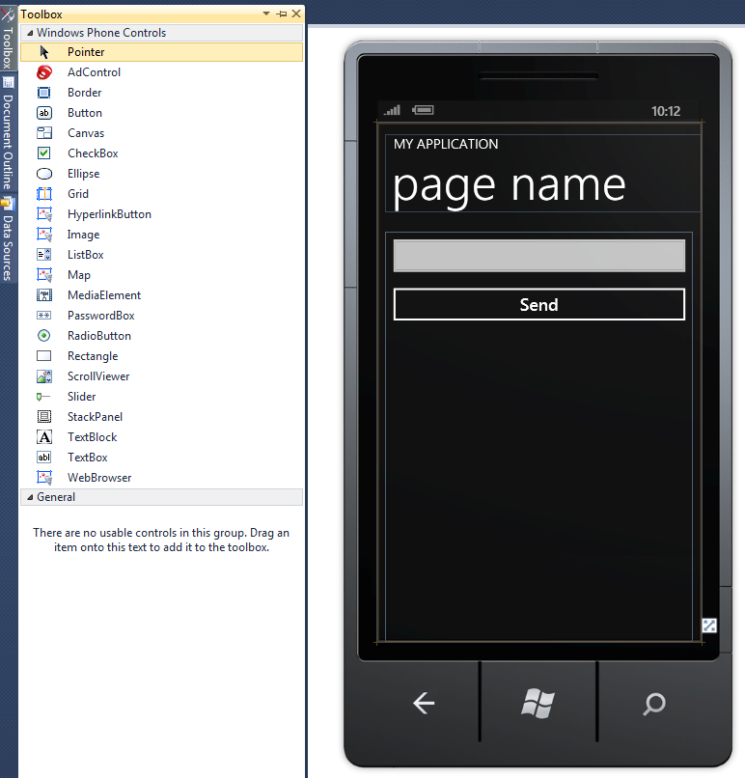
Silverlight controls
Silverlight control set is rich
Familiar to existing Silverlight and .NET developers
Some additional features
  For example, Software Input Panel support on TextBox

Slide 12
Creating our
first application
Code is available at http://www2.cs.uh.edu/~rzheng/course/COSC7388fa12/

Slide 13
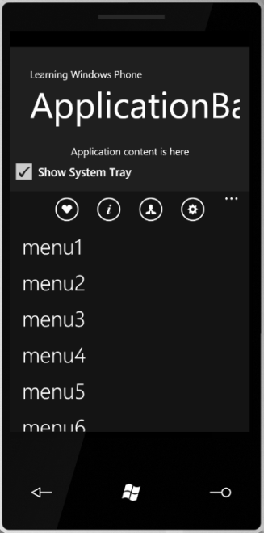
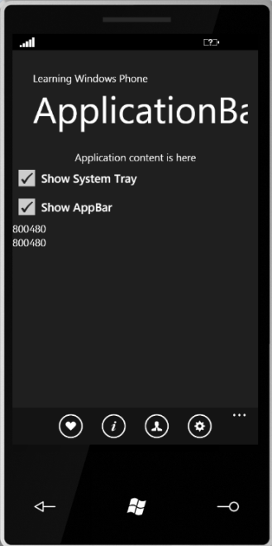
Application bar and system tray
System Tray
  No integration, but does affect Layout
  Show:Hide using SystemTray.IsVisible
Application Bar
  Up to 4 Buttons
  Menu Items (Recommended 6)
  Toggle Visibility
  <mypage>.ApplicationBar.IsVisible

Slide 14
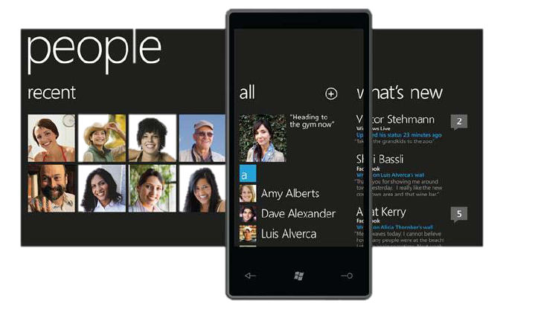
Panorama
Part of the native Windows Phone look and feel
Panorama is a long horizontal canvas
PanoramaItem serves as a container that hosts other content and controls

Slide 15
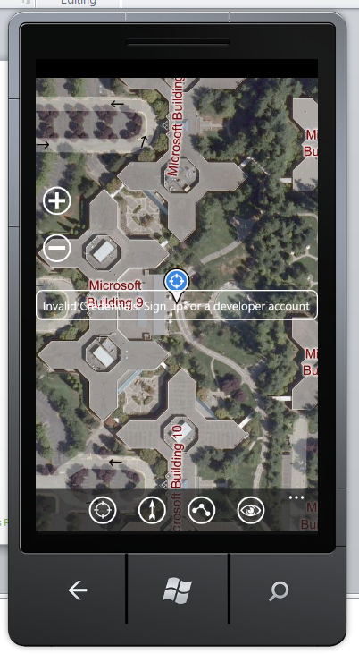
More controls …
Standard Controls
  Buttons, Image, Layout, ListBox, TextBox, Slider, Other…
Bing Maps
  Bing Map Control, Integration with Bing Maps Services
Deep Zoom
  Included in core run-time, Optimized to take advantage of GPU, Consumes same content as SL on desktop, Supported for Online content
Web Browser
  Displays network and local content, Supports pan, double tap and pinch to zoom, Supports transforms & projections, Application can interact with javascript

Slide 16
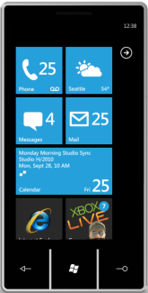
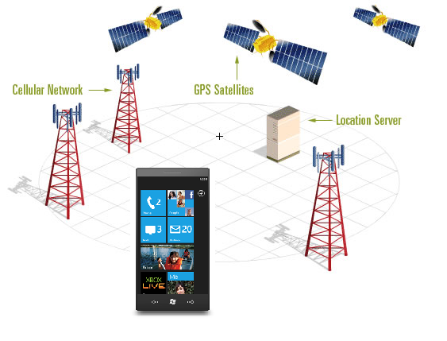
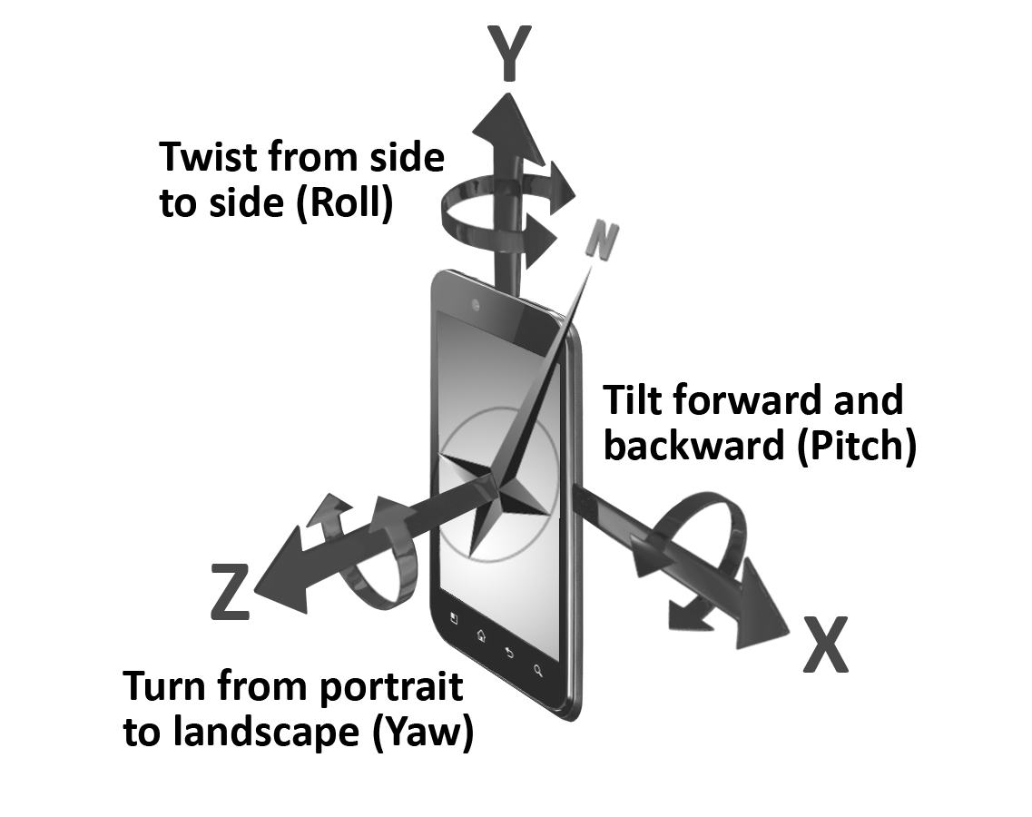
Sensors on your smart phone
Audio sensor (microphone)
Image sensor (camera, video recorder)
Tri-Axial Accelerometer
Location sensor (GPS, cell tower, WiFi)
Proximity sensor (infrared)
Magnetic compass
Gyroscope
Light sensor
Temperature sensor
+Y
-Z
-X
+X
+Z
-Y

Slide 17
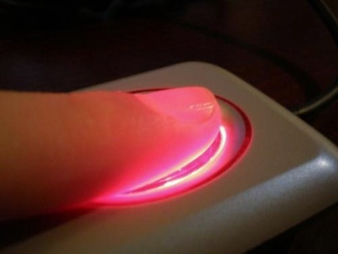
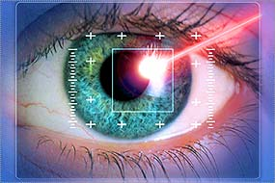
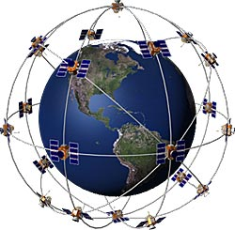


Sensors mining and sample applications
Activity recognition (Walking, Jogging, Climbing Stairs, Lying Down, Sitting, Standing)
Fall/movement detection
Biometric identification
Location-based applications
Social networking applications
Voice-activated systems

Slide 18
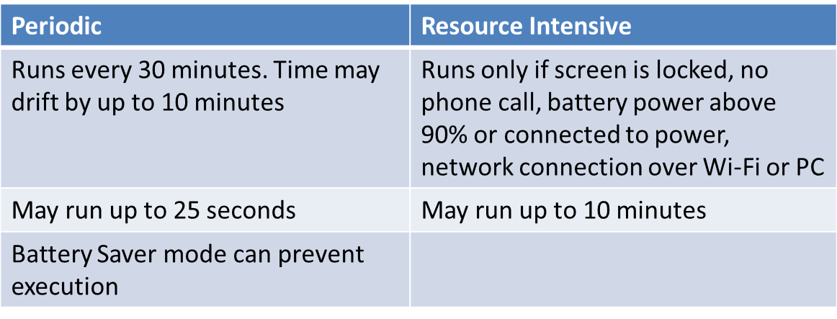
Background agents (7.1 SDK)
Execute code in the background
Two types of tasks
Scheduled tasks are limited to run only part of the APIs
Notes:
Two types of tasks:
Periodic: run for a small amount of time on a regular recurring interval
Resource-intensive: run for a relatively long period of time when the phone meets a set of requirements
Max of 6 MB of memory
Must be rescheduled after 14 days (can be changed using ExpirationTime property)
Unscheduled if they exit two consecutive times due to exceeding the memory quota or any other unhandled exception
When running under the debugger, memory and timeout restrictions are suspended
Scheduled tasks are limited to run only part of the APIs
Some are detected by the development tools and will raise an error at run or compile time
Other APIs are restricted by the Windows Phone Marketplace application submission process

Slide 19
A location-aware
application
Code is available at http://www2.cs.uh.edu/~rzheng/course/COSC7388fa12/

Slide 20

Windows Azure
Service Platform

Slide 21
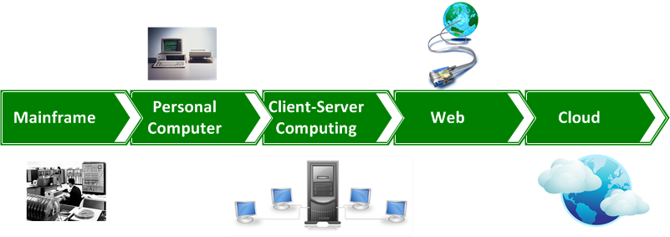
What is cloud computing?
The use of computing resources (hardware and software) that are delivered as a service over a network (typically the Internet)
The name comes from the use of a cloud-shaped symbol as an abstraction for the complex infrastructure it contains in system diagrams
Notes:
Simply put, cloud computing provides a variety of computing resources , from servers and storage to enterprise applications such as email, security, backup/DR, voice, all delivered over the Internet. The Cloud delivers a hosting environment that is immediate, flexible, scalable, secure, and available – while saving corporations money, time and resources.
Why Cloud? → Give Development diagram
Traditional infrastructure model & acceptable surplus
Actual infrastructure demand → unacceptable surplus and unacceptable deficit

Slide 22

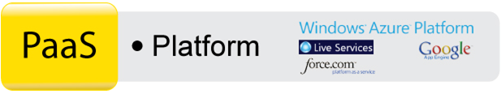

Cloud service classification
Consume
Software
as-a-Service
Build
Platform
as-a-Service
Host
Infrastructure
as-a-Service
Notes:
Software as a Service (SaaS)
From end user’s point of view
Apps are located in the cloud
Software experiences are delivered through the Internet
Platform as a Service (PaaS)
From developer’s point of view (i.e. cloud users)
Cloud providers offer an Internet-based platform to developers who want to create services but don't want to build their own cloud
Infrastructure as a Service (IaaS)
Cloud providers build datacenters
Power, scale, hardware, networking, storage, distributed systems, etc
Datacenter as a service
Cloud users rent storage, computation, and maintenance from cloud providers (pay-as-you-go; like utility)

Slide 23
Cloud service classification
IaaS
PaaS
SaaS
On-Premise
You manage
Data / Users
You manage
Data / Users
Data / Users
Data / Users
Application
Application
Application
Application
Runtime
Runtime
Runtime
Runtime
Managed by vendor
You manage
Database
Database
Database
Database
Managed by vendor
O/S
O/S
Managed by vendor
O/S
O/S
Virtualization
Virtualization
Virtualization
Virtualization
Server HW
Server HW
Server HW
Server HW
Storage
Storage
Storage
Storage
Networking
Networking
Networking
Networking

Slide 24

Azure service platform
Microsoft cloud platform (IaaS/PaaS)
On-demand services hosted on Microsoft Data Centers
Cloud operating system
Provide set of services that allows
  Development
  Management
  Hosting of applications off-premise
Commercially available: Feb. 1, 2010.

Slide 25
















Azure service platform
Internet
  Developer Experience
  Use existing Skills and Tools
platform
AppFabric
Compute
Storage
Billing &
Payments
Information Marketplace
Relational data
Connectivity
Management
CDN
Management
Access control
Flexible APIs
Reporting & BI

Slide 26
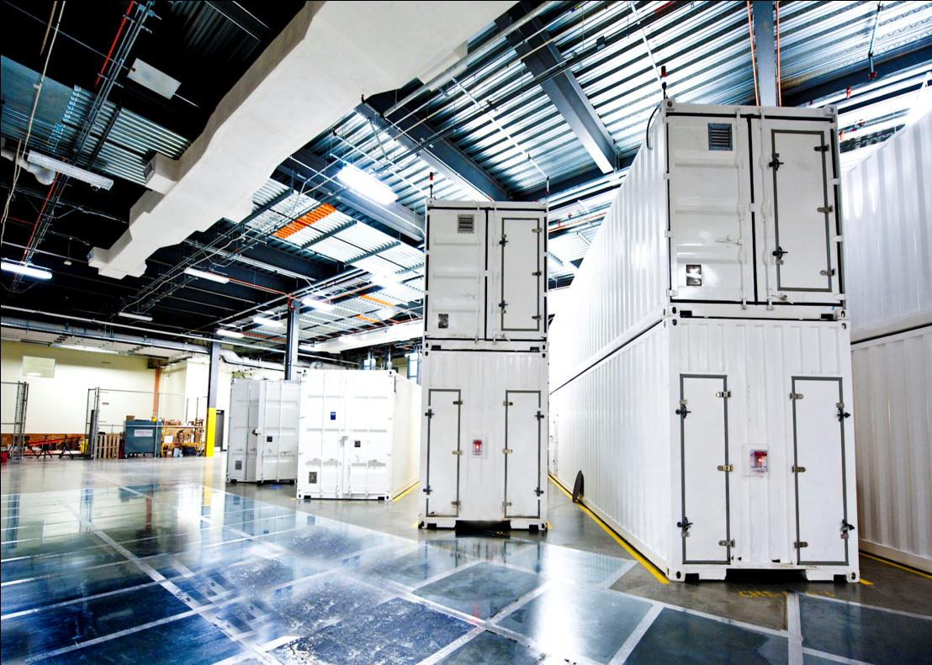
Azure data centers
West Europe
North Central US
North
Europe
South Central US
East Asia
Southeast Asia
 | Regional hosting locations
 | 200ms Latency from 2 regional hosting locations
 | Hosting locations within 100ms of the customer
 | At least one hosting location can be reached within 100ms, but not two
 | No points to test from or greater than 200ms latency

Slide 27
Pay-as-you-go model
  Small
  Medium
  Large
  X-Large
$0.12
$0.24
$0.48
$0.96
Per service hour
Per service hour
Per service hour
Per service hour
  Unit of Compute defined
  Equivalent compute capacity of a 1.6Ghz processor (on 64bit platform)
  Small
  Medium
  Large
  X-Large
1 x 1.6Ghz
2 x 1.6Ghz
4 x 1.6Ghz
8 x 1.6Ghz
(moderate IO)
(high IO)
(high IO)
(high IO)
1.75 GB memory
3.5 GB memory
7.0 GB memory
14 GB memory
250 GB storage
500 GB storage
1,000 GB storage
2,000 GB

Slide 28




Windows Azure Compute
Computation environment: code + configuration
Web Role
  Customized for Web app
  Hosted by IIS 7
Worker Role
  Performs background processing
  Inbound on any TCP port
Virtual Machine Role
  Windows Server 2008/2012/Ubuntu/openSUSE/CentOS
  .NET Framework – 3.5 SP1 and later
  Full admin access

Slide 29

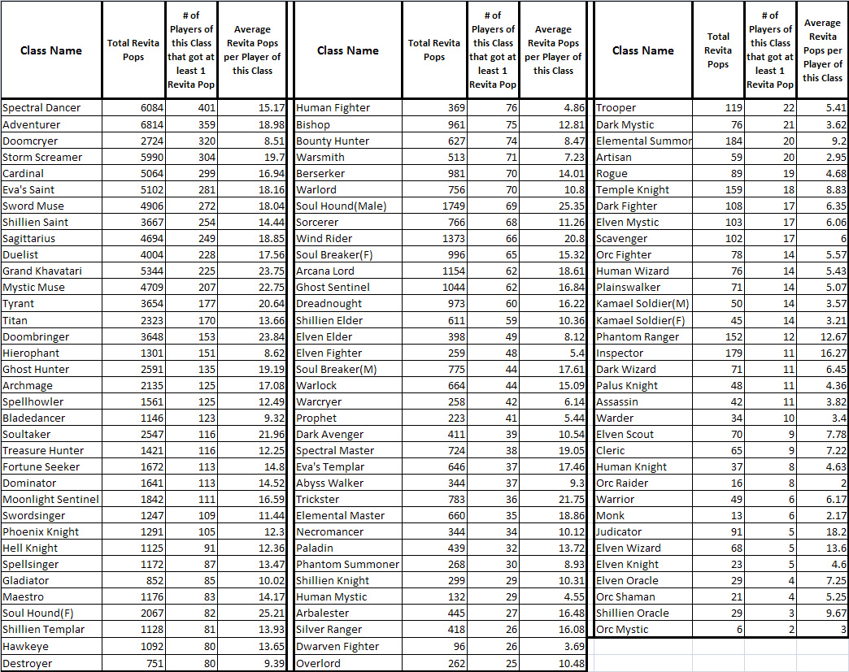

Windows Azure Storage
SQL Azure
  Familiar relational database
  Highly available, managed for you
  T-SQL
Windows Azure Tables
  Non-relational structured storage
  Scale-out, billions of rows
  OData
Windows Azure Blobs
  Big files
  REST

Slide 30
A WP application
with cloud support
Code is available at http://www2.cs.uh.edu/~rzheng/course/COSC7388fa12/

Slide 31
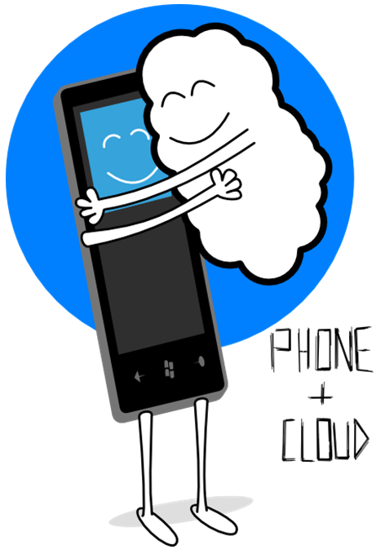

Why phone and cloud?
Phone
Connected
Pervasive
Marketplace
Cloud
Common endpoint
Scalable
Utility billing

Slide 32
Why WP7 and Windows Azure?
Common development tools
Emulator for development
Complementary application models
  Phone: sometimes on, connected
  Cloud always available, running

Slide 33
Microsoft Project Hawaii
New effort to investigate the ability of the cloud to enhance end-user experience on mobile devices
  Unleash the creative power of students
System & networking infrastructure for writing cloud-enhanced mobile applications
Software platform & materials to enable university Profs to offer courses in “mobile + cloud”

Slide 34
Hawaii cloud services
Path Prediction Service
This service enables a mobile application to predict a user’s destination based on current route data.
Translator Service
This service provides an interface to Microsoft Translator.
Relay Service
This service provides a relay point in the cloud that mobile applications can use to communicate.
Optical Character Recognition (OCR) Service
This service takes a photographic image that contains some text and returns the text.
Speech-to-Text Service
This service takes a spoken phrase and returns text (currently in English only).

Slide 35
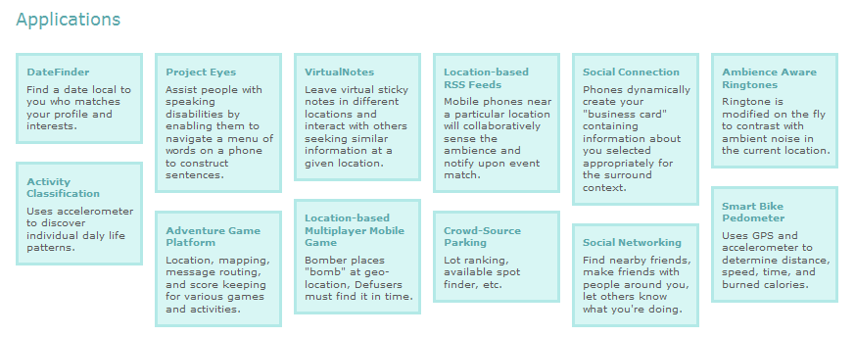
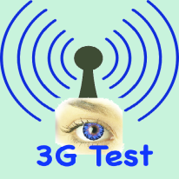
Sample applications

Slide 36

Setting up
your computer

Slide 37
Basic setup
Microsoft Visual Studio 2010/2012 Professional
(available at dept. office or https://www.dreamspark.com/)
.NET Framework (3.5 SP1 or later)
(installed with Visual Studio)
Windows Phone Developer Tool
(available at https://dev.windowsphone.com//en-us)
Windows Azure Tools for Microsoft Visual Studio
(http://www.microsoft.com/en-us/download/details.aspx?id=15658 or just google for it)
Project Hawaii Software Development Kit 2.0 (available at http://research.microsoft.com/en-us/projects/hawaii/)

Slide 38
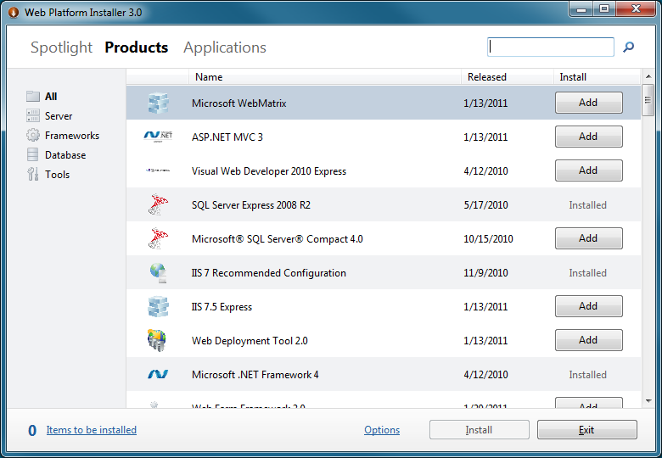
Advance setup
Configure your IIS to work with PHP, Java, Ruby …
Use Web Platform Installer

Slide 39
Unlock your phone (for free)
Register a Windows Live ID
Get a dreamspark student account
Join AppHub community with dreamspark account
($99/year but free for students)
Upload a WP7 “hello world” application to start the GeoTrust verification process
Provide your ID (Texas ID, Driver License, US Visa …) when contacted by GeoTrust
Contact AppHub to fully activate your developer account once verified by GeoTrust
Use Windows Phone Developer Registration tool to unlock your phone

Slide 40
References
[1] Tomer Shamam, Windows Phone 7 Development
[2] Tomer Shamam, Advanced Windows Phone 7.5 Applications
[3] Drue Reeves, Demystifying Cloud Computing
[4] Michael Crump, Getting Started with Windows Azure and Windows Phone 7
[5] Microsoft Research Asia, Location-Based Services on the Cloud
[6] Ben Pring, Cloud Computing: Moving From Hype to Reality
[7] Microsoft Project Hawaii, http://research.microsoft.com/en-us/projects/hawaii/
[8] Gary M. Weiss, Smart Phone-Based Sensor Mining, DMIN'11 Tutorial

