Slide 1
Social Media & Health Care

Slide 2
Overview
Spawn new technologies in healthcare
Patient communities
Social media for providers

Slide 3
New Technologies
Health 2.0 showcases and propels new health care technology.
  mySugr helps diabetics to manage their condition
  Nhumi.com improves communication between doctors and patients by providing a 3D-model of the entire human body in which diseases can be localized and described
  To overcome language barriers, universaldoctor.com helps translating between many different languages.
  Biovotion presented a sensor that monitors physiological functions non-invasively and thereby helps reducing hospital stays.
Engagement
Conversation
Community
Monitoring

Slide 4
Online Communities
Online communities facilitate exchange of information, seeking advices on disease management
  “Peer to peer healthcare”
  Patientslikeme and Curetogether for patients
  Sermo (20%) and Doximity as secure communities among physicians and medical professionals

Slide 5
E-Patients
E-Patients are defined as those "who are equipped, enabled, empowered and engaged in their health and health care decisions
The Pew Internet and American Life Project found:
  80% of internet users (or 59% of adults) have looked online for health information
  34% of internet users (or 25% of adults) have read someone else’s comments about health or medical issues in an online news group, website, or blog

Slide 6
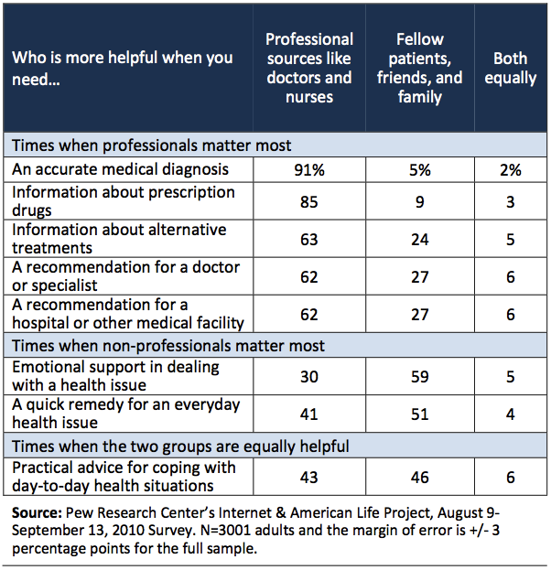

Slide 7
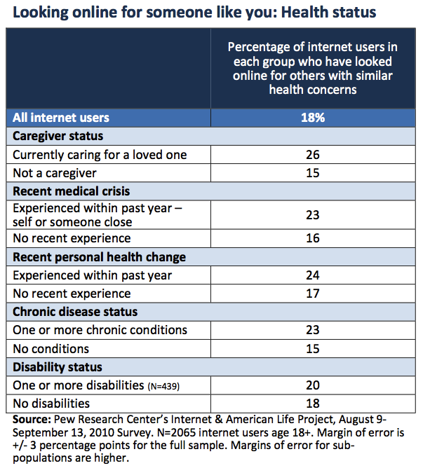

Slide 8
Personal Health Record (PHR)
Individual monitors, enters and maintains his/her health record
  Microsoft health vault (google health discontinued)
Convergence of PHR with EHR
Privacy considerations
  Accidental disclosure
  Insider curiosity
  Insider subordination
  Uncontrolled secondary usage
  Outsider intrusion

Slide 9
Why Google Health Failed?
Debut in May 2008, ended in June 2011
Limited support of the Continuity of Care Record standard
  Electronic health records still not prevalent enough
Lack of participation of healthcare provider
Lack of empowerment to the patients
  Patients are either unaware of PHR or have their data elsewhere (e.g., provider portal)
Lack of trust

Slide 10
Health Care Social Media List
State | Hospitals | YouTube | Facebook | Twitter | LinkedLn | 4Squre | Blog | Total
NY | 119 | 48 | 98 | 62 | 70 | 99 | 8 | 504
CA | 103 | 53 | 87 | 65 | 39 | 81 | 11 | 439
FL | 83 | 49 | 76 | 68 | 31 | 56 | 15 | 378
TX | 92 | 33 | 76 | 50 | 45 | 67 | 14 | 377
IL | 71 | 34 | 55 | 44 | 34 | 63 | 10 | 311
More data at http://network.socialmedia.mayoclinic.org/hcsml-grid/

Slide 11
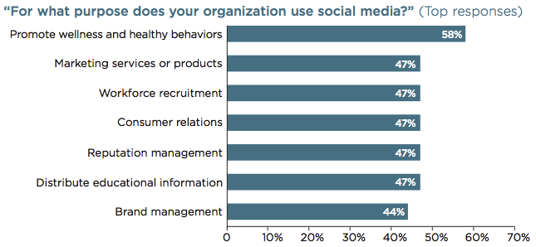
Survey on Social Media Usage in Hospitals
From “Ready to Interact: Social Media Use by U.S. Hospitals and Health Systems”

Slide 12
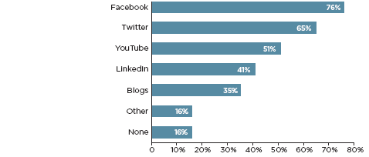
Forms of Social Media
From “Ready to Interact: Social Media Use by U.S. Hospitals and Health Systems”

Slide 13
Government Involvement
Department of Health and Human Services (HHS)
  HHS center for new media promotes and supports the strategic implementation of new media
  Health data initiatives
Center for disease control
  Flu.gov
  Emergency Preparedness and Response
FDA
  Working on guideline on use of social media for pharma
  Twitter to solicit inputs

Slide 14
Summary
Promising but chaotic
Facebook solves all?
Pharma
Government
/Policy
Patients
Healthcare provider
Device Vendor

Slide 15
References
Social Media in Health Care: Barriers and Future Trends http://www.ihealthbeat.org/perspectives/2010/social-media-in-health-care-barriers-and-future-trends.aspx
A Look at Social Media in Health Care -- Two Years Later http://www.ihealthbeat.org/perspectives/2012/a-look-at-social-media-in-health-care-two-years-later.aspx
Health 2.0 http://www.health2con.com/
Qualified self http://quantifiedself.com/
MedHelp, http://www.medhelp.org/

