Slide 1
Location, Location, Location
Under the Hood of Localization Services with Applications in Healthcare

Slide 2
Outline
Location-based services (LBS)
Localization techniques
Localization systems
Issues

Slide 3
Why do Companies and Governments Want Your Location Information?
Researchers Alasdair Allan and Pete Warden revealed that, since Apple released its latest iOS4 mobile operating system, the iPhone and iPad 3G have been storing unencrypted and unprotected logs of users' geographic coordinates in a hidden file.
In a statement, Google said, "All location sharing on Android is opt-in by the user. We provide users with notice and control over the collection, sharing and use of location in order to provide a better mobile experience on Android devices. Any location data that is sent back to Google location servers is anonymized and is not tied or traceable to a specific user."
Gov. Jerry Brown on Sunday vetoed a bill that would have required law enforcement officers to get a search warrant in order to obtain location information generated by a cellphone, tablet computer or automobile navigation system.

Slide 4
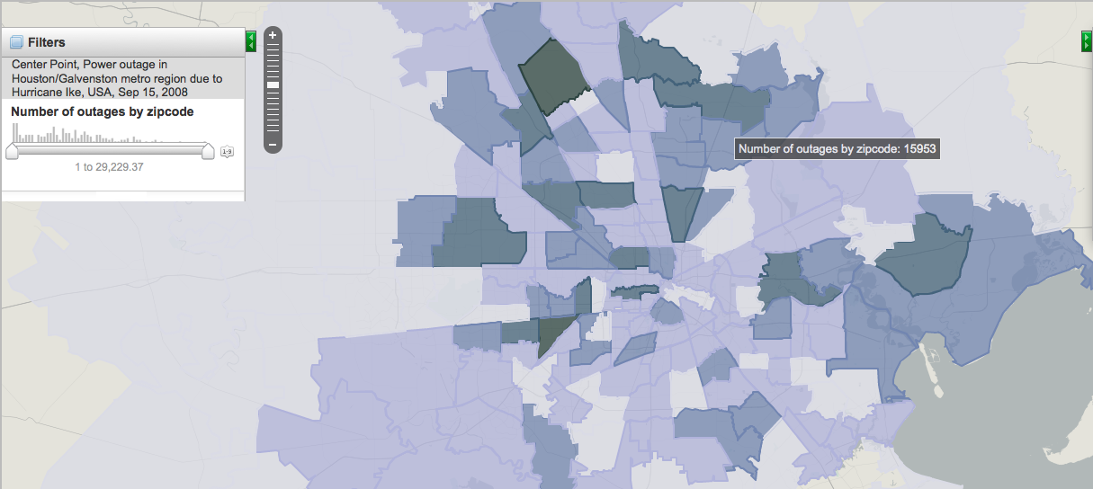
Location Information for the Greater Good

Slide 5
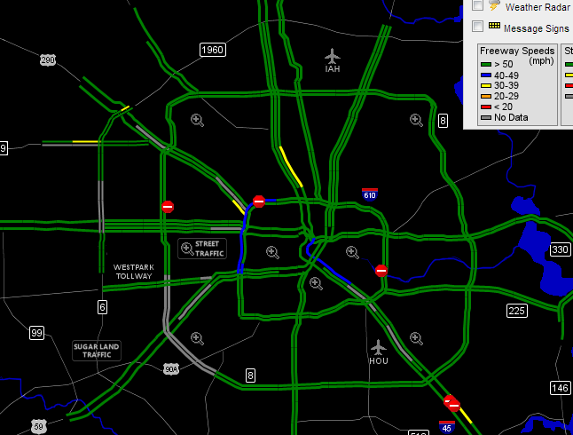
Location Information for the Greater Good

Slide 6
Locations
Three types of locations:
  Physical locations: coordinates, zip code
  Symbolic: Staff kitchen, Starbucks in Meyerland plaza, (IP addresses)
  Relative/proximity: within 10 miles of the university
Location-based services
  Information services accessible with mobile devices utilizing the ability to make use of the location of the mobile device
  “Where I am”, “What/who is close by”, “How to get to place A”

Slide 7
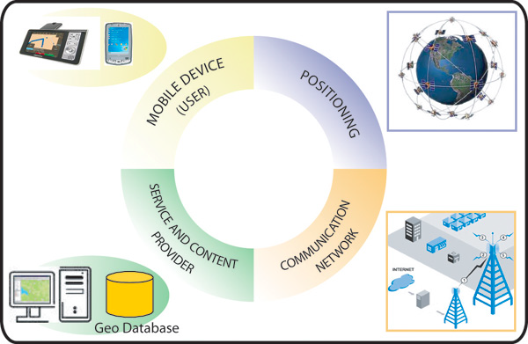
Components of LBS
Steiniger et al. “Fundation of Location Based Services“

Slide 8
Usage of LBS
Action | Questions | Operations
orientation & localisation locating | where am I? where is {person|object}? | positioning, geocoding, geodecoding
navigation navigating through space, planning a route | how do I get to {place name| address| xy}? | positioning, geocoding, geodecoding routing
search searching for people and objects | where is the {nearest | most relevant | &}{person | object}? | positioning, geocoding, calculating distance and area, finding relationships
identification identifying and recognising persons or objects | {what | who | how much} is {here | there}? | directory, selection, thematic/ spatial, search
event check checking for events; determining the state of objects | what happens {here | there}?

Slide 9
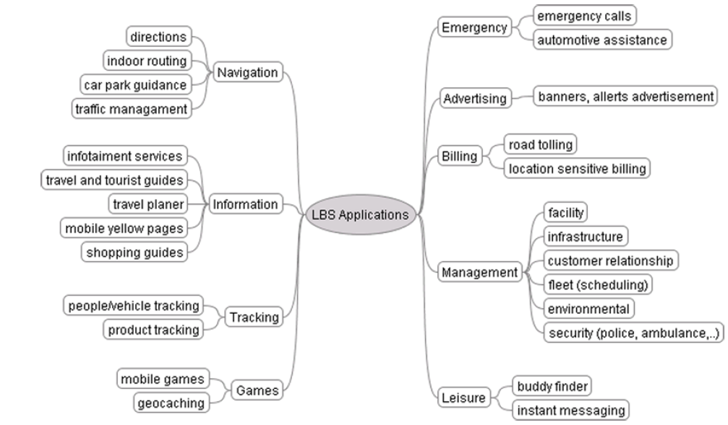
Categorization of LBS

Slide 10
In Healthcare…
Emergency services: triage, search & rescue
  Location of doctors, patients
Navigation services: direct me to the closest emergency room
Information services
  Time of wait in different hospitals
Tracking and management
  Patient, doctor, equipment tracking
Billing
  Location sensitive billing
  Fraud detection

Slide 11
Outline
Location-based services (LBS)
Localization techniques
Localization systems
Issues

Slide 12
A Taxonomy of Localization Techniques
Types of location (physical, symbolic, relative)
Granularity of location
How is infrastructure involved
  Infrastructure provides the location
  Mobile devices determine the location
Indoor vs outdoor
Signal used
  Wireless
  Inertial
  Optical
  Acoustic
  …

Slide 13
Wireless localization
GPS
Cellular E-911
WiFi-based indoor localization
Radio frequency Identifier (RFID)

Slide 14
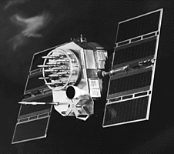
Global Position System (GPS)
GPS is a worldwide radio-navigation system formed from 24 satellites and their ground stations
  Uses satellites in space as reference points for locations here on earth
  Ground stations help satellites determine their exact location in space

Slide 15
GPS Orbit characteristics:
Semi-Major Axis (Radius): 26,600 km
Orbital Period : 11 h 58 min
Orbit Inclination: 55 degrees
Number of Orbit Planes: 6 (60 degree spacing)
Number of Satellites: 24 (4 spares)
Approximate Mass: 815 kg, 7.5 year lifespan
Data Rate (message): 50 bit/sec
PRN (Pseudo-Random Noise) Codes: Satellite-dependent Codes
Transmit, Frequencies L-Band L1: 1575.42 MHtz
L2: 1227.60 MHtz

Slide 16
GPS Control Segment
US Air Force and NIMA Control and Tracking Stations
Hermitage
MCS Colorado Springs
Bahrain
Hawaii
Kwajalein
Ascension
Ouito
Diego Garcia
Smithfield
Buenos Aires
US Airforce Tracking Sites
US Airforce Upload Sites
See also map at <http://164.214.2.59/GandG/sathtml>
MCS – Master Control Station
US NIMA Tracking Sites

Slide 17


How does GPS work?
12,500 km
11,200 km
11,500 km

Slide 18
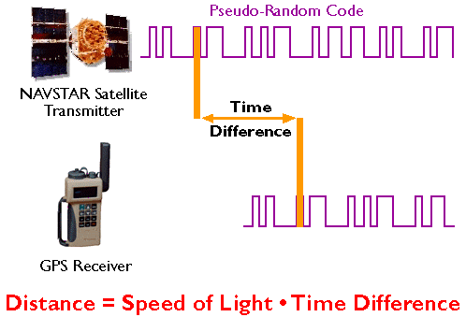
How to measure the distance
Solution 1
  Generate the same copy of the signal at the exactly the same time on the satellites and the ground unit
  Measure the time difference
delayed:“I cant fight this feeling any more,”
Local: “I can’t fight this feeling any more,”

Slide 19
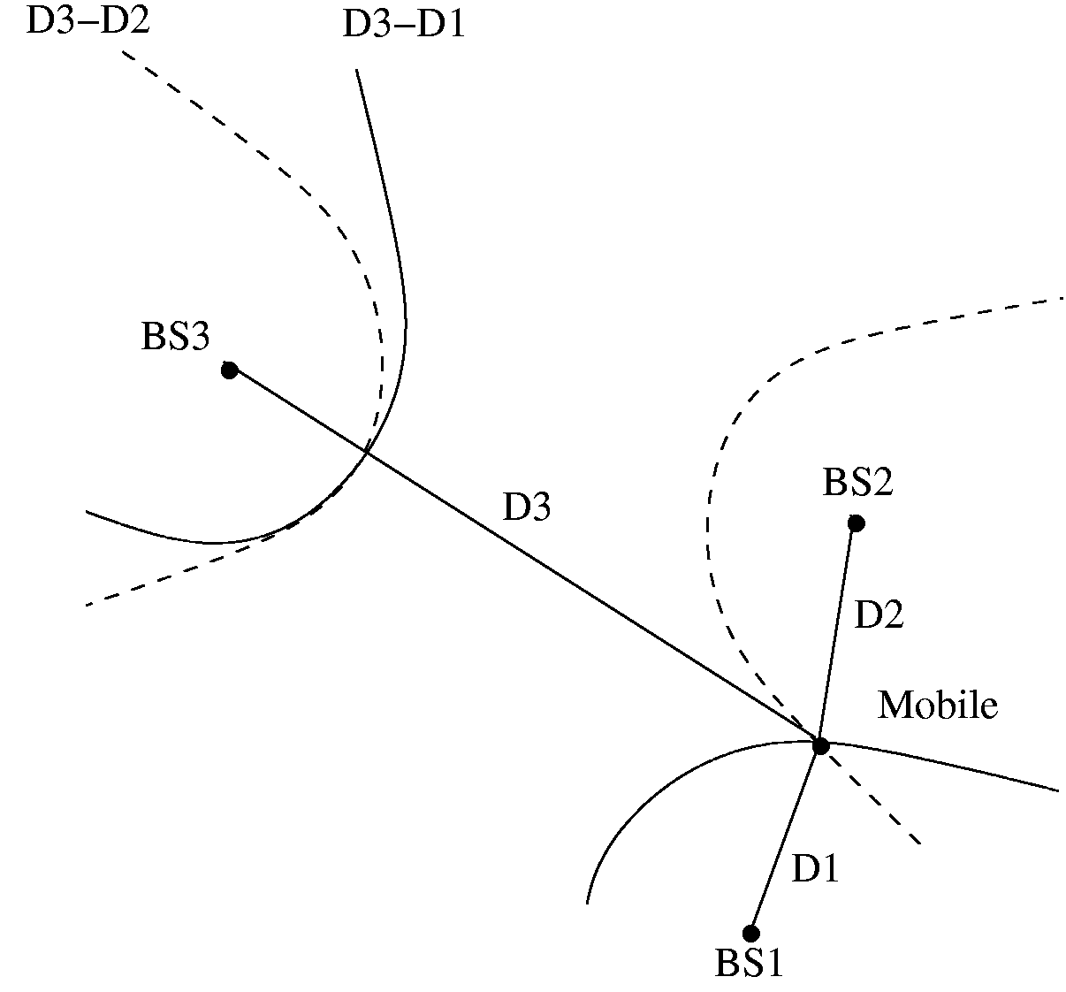
Time Difference of Arrival (TDOA)
3 anchors with known positions (at least) are required to find a 2D-position from a couple of TDOAs
In 3D, needs the 4th satellite!
Anchor 3 (x_{A3},y_{A3})
Anchor 2 (x_{A2},y_{A2})
Mobile (x_{m},y_{m})
Anchor 1 (x_{A1},y_{A1})
4 unknowns (x, y, z, time) and 4 knowns
Have the added benefit of synchronizing the clock on the ground unit

Slide 20
Where are the satellites?
Satellite master plan
Measurements from control stations
Broadcast the corrected ephemeris information

Slide 21
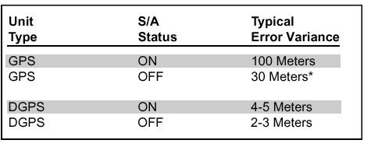
Sources of errors
Travel speed of EM wave in atmosphere
Multipath
Ephemeris Errors
Selective availaiblity

Slide 22
Differential GPS
A stationary receiver with precise known location corrects the errors with respect to particular set of satellites
Required additional radio link to receive the information

Slide 23
Cellular E-911
E911 Phase 1: Wireless network operators must identify the phone number and cell phone tower used by callers, within six minutes of a request by a PSAP.
E911 Phase 2: Wireless network operators must provide the latitude and longitude of callers within 300 meters
Solutions to phase 2
  Triangulation based on signal from multiple cell towers
  Assisted GPS
    Information used to acquire satellites more quickly: time & orbital data
    Calculation of position by the server using information from the GPS receiver

Slide 24
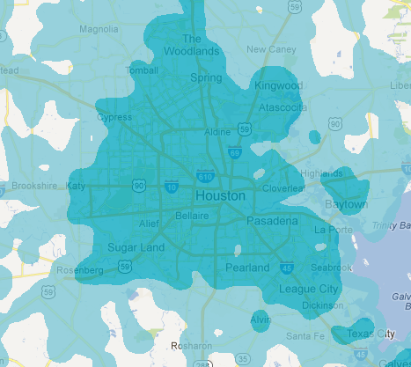
WiFi-based Indoor Localization
Weaker signal and rich multipath indoor make GPS highly inaccurate or inaccessible
WiFi infrastructure abundant
Skyhook has 275 employees, 240 of whom are drivers recording Wi-Fi signals (2008)
(why not yet killed by Google and Apple?)

Slide 25
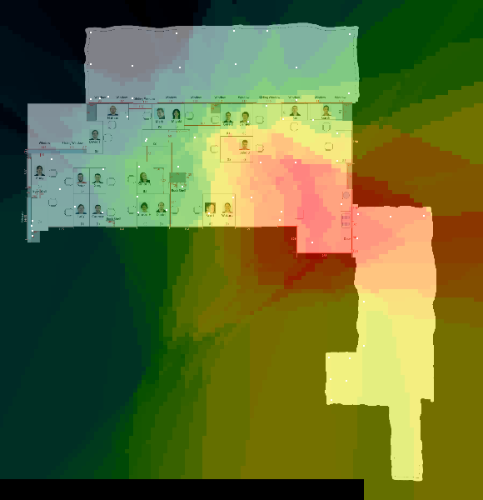
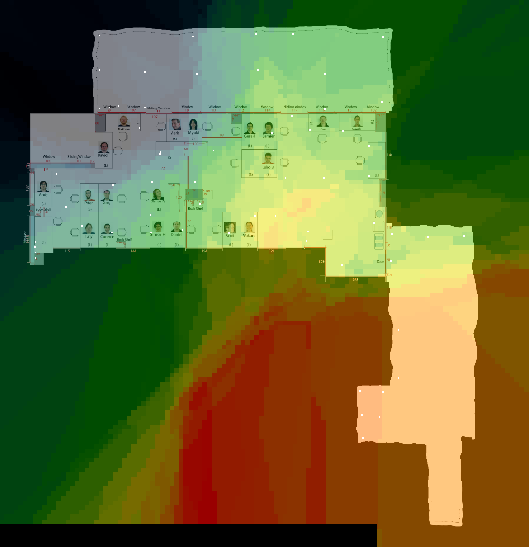
WiFi Fingerprinting
TOA, TODA, AOA are generally difficult to be estimated accurately with WiFi devices
Small-scale fading leads to large variations of received WiFi signal even when the device is stationary

Slide 26
Solution approach
Site Survey
Training
Model
f: RSS -> <x,y>
Location
new RSS readings

Slide 27
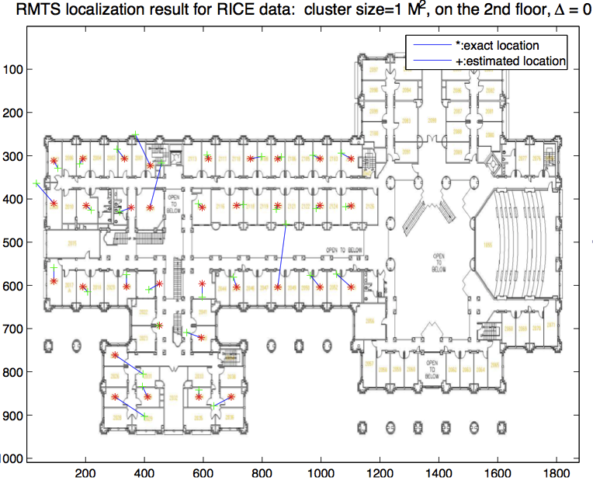
Localization result

Slide 28
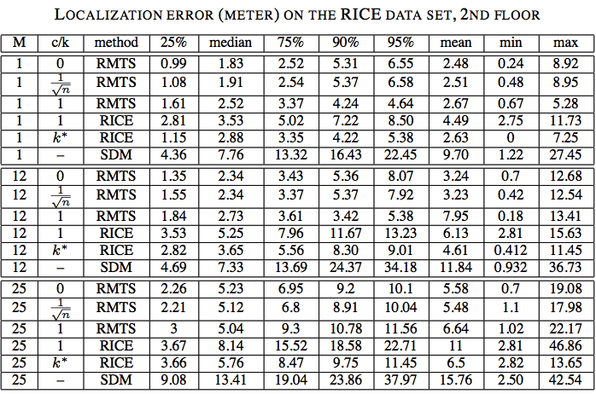
Location accuracy

Slide 29
Hybrid Localization Techniques
Challenges with FP-based Approaches
  Boils down to a supervised clustering approach
  Needs site survey
    Subject to changes
  Room-level accuracy
  Map required to determine the symbolic locations
Other sensing modalities
  Inertial sensors: accelerometers, gyro sensor, magnetometer/compass
  Ranging sensors: acoustic, infrared, ultra-wide band RF, laser

Slide 30
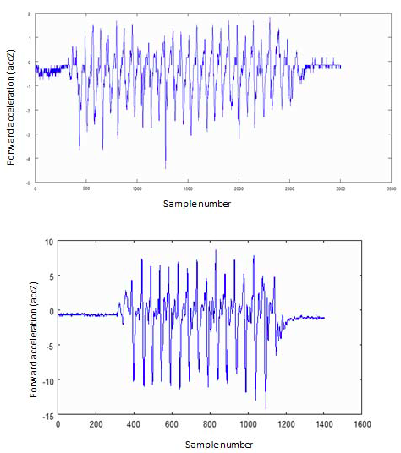
Accelerometer readings while walking

Slide 31
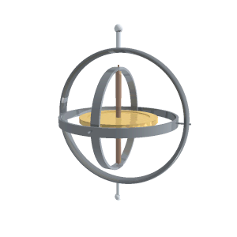

Gyroscope
Rotary Gyroscope
MEMS vibrating Structure Gyroscope

Slide 32
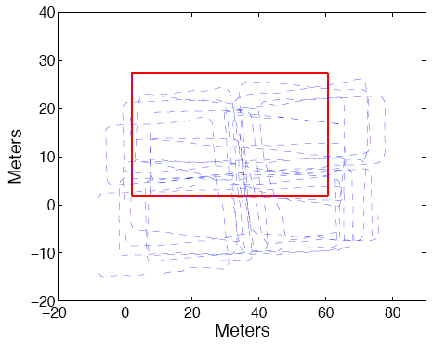
Challenges with inertial sensing
Combining accelerometer and gyro, we can obtain displacement and turn information
Noise is cumulative
Sensor orientation and placement matter

Slide 33
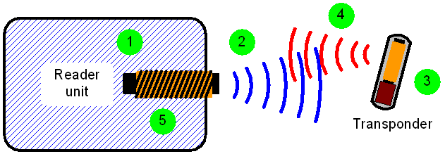
RFID for proximity sensing
Active and passive tags

Slide 34
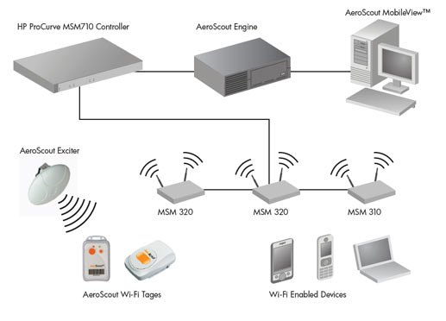
Example Localization systems
AeroScout
  WiFi based location using RSS and TDOA
  AeroScout tag: WiFi and low-freq radio, battery powered
  Exciter: Adjustable range from 50cm to 6m
  “Choke point”

Slide 35
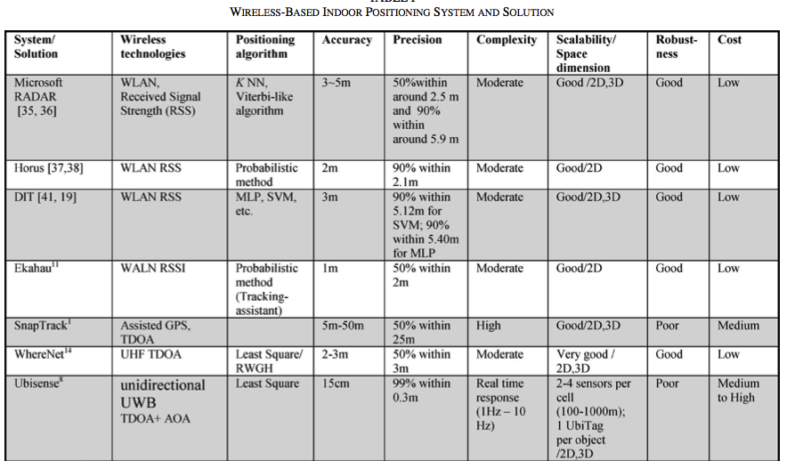
Liu et al. Survey of Wireless Indoor Positioning
Techniques and Systems

Slide 36
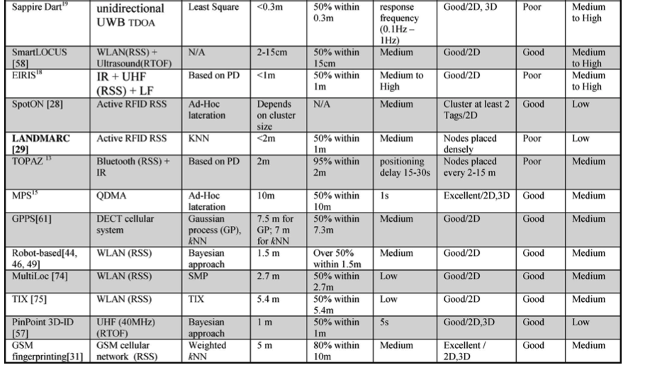
Wireless indoor location solutions

Slide 37
WiFi Slam
Location SDK
WiFi + Inertial sensors
Inertial sensors only
http://www.youtube.com/watch?v=B_GdXp_Swjs
http://www.wifislam.com/blog/2012/10/29/sneak-peek-wifislam-without-wi-fi-2/

Slide 38
Real-time Locating System (RTLS) in hospitals
Continuously track each patient's location
Track the location of doctors and nurses in the hospital
Track the location of expensive and critical instruments and equipment
Restrict access to drugs, pediatrics, and other high-threat areas to authorized staff
Monitor and track unauthorized persons who are loitering around high-threat areas
Facilitate triage processes by restricting access to authorized staff and "approved" patients during medical emergencies, epidemics, terrorist threats, and other times when demands could threaten the hospital's ability to effectively deliver services
Use the patient's RFID tag to access patient information for review and update through a hand-held computer

Slide 39
RFID RTLS Solutions Abound
The Royal Alexandra Hospital uses a hospital-wide RFID asset tracking virtual asset library in order to (Vilamovska et al., 2008)
  improve the use of its assets;
  ensure the availability of medical devices at the point of need;
  streamline routine scheduled maintenance;
  reduce health and safety risks resulting from failure to meet scheduled inspection plans.
Radianse Reveal Asset Tracking platform
  Southern Ohio Medical Center uses it to increase its efficiency of asset and equipment tracking
Bon Secours Richmond Health System deployed the largest RFID- enabled mobile asset management programs in US healthcare industry
Memorial Medical Center in Long Beach (CA) and Shelby County Regional Medical Center uses RFID for emergency department workflow improvement
  Cut the first triage nurse from 1hr 20 min to 9 min for incoming patients

Slide 40
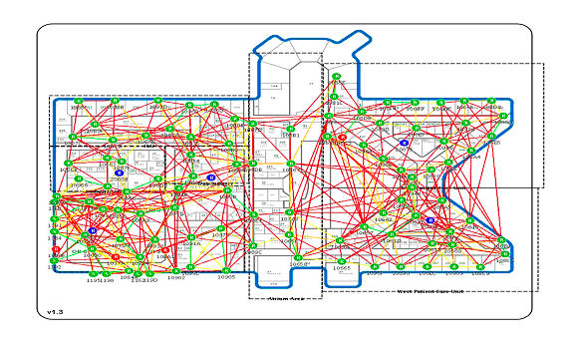
AwarePoint
RFID asset tracking sensors are simply plugged in to standard electrical outlets to form the Awarenet® mesh network (Zigbee)
Active tag using Zigbee allows continuous update

Slide 41
Issues with LBS
Control
  e.g. LBS for navigation
Trust
  With whom to share locations with
Privacy & security
  e.g., proximity to a hospital location may indicate illness
  e.g., RFID readers on highways can track speeding
  e.g., Jill at Audi dealership – intent to purchase a vehicle

Slide 42
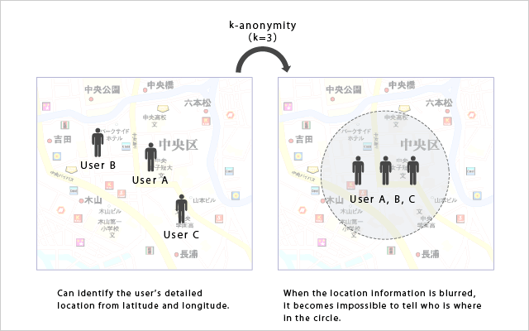
Location Privacy
K anonymity
Use of decoys
The challenges is the tradeoff between privacy and utility

