Slide 1
Mobile and Cloud Computing
COSC7388 Spring 2011
Dr. Rong Zheng

Slide 2
Top 10 Strategic Technology in 2011*
2010
Cloud computing
Advanced analytics
Client computing
IT for green
Reshaping the data center
Social computing
Security – activity monitoring
Flash memory
Virtualization for availability
Mobile applications
2011
Cloud computing
Mobile applications & media tablets
Next generation analytics
Social analytics
Social communication and collaboration
Video
Context-aware computing
Ubiquitous computing
Storage class memory
Fabric-based infrastructure and computers
*http://www.gartner.com/it/page.jsp?id=1454221
Notes:
Gartner defines a strategic technology as one with the potential for significant impact on the enterprise in the next three years. Factors that denote significant impact include a high potential for disruption to IT or the business, the need for a major dollar investment, or the risk of being late to adopt.

Slide 3
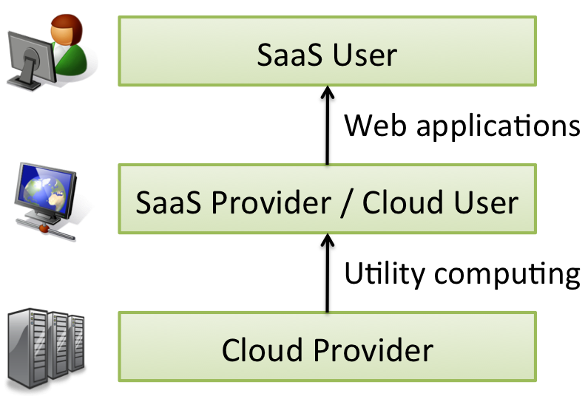
What is Cloud Computing
Utility computing
  Applications delivered as services over the Internet and
  Hardware and systems software in the datacenters that provide those services.
What is unique
  Illusion of infinite computing resources available on demand
  Elimination of an up-front commitment by Cloud users
  Ability to pay for use of computing resources on a short-term basis as needed
Saas: Software as a Service

Slide 4
Mobile Computing
Bob Metcalfe, 1995
  “Mobile wireless computers are like mobile pipeless bathrooms – portapotties. They will be common on vehicles, and at construction sites, and rock concerts. My advice is to wire up your home and stay there.”
Mobile computing is a form of human-computer interaction where a computer is expected to be transported during normal usage
  Mobile (wireless) communication
  Mobile hardware: wearable computers, smart phones, PDAs, mobile laptops
  Mobile software: system and application ➔ emphasis of the class

Slide 5
Pervasive/ubiquitous Computing
Different from mobile computing (see Mark Weiser’s pioneer paper)
To make “computer” disappear
  Embedded technologies: sensors and actuators
  HCI

Slide 6
Why Mobile & Cloud?
Mobiles
Ubiquitous and distributed
Portability of physical devices
Limited storage
Limited computation power
Limited bandwidth
Context aware
Clouds
Centralized
Portability of software
“infinite” storage
“infinite” computation power
Context agnostic

Slide 7

Why Mobile & Cloud?
Narrow view: mobiles as a portal to cloud
  All computing done inside the cloud
Broader view: integration of mobiles and the cloud
  Contextual information from mobiles
  Enhancing mobile experience by cloud
  Mobile cloud
Cloud
Mobiles

Slide 8
Scope of the Course
Primarily focus on system and applications of mobile and cloud computing
  You are expected to be familiar with OS, computer networks, wireless technologies
  Programming is the means not the goal
System side
  Cloud platforms, services and resource management
  Abstraction for mobile computing
  Security and privacy
Application side
  Mobile apps

Slide 9
Logistics
Lectures, guest lectures, project proposal/status update/final presentations
20+ papers
  Sign up for presentation today
  Paper critiques required from everyone BEFORE class
  Presentation slides ready 2 days ahead for feedbacks
  Bonus for extra presentations
Survey report
Semester long projects
  <= 3 students per group
  Platform of your choice
  Final report

Slide 10
Paper Critiques
Three paragraphs:
What problems does the paper address?
  Are they important?
  What has been done so far?
How are the problems addressed?
  Solution techniques (theory, algorithms, implementation …)
  Effectiveness of the solution
Your assessment
  Is the solution valid/effective?
  Does the proposed approach solve the problem?
  Is the evaluation thorough?
  Better solution? Extension of the work?

Slide 11
Microsoft Hawaii
Microsoft research initiative on the creation of a set of cloud-enabled mobile applications and associated support services
  Many institutional participants
Forms of support
  Phones (5 Samsung fusion phones, Mobile 7)
  Azure and other cloud services (cloud storage, computing, Rendezvous, OCR, Relay, speech to text)
  Online forum
  Hawaii best project award
Huy Nguyen will help with Hawaii related issues encountered
http://research.microsoft.com/en-us/um/redmond/projects/hawaii/

Slide 12
Introduction to Mobile Computing
Objectives:
the basic conception of mobile computing;
a quick overview of wireless technologies
Readings:
Satyanarayanan, M., Fundamental challenges in mobile computing, PODC '96: Proceedings of the fifteenth annual ACM symposium on Principles of distributed computing, pp. 1--7, ACM, New York, NY, USA, 1996
Mark Weiser, Some computer science issues in ubiquitous computing. Commun. ACM 36, 7 (July 1993), 75-84

Slide 13
Applications
Vehicles
Nomadic user
Smart mobile phone
Invisible computing
Wearable computing
Intelligent house or office
Meeting room/conference
Taxi/Police/Fire squad fleet
Service worker
Lonely wolf
Disaster relief and Disaster alarm
Games
Military / Security

Slide 14
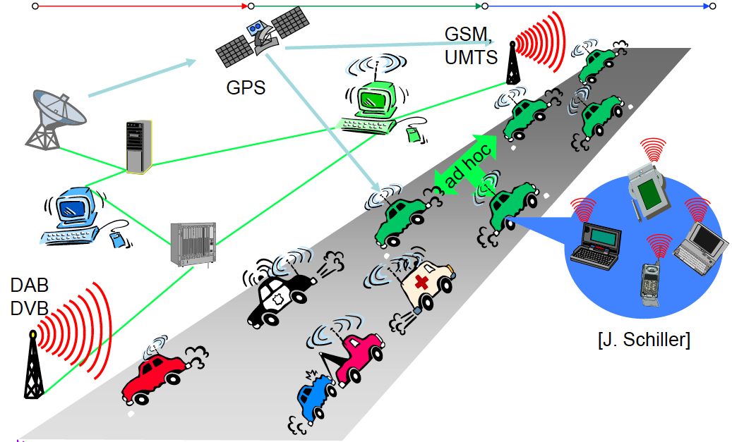
Vehicles

Slide 15
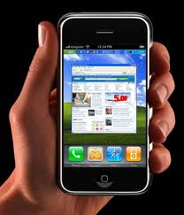
Smart mobile phone
Voice calls, video calls
Social networking
Email or instant messaging
Play games
Up-to-date localized information
  Map
  Pull: Find the next Pizzeria
  Push: “Hey, we have great Pizza!”
Stock/weather/sports info
Ticketing
Trade stock
etc.

Slide 16
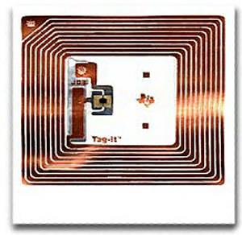
Object Tracking
Book, pallet, packet, airline baggage, container, truck tracking
Identification badges for building/car access control or animal identfication
Electronic toll collection
Electronic cash in smart cards or credit cards
Prisoner tracking
Store checkout as cashier replacement

Slide 17
Disaster Relief
After earthquake, tsunami, volcano, etc:
You cannot rely on infrastructure but you need to orchestrate disaster relief
Early transmission of patient data to hospital
Satellite
Ad-Hoc network

Slide 18
Drivers of Mobile Computing
Ubiquitous connectivity (infrastructure or ad hoc)
Reduced cost of storage, access, computing
Location services (GPS, cellular, WiFi, …)
Display technologies
Sensing technologies (MEMS)

Slide 19
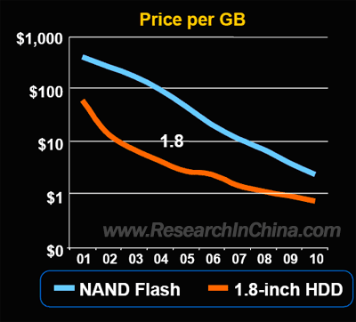
Cost of Storage

Slide 20
Wireless Bandwidth

Slide 21
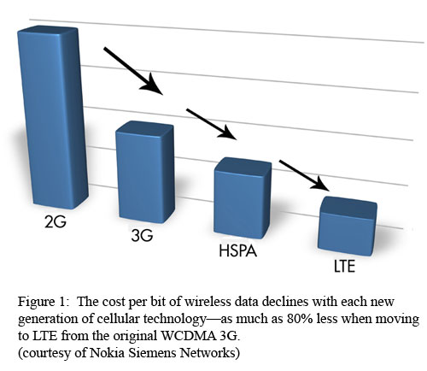
Cost of Bits

Slide 22
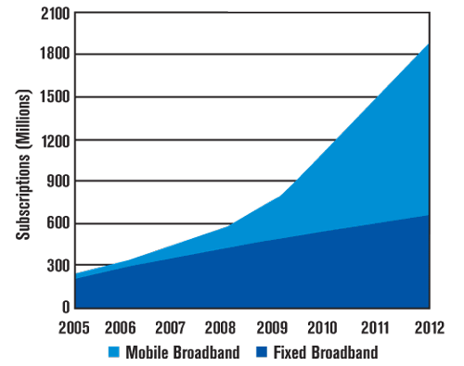
Growth of Mobile subscribers

Slide 23
Battery Technologies ☹
No Moore’s law for batteries or solar cells
CPU: power consumption ~ CV2f
  C: total capacitance, reduced by integration
  V: supply voltage, can be reduced to a certain limit
  f: clock frequency, can be reduced temporally

Slide 24
Limitation of Mobile Computing (a 96 view)
Mobile elements are resource-poor relative to static elements
Mobility is inherently hazardous
Mobile connectivity is highly variable in performance and variability
Mobile elements rely on a finite energy source
Bit/Hz cost for mobile data remains to be high

Slide 25
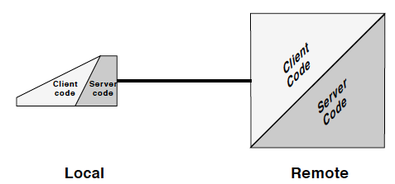
Tension between Autonomy and Interdependence
Resource pool devices; safety hazard → needs of server (cloud) supports
Variability of connectivity → needs for local storage and computation

Slide 26
Challenges in Mobile Computing (a 96’s view)
Caching metrics
Consistency
Resource revocation
Agility vs stability
Global estimation from local observations

Slide 27
Challenges in Mobile Computing (Today’s View)
All above but more,
Energy management
Privacy and security
Platform diversity (for development)

