Slide 1
Mobile and Cloud Computing
COSC7388 Spring 2011
Dr. Rong Zheng

Slide 2
Introduction to Cloud Computing

Slide 3
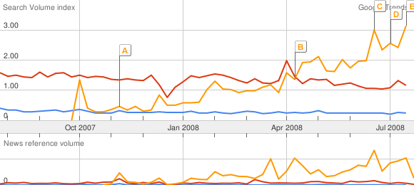
The Hype
Cluster Computing
Cloud Computing
Grid Computing

Slide 4
What is Cloud Computing?
Web-scale problems
Large data centers
Different models of computing
Highly-interactive Web applications

Slide 5
1. Web-Scale Problems
Characteristics:
  Definitely data-intensive
  May also be processing intensive
Examples:
  Crawling, indexing, searching, mining the Web
  “Post-genomics” life sciences research
  Other scientific data (physics, astronomers, etc.)
  Sensor networks
  Web 2.0 applications
  …

Slide 6
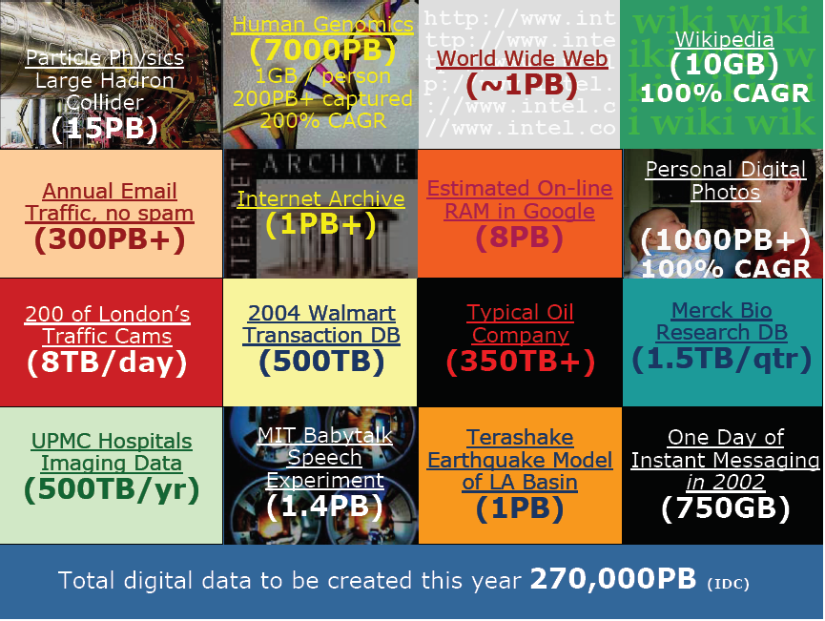
Notes:
slides borrowed from
Data-Rich Computing: Where It’s At @hadoop summit 2008
Phillip B. GibbonsIntel Research Pittsburgh

Slide 7
What to do with more data?
Answering factoid questions
  Pattern matching on the Web
  Works amazingly well
Learning relations
  Start with seed instances
  Search for patterns on the Web
  Using patterns to find more instances
Who shot Abraham Lincoln? → X shot Abraham Lincoln
(Brill et al., TREC 2001; Lin, ACM TOIS 2007)
(Agichtein and Gravano, DL 2000; Ravichandran and Hovy, ACL 2002; … )

Slide 8
2. Large Data Centers
Web-scale problems? Throw more machines at it!
Clear trend: centralization of computing resources in large data centers
  Necessary ingredients: fiber, juice, and space
  What do Oregon, Iceland, and abandoned mines have in common?
Important Issues:
  Redundancy
  Efficiency
  Utilization
  Management

Slide 9
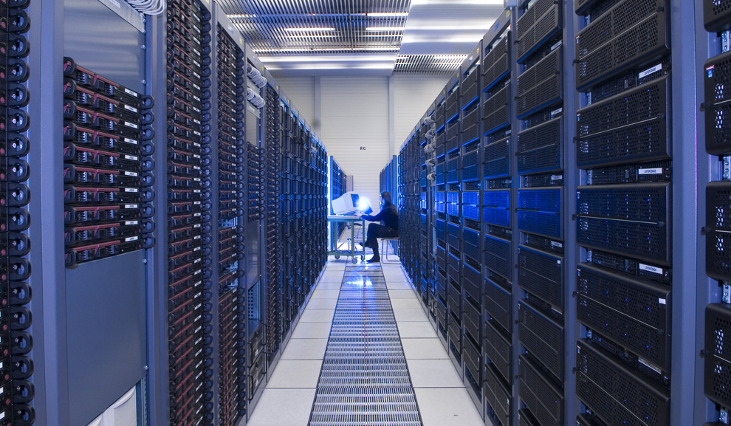
Maximilien Brice, © CERN

Slide 10
Key Technology: Virtualization
App
App
App
App
App
App
OS
OS
OS
Operating System
Hypervisor
Hardware
Hardware
Traditional Stack
Virtualized Stack

Slide 11





Data Center Networking
Internet
Data Center
Core
Layer-3 router
Aggregation
Layer-2/3 switch
Access
Layer-2 switch
Servers

Slide 12
3. Different Computing Models
Utility computing
  Pay as your go
  Why buy machines when you can rent cycles?
  Examples: Amazon’s EC2, GoGrid, AppNexus
Platform as a Service (PaaS)
  Give me nice API and take care of the implementation
  Example: Google App Engine
Software as a Service (SaaS)
  Just run it for me!
  Example: Gmail
Lower-level,
Less management
Higher-level,
More management
EC2
Azure
AppEngine
Force.com

Slide 13
4. Web Applications
What is the nature of software applications?
  From the desktop to the browser
  SaaS == Web-based applications
  Examples: Google Maps, Facebook
How do we deliver highly-interactive Web-based applications?
  AJAX (asynchronous JavaScript and XML)
  For better, or for worse…

Slide 14
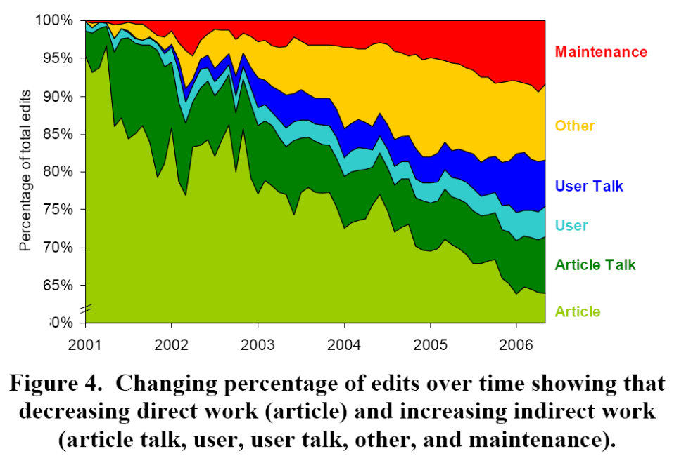
Example: Wikipedia Anthropology
Kittur, Suh, Pendleton (UCLA, PARC), “He Says, She Says: Conflict and Coordination in Wikipedia” CHI, 2007
Increasing fraction of edits are for
work indirectly related to articles
Experiment
  Download entire revision history of Wikipedia
  4.7 M pages, 58 M revisions, 800 GB
  Analyze editing patterns & trends
Computation
  Hadoop on 20-machine cluster
Notes:
3 slides from
“Data Intensive Super Computing”
Randal E. Bryant, Carnegie Mellon University

Slide 15
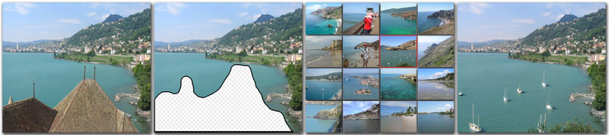
Example: Scene Completion
Image Database Grouped by Semantic Content
  30 different Flickr.com groups
  2.3 M images total (396 GB).
Select Candidate Images Most Suitable for Filling Hole
  Classify images with gist scene detector [Torralba]
  Color similarity
  Local context matching
Hays, Efros (CMU), “Scene Completion Using Millions of Photographs” SIGGRAPH, 2007
Computation
  Index images offline
  50 min. scene matching, 20 min. local matching, 4 min. compositing
  Reduces to 5 minutes total by using 5 machines
Extension
  Flickr.com has over 500 million images …

Slide 16
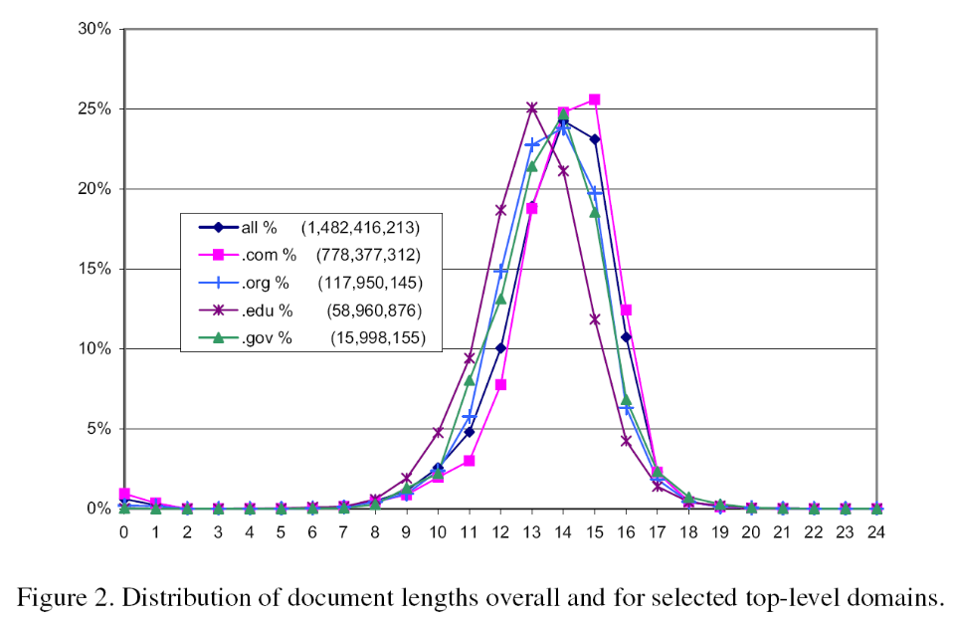
Example: Web Page Analysis
Fetterly, Manasse, Najork, Wiener (Microsoft, HP), “A Large-Scale Study of the Evolution of Web Pages,” Software-Practice & Experience, 2004
Experiment
  Use web crawler to gather 151M HTML pages weekly 11 times
    Generated 1.2 TB log information
  Analyze page statistics and change frequencies
Systems Challenge
  “Moreover, we experienced a catastrophic disk failure during the third crawl, causing us to lose a quarter of the logs of that crawl.”

Slide 17
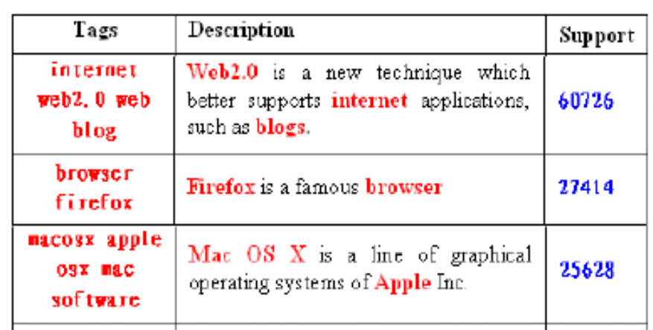
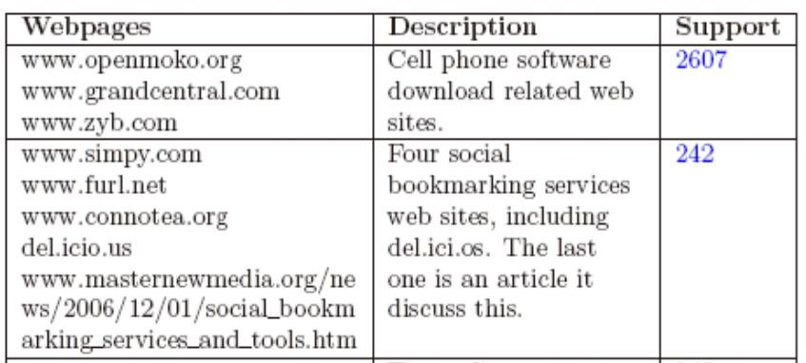
Example: Data Mining
Haoyuan Li, Yi Wang, Dong Zhang, Ming Zhang, Edward Y. Chang: Pfp: parallel fp-growth for query recommendation. RecSys 2008: 107-114
del.icio.us crawl->a bipartite graph covering 802739 Webpages and 1021107 tags.

Slide 18
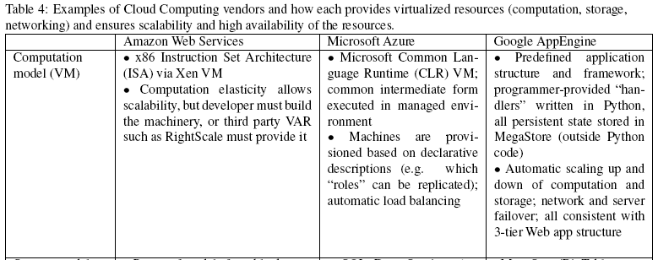
Behind the Scene

Slide 19
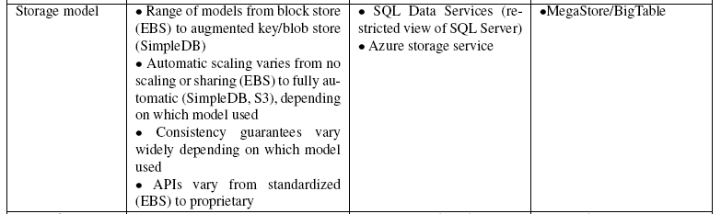
Behind the Scene

Slide 20
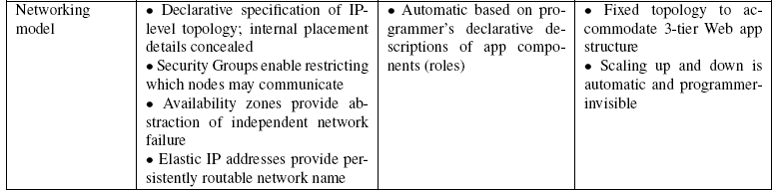
Behind the Scene

Slide 21
Economics of Cloud Users
Pay by use instead of provisioning for peak
Capacity
Resources
Resources
Demand
Capacity
Demand
Time
Time
Static data center
Data center in the cloud
Unused resources

Slide 22
Economics of Cloud Users
Risk of over-provisioning: underutilization
Capacity
Unused resources
Resources
Demand
Time
Static data center

Slide 23

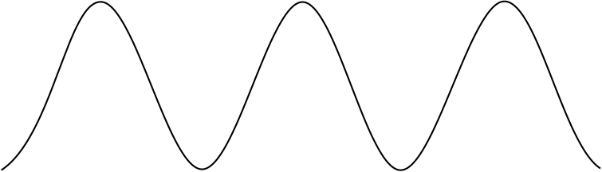
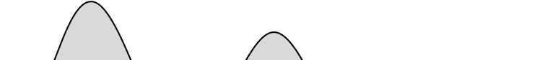

Economics of Cloud Users
Heavy penalty for under-provisioning
Resources
Capacity
Demand
Resources
Capacity
1
2
3
Time (days)
Demand
Lost revenue
1
2
3
Time (days)
Resources
Capacity
Demand
1
2
3
Time (days)
Lost users

Slide 24
Economics of Cloud Providers
5-7x economies of scale [Hamilton 2008]
Extra benefits
  Amazon: utilize off-peak capacity
  Microsoft: sell .NET tools
  Google: reuse existing infrastructure
Resource | Cost in Medium DC | Cost in Very Large DC | Ratio
Network | $95 / Mbps / month | $13 / Mbps / month | 7.1x
Storage | $2.20 / GB / month | $0.40 / GB / month | 5.7x
Administration | ≈140 servers/admin | >1000 servers/admin | 7.1x

Slide 25
Adoption Challenges
Challenge | Opportunity
Availability | Multiple providers & DCs
Data lock-in | Standardization
Data Conﬁdentiality and Auditability | Encryption, VLANs, Firewalls; Geographical Data Storage

Slide 26
Growth Challenges
Challenge | Opportunity
Data transfer bottlenecks | FedEx-ing disks, Data Backup/Archival
Performance unpredictability | Improved VM support, flash memory, scheduling VMs
Scalable storage | Invent scalable store
Bugs in large distributed systems | Invent Debugger that relies on Distributed VMs
Scaling quickly | Invent Auto-Scaler that relies on ML; Snapshots

Slide 27
Policy and Business Challenges
Challenge | Opportunity
Reputation Fate Sharing | Offer reputation-guarding services like those for email
Software Licensing | Pay-for-use licenses; Bulk use sales

Slide 28
Short Term Implications
Startups and prototyping
One-off tasks
  Washington post, NY Times
Cost associativity for scientific applications
Research at scale

Slide 29
Long Term Implications
Application software:
  Cloud & client parts, disconnection tolerance
Infrastructure software:
  Resource accounting, VM awareness
Hardware systems:
  Containers, energy proportionality

