Slide 1
A Tutorial on Windows Phone 7 and Windows Azure
COSC7388 Spring 2011
Huy Nguyen

Slide 2
Outline
Introduction to Azure Service Platform
Project Hawaii
Setting up your computer
Building Windows Phone 7 application with Windows Azure Platform
Migrating your application to the Cloud & unlock your phone

Slide 3



Cloud Service Classification
Consume
Software
as-a-Service
Build
Platform
as-a-Service
Host
Infrastructure
as-a-Service

Slide 4
Cloud Service Classification
IaaS
PaaS
SaaS
On-Premise
You manage
Data / Users
You manage
Data / Users
Data / Users
Data / Users
Application
Application
Application
Application
Runtime
Runtime
Runtime
Runtime
Managed by vendor
You manage
Database
Database
Database
Database
Managed by vendor
O/S
O/S
Managed by vendor
O/S
O/S
Virtualization
Virtualization
Virtualization
Virtualization
Server HW
Server HW
Server HW
Server HW
Storage
Storage
Storage
Storage
Networking
Networking
Networking
Networking

Slide 5

Azure Service Platform
Microsoft cloud platform (PaaS)
On-demand services hosted on Microsoft Data Centers
Cloud operating system
Provide set of services that allows
  Development
  Management
  Hosting of applications off-premise
Commercially available: 1 Feb 2010.

Slide 6
















Azure Service Platform
Internet
  Developer Experience
  Use existing Skills and Tools
platform
AppFabric
Compute
Storage
Billing &
Payments
Information Marketplace
Relational data
Connectivity
Management
CDN
Management
Access control
Flexible APIs
Reporting & BI

Slide 7
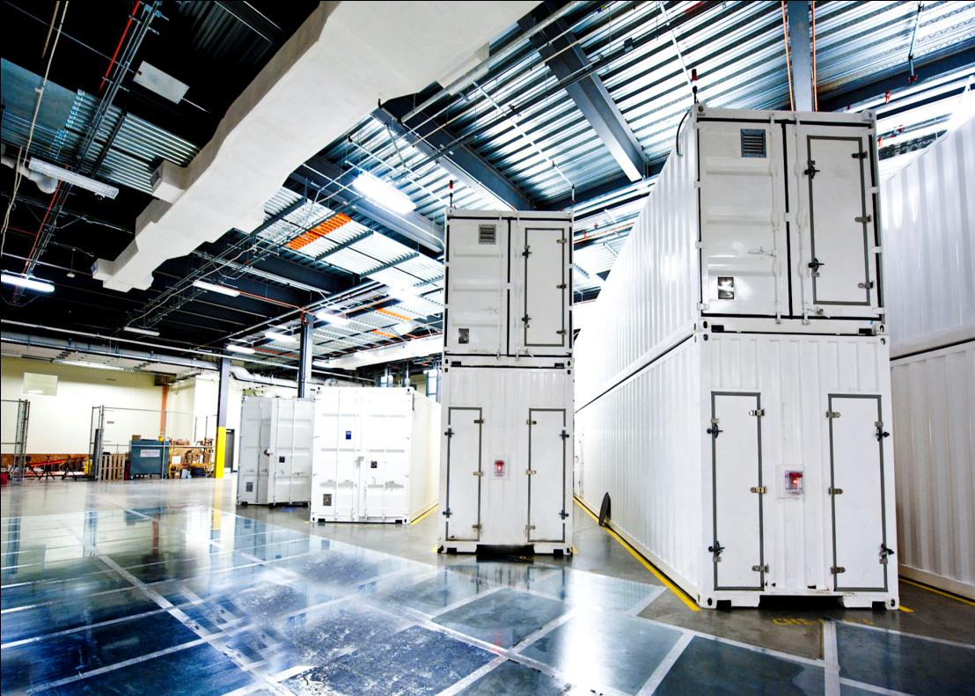
Azure Data Centers
West Europe
North Central US
North
Europe
South Central US
East Asia
Southeast Asia
 | Regional hosting locations
 | 200ms Latency from 2 regional hosting locations
 | Hosting locations within 100ms of the customer
 | At least one hosting location can be reached within 100ms, but not two
 | No points to test from or greater than 200ms latency

Slide 8
Pay-as-you-go
  Small
  Medium
  Large
  X-Large
$0.12
$0.24
$0.48
$0.96
Per service hour
Per service hour
Per service hour
Per service hour
  Unit of Compute defined
  Equivalent compute capacity of a 1.6Ghz processor (on 64bit platform)
  Small
  Medium
  Large
  X-Large
1 x 1.6Ghz
2 x 1.6Ghz
4 x 1.6Ghz
8 x 1.6Ghz
(moderate IO)
(high IO)
(high IO)
(high IO)
1.75 GB memory
3.5 GB memory
7.0 GB memory
14 GB memory
250 GB storage
500 GB storage
1,000 GB storage
2,000 GB

Slide 9




Windows Azure Compute
Computation environment: code + configuration
Web Role
  Customized for Web app
  Hosted by IIS 7
Worker Role
  Performs background processing
  Inbound on any TCP port
Virtual Machine Role
  Windows Server 2008 R2
  .NET Framework – 3.5 SP1 and 4.0
  Supports Full Trust but no Admin rights

Slide 10
Windows Azure Storage
Scalable storage in the cloud
  100tb per storage account
  Auto-scale to meet massive volume and throughput
Accessible via RESTful Web Service API
  Access from Windows Azure Compute
  Access from anywhere via internet
  Supporting .NET Client Library
Various storage types

Slide 11

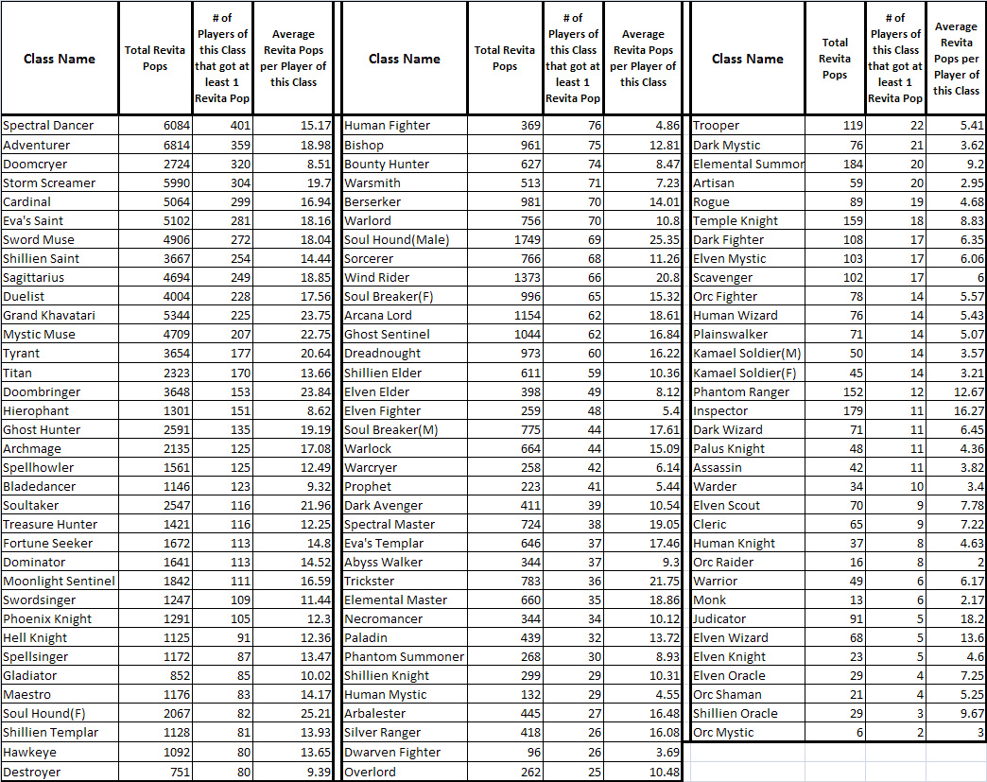

Windows Azure Storage
SQL Azure
  Familiar relational database
  Highly available, managed for you
  T-SQL
Windows Azure Tables
  Non-relational structured storage
  Scale-out, billions of rows
  OData
Windows Azure Blobs
  Big files
  REST

Slide 12
Windows Azure AppFabric
Cloud middleware platform
Connect Windows Azure Platform applications with existing applications and databases
Bridging on-premise and off-premise applications
Exposed through open protocols
Accessible from anywhere

Slide 13
Hello Azure
Hello WP7
Code is available online at http://www2.cs.uh.edu/~rzheng/course/COSC7388sp11/

Slide 14

Hawaii Academic
Outreach Program

Slide 15
Project Hawaii
New effort to investigate the ability of the cloud to enhance end-user experience on mobile devices
  Unleash the creative power of students
System & networking infrastructure for writing cloud-enhanced mobile applications
Software platform & materials to enable university Profs to offer courses in “mobile + cloud”

Slide 16


Why Phone and Cloud?
Phone
Connected
Pervasive
Marketplace
Cloud
Common endpoint
Scalable
Utility billing

Slide 17
Why WP7 and Windows Azure?
Common development tools
Emulator for development
Complementary application models
  Phone: sometimes on, connected
  Cloud always available, running

Slide 18
Project Hawaii Success Metrics
New courses offered at Universities with Windows technologies
New cloud enabled applications
New back-end cloud services
A generation of student developers trained on Microsoft platforms

Slide 19
Sample Hawaii Application
(provided to students in source code form)
Find My Phone
Scenario
  User loses their phone (oops).
  Logs into the “Find My Phone” website.
  Issues request for the phone to report in
  Views the phone’s location on a map.
What’s involved
  Windows Azure - for hosting “find-my-phone” web and database services
  Windows Live ID Authentication - for web site login
  Hawaii Notification Service - persistent alerting channel
  Hawaii Location Service - to get current Latitude/Longitude/Altitude
  Bing Map Service - maps and imagery for a particular location

Slide 20
Hawaii Cloud Services
Exclusive for project participants (that’s us)
Many more to come !!
Service Name | Provider
Compute | Azure
Storage | Azure
Authentication | Windows Live ID
Mapping | Bing Maps
Location | Orion
Notification | MSR
Application Depot | MSR
Rendezvous/Relay | MSR
Speech <-> Text | MSR
OCR | MSR

Slide 21
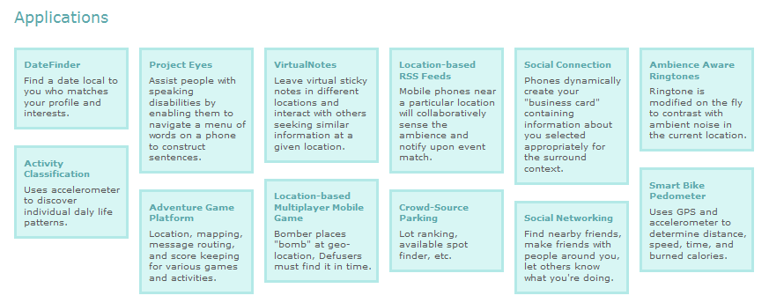

Student Written Applications

Slide 22
Hawaii Forum
Ask questions and share knowledge.
Discussion forum is on MSR’s community server:
  http://community.research.microsoft.com
  Hawaii Project forum is private.
  Students create an account for themselves
    See “Join” link at top of main page.
  Email hiforum@microsoft.com for account name
  http://community.research.microsoft.com/forums/149.aspx

Slide 23

Setting up
your computer

Slide 24
Basic Setup
Microsoft Visual Studio 2010 Professional
(available at dept. office or https://www.dreamspark.com/)
.NET Framework 3.5 SP1 or 4.0
(installed with VS 2010)
Windows Phone Developer Tool
(available at http://create.msdn.com/en-us/)
Windows Azure Tools for Microsoft Visual Studio
(http://www.microsoft.com/downloads/en/details.aspx?FamilyID=7a1089b6-4050-4307-86c4-9dadaa5ed018&displaylang=en
or just google for it)

Slide 25
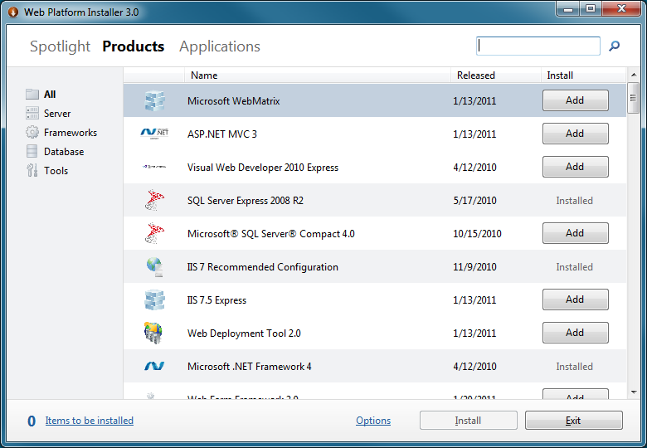
Advance Setup
Configure your IIS to work with PHP, Java, Ruby …
Use Web Platform Installer

Slide 26
Storing data with
Windows Azure Table
Code is available online at http://www2.cs.uh.edu/~rzheng/course/COSC7388sp11/

Slide 27
Deploy app onto
the cloud
Code is available online at http://www2.cs.uh.edu/~rzheng/course/COSC7388sp11/

Slide 28
Unlock your phone (for free)
Register a Windows Live ID
Get a dreamspark student account
Join AppHub community with dreamspark account
($99/year but free for students)
Upload a WP7 “hello world” application to start the GeoTrust verification process
Provide your ID (Texas ID, Driver License, US Visa …) when contacted by GeoTrust
Contact AppHub to fully activate your developer account once verified by GeoTrust
Use Windows Phone Developer Registration tool to unlock your phone

Slide 29
Thank you !!

