Slide 1
Dynamo: Amazon’s Highly Available Key-value Store
COSC7388 – Advanced Distributed Computing
Presented By:
Eshwar Rohit
0902362

Slide 2
Outline
Introduction
Background
Architectural Design
Implementation
Experiences & Lessons learnt
Conclusions

Slide 3
INTRODUCTION

Slide 4
Challenges for Amazon
Reliability at massive scale.
Strict operational requirements performance and efficiency.
Highly decentralized, loosely coupled, service oriented architecture.
Diverse set of services.
Notes:
slightest outage has significant financial consequences and impacts customer trust
Persistent state needs to be managed in the face of these failures

Slide 5
Dynamo
Dynamo, a highly available and scalable distributed data store built for Amazon’s platform.
Simple key/value interface
“always writeable” data store
Clearly defined consistency window
Operation environment is assumed to be non-hostile
Built for latency sensitive applications
Each service that uses Dynamo runs its own Dynamo instances.
Notes:
Unique features of Dyanmo
Always writable---For a number of Amazon services, rejecting customer updates could result in a poor customer experience.

Slide 6
BACKGROUND

Slide 7
Why not use RDBMS
Services only store and retrieve data by primary key (no complex querying)
Replication technologies are limited
Not easy to scale-out databases
Load balancing not easy
Notes:
Excess functionality requires expensive hardware and highly skilled personnel for its operation, making it a very inefficient solution

Slide 8
Service Level Agreements (SLA)
Provide a response within 300ms for 99.9% of its requests for a peak client load of 500 requests per second.
Notes:
Guarantee that the application can deliver its functionality in a bounded time, each and every dependency in the platform needs to deliver its functionality with even tighter bounds.

Slide 9
Design Considerations
Optimistic replication techniques. Why?
Conflict resolution. When? Who?
Incremental scalability
Symmetry
Decentralization
Heterogeneity
Notes:
strong consistency and high data availability cannot be achieved simultaneously
changes are allowed to propagate to replicas in the background, and concurrent, disconnected work is tolerated
Traditionally conflict resolution –writes & simple read complexity. writes may be rejected if all replicas have not been accessed. So do it during reads
Who? data store (last write wins)or the application(suitable conflict resolution scheme)

Slide 10
SYSTEM ARCHITECTURE

Slide 11
System Architecture
Focus is on core distributed systems techniques used in Dynamo:
Partitioning, Replication, Versioning, Membership, Failure handling, Scaling.

Slide 12
System Interface
get(key): locates and returns a single object or a list of objects with conflicting versions along with a context.
put(key, context, object): determines where the replicas of the object should be placed based on the associated key, and writes the replicas to disk.
Context encodes system metadata such as version of the object.
Notes:
Simple interface with two operations.

Slide 13
Partitioning Algorithm
Scale incrementally.
Dynamically partition the data over the set of nodes.
Consistent hashing
Node assigned a random value the represents its “position” on the ring.
Data item’s key is hashed to yield its position on the ring.
Challenges:
    Non-uniform data and load distribution.
    Oblivious to the heterogeneity.
Solution: Virtual Nodes
  Each node can be responsible for more than one virtual node.
Advantages
  Load balancing when a node becomes unavailable.
  Load balancing when a node becomes available or a new node is added.
  Handling Heterogeneity.
Notes:
The number of virtual nodes that a node is responsible can decided based on its capacity, accounting for heterogeneity in the physical infrastructure.

Slide 14
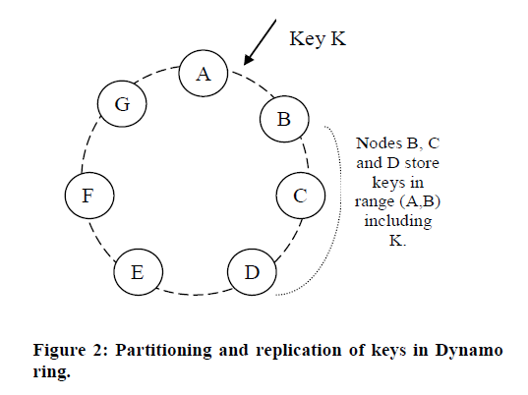
Partitioning & Replication

Slide 15
Replication
High availability and durability.
Data item is replicated at N hosts. N is a parameter configured “per-instance”.
Coordinator is responsible for key, k, replicates at N-1 nodes.
Preference list for a key has only distinct physical nodes (spread across multiple data centers) and has more than N nodes.
Notes:
The list of nodes that is responsible for storing a particular key is called the preference list.

Slide 16
Data Versioning
Eventual consistency.
Allows for multiple versions to be present in the system at the same time.
Syntactic reconciliation
    System determines the authoritative version.
    Cannot resolve conflicting versions.
Semantic reconciliation
    Client does the reconciliation.
Technique: Vector Clocks
    A list of (node, counter) pairs associated with each object
    Counters on the first object’s clock <= to all of the nodes in the second clock, then the first is an ancestor of the second, otherwise, the two changes are considered to be in conflict and require reconciliation.
    Context contains the Vector Clock info.
    Certain failure scenarios may lead to very long vector clocks
Notes:
Each modification results in new and immutable version of the data
Reconciliation: collapse multiple branches of data evolution back into one authoritative version
eventual consistency allows for updates to be propagated to all replicas asynchronously
client must perform the reconciliation in order to collapse multiple branches of data evolution back into one

Slide 17
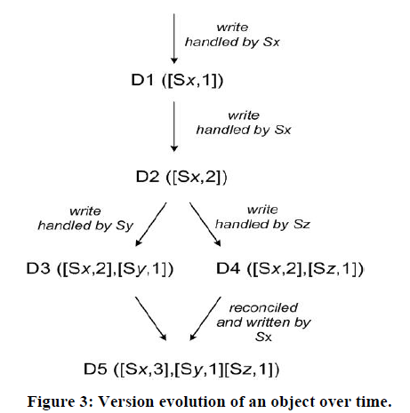
Data Versioning

Slide 18
Execution of get () and put () operations
Any storage node in Dynamo is eligible to receive client get and put request for any key.
Two strategies to select a coordinator node
    Load balancer
    Partition-aware client library
Read and write operations involve the first N healthy nodes in the preference list
Notes:
Load balancer that will select a node based on load information. Adv: Application independent of Dynamo specific code.
Partition-aware client library routes requests directly to the appropriate coordinator (first among the top N nodes in the preference list) nodes. Adv: lower latency because it skips a potential forwarding step.

Slide 19
Execution of get () and put () operations
Put() request:
    Coordinator generates the vector clock for the new version
    Writes the new version locally.
    The coordinator then sends the new version to the N highest-ranked reachable nodes. If at least W-1 nodes respond then the write is considered successful. (W is minimum number of nodes on which write has to be successful to complete a put request W<N)
Get() request:
    Coordinator requests from the N highest-ranked reachable nodes in the preference list, and then waits for R responses. (R is the minimum number of nodes that need to respond to complete a get request in-order to account for any divergent versions)
    In case of multiple versions of the data, syntactic or semantic reconciliation is done.
    Reconciled versions are written back.

Slide 20
Handling Failures: Hinted Handoff
Durability
Scenario
Works best if the system membership churn is low and node failures are transient
Notes:
A is temporarily down during a write operation
A replica that would normally have lived on A will now be sent to node D.
The replica sent to D will have a hint in its metadata that suggests which node was the intended recipient of the replica (in this case A).
Upon detecting that A has recovered, D will attempt to deliver the replica to A.
Once the transfer succeeds, D may delete the object from its local store without decreasing the total number of replicas in the system.

Slide 21
Handling permanent failures: Replica synchronization
Scenarios under which hinted replicas become unavailable before they can be returned to the original replica node.
Uses an anti-entropy protocol.
Merkle Trees:
    detect the inconsistencies between replicas faster
    minimize the amount of transferred data
Dynamo uses Merkle trees for anti-entropy:
    Each node maintains a separate Merkle tree for each key range.
    Two nodes exchange the root of the Merkle tree corresponding to the key ranges that they host in common.
    Determine any differences and perform the appropriate synchronization action.
    Disadvantage: requires the tree(s) to be recalculated when a node joins or leaves the system.
Notes:
A Merkle tree is a hash tree where leaves are hashes of the values of individual keys. Parent nodes higher in the tree are
hashes of their respective children.
Fig 1 frm my drawings

Slide 22
Merkle Tree
K1 – K7
HASHED VALUES OF CHILDREN
K1 – K5
K6– K7
K1 – K3
K4 – K5
K6 – K7
k1
k2
k3
k4
k5
k6
k7
HASHES OF VALUES OF INDIVIDUAL KEYS
Notes:
A Merkle tree is a hash tree where leaves are hashes of the values of individual keys. Parent nodes higher in the tree are
hashes of their respective children.

Slide 23
Membership and Failure Detection
Ring Membership
    A gossip-based protocol
    Nodes are mapped to their respective token sets (Virtual nodes) and mapping is stored locally.
    Partitioning and placement information also propagates via the gossip-based protocol.
    May temporarily result in a logically partitioned Dynamo ring.
External Discovery
    Some Dynamo nodes play the role of seeds.
    All nodes eventually reconcile their membership with a seed.
Failure Detection
    Avoid failed attempts at communication.
    Decentralized failure detection protocols use a simple gossip-style protocol
Notes:
A gossip-based protocol propagates membership changes.
Each node contacts a peer chosen at random every second to reconcile membership changes

Slide 24
Summary of Techniques
Problem | Technique | Advantage
Partitioning | Consistent Hashing | Incremental Scalability
High Availability for writes | Vector clocks with reconciliation during reads | Version size is decoupled from update rates.
Handling temporary failures | Hinted handoff | Provides high availability and durability guarantee when some of the replicas are n
Recovering from permanent failures | Anti-entropy using Merkle trees | Synchronizes divergent replicas in the background
Membership and failure detection | Gossip-based membership protocol and failure detection | Preserves symmetry and avoids having a centralized registry for storing membership and node liveness information.

Slide 25
IMPLEMENTATION

Slide 26
IMPLEMENTATION
Each client request results in the creation of a state machine.
State machine for read request:
    Send read requests to the nodes,
    Wait for minimum number of required responses
    If too few replies within a time bound, fail the request
    Otherwise gather all the data versions and determine the ones to be returned
    Perform reconciliation, write context.
Read Repair
    State machine waits for a small period of time to receive any outstanding responses.
    Stale versions are updated by the coordinator.
    Less load on anti-Entropy.
Write operation:
    Write requests are coordinated by one of the top N nodes in the preference list
Notes:
logic for identifying the nodes responsible for a key, sending the requests, waiting for responses, potentially doing retries, processing the replies and packaging the response to the client.

Slide 27
Experiences & lessons learnt

Slide 28
Durability & Performance
Typical SLA: 99.9%of the read and write requests execute within 300ms.
Observations from experiments:
    Diurnal behavior
    write latencies are higher than read latencies
    99.9th percentile latencies are an order of magnitude higher than the average.
Optimization policy for some customer facing services.
    Nodes equipped with object buffer in main memory.
    faster reads & writes but less durable
    Durable Writes
Notes:
several factors such as variability in request load, object sizes, and locality patterns. (critique y 99.9 latency is far greater than average and also these experiments are done in a homogenous environment also the NRW 3,2,2 reasons not very clearly explained)

Slide 29
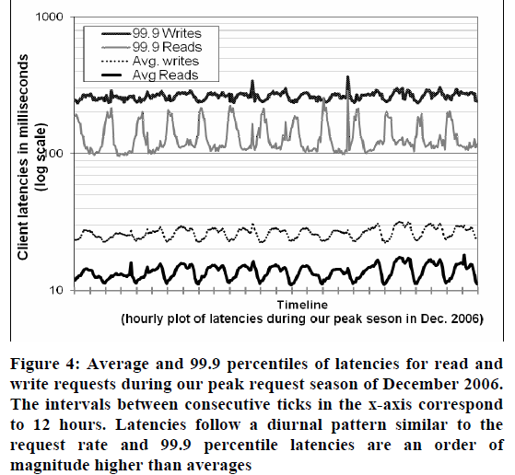

Slide 30
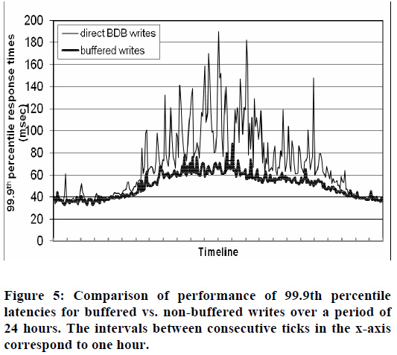

Slide 31
Ensuring Uniform Load distribution
Uniform key distribution
Access distribution of key non-Uniform
Spread the Popular keys
Out of balance (>15% deviation from avg load)
Observations from figure 6:
    low loads - imbalance ratio - 20%
    high loads - imbalance ratio - 10%
Notes:
Under high loads, a large number of popular keys are accessed and due to uniform distribution of keys the load is evenly distributed
During low loads, fewer popular keys are accessed, resulting in a higher load imbalance

Slide 32
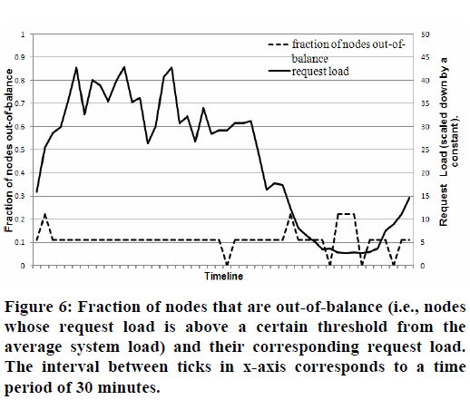

Slide 33
Dynamo’s partitioning scheme
Strategy 1: T random tokens per node and partition by token value
Strategy 2: T random tokens per node and equal sized partitions
    Advantages :
      decoupling of partitioning and partition placement
      enabling the possibility of changing the placement scheme at runtime.
Strategy 3: Q/S tokens per node, equal-sized partitions
    Divide the hash space into Q equally sized partitions. (S number of physical nodes)
Notes:
Scanning local persistence store (to retrieve the appropriate set of data items to be handed to new node).
process of archival is complicated

Slide 34
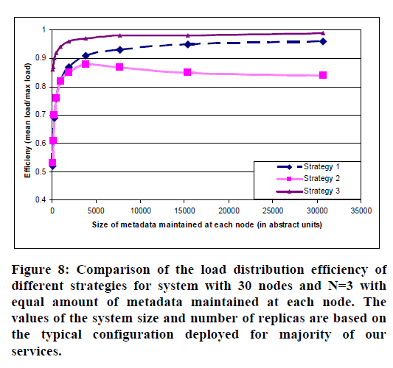

Slide 35
Divergent Versions: When and
How Many?
Two scenarios
    When the system is facing failures (node failures, data center failures, and network partitions.)
    When the system is handling a large number of concurrent writers to a single data item and multiple nodes end up coordinating the updates concurrently.
For a shopping cart service over 24 hrs
    1 version -99.94%
    2 versions - 0.00057%
    3 versions - 0.00047%
    4 versions - 0.00009%
Notes:
Increase in Divergent versions not due to failures but due to the increase in number of concurrent writers.
concurrent writes is usually triggered by busy robots

Slide 36
Client-driven or Server-driven
Coordination
Server Driven (load balancer):
    Read request: Any Dynamo node
    Write request: Node in the key’s preference list
Client Driven:
    state machine moved to the client nodes
    Client periodically picks a random Dynamo node to obtain the preference list for any key.
    Avoids extra network hop.

Slide 37
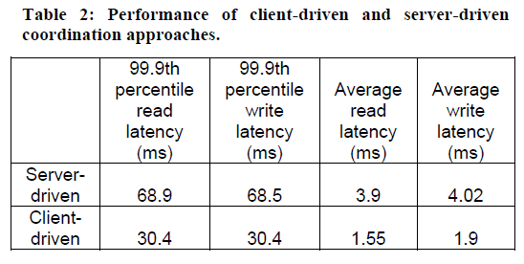
Client-driven or Server-driven
Coordination

Slide 38
Balancing background vs foreground tasks
Background :Replica synchronization and data handoff
Foreground : put/get operations
Problem of resource contention
Background tasks ran only when the regular critical operations are not affected significantly
Admission controller dynamically allocates time slices for background tasks.

Slide 39
Conclusions
Desired levels of availability and performance
Successful in handling server failures, data center failures and network partitions.
Incrementally scalable
Allows service owners to customize by tuning the parameters N, R, and W.

Slide 40
Questions?
THANK YOU

