Slide 1
Optimizing Cost and Performance in Online Service Provider
COSC7388 – Advanced Distributed Computing
Presented By:
Eshwar Rohit
0902362

Slide 2
Outline
Introduction
Problem Formulation
Entact Key Techniques
Prototype Implementation
Experimental Setup
Results
Conclusions

Slide 3
INTRODUCTION

Slide 4
INTRODUCTION
OSP? search, maps, and instant messaging
OSP considerations: Cost & Performance
Manually configure a delicate balance between cost and performance.
Paper presents a method, Entact, to jointly optimize the cost and the performance of delivering traffic from OSP network to its users.
Goal: Automatic Traffic Engineering (TE).

Slide 5
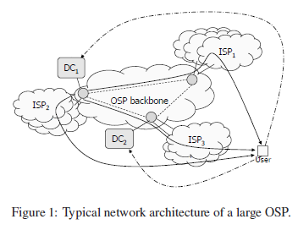
OSP Network Architecture

Slide 6
Considerations
Geographically dispersed data centers (DC).
Different users interact with different DCs, and ISPs help the OSPs carry traffic to and from the users.
Numerous destination prefixes and numerous choices for mapping users to DCs and selecting ISPs.
Some ISPs are free, some are exorbitantly expensive.

Slide 7
Traffic Cost & Performance for OSPs
Cost of carrying traffic
  Internal & External Links
  Assumptions
  function of traffic volume, F(v) (price × v)
  charging volume, 95th percentile across all the samples (P95)
Performance measure of interest
  Performance of many online services, is latency-bound.
  Round trip time (RTT) is the performance measure.
Cost-performance optimization
  P DCs and an total of Q ISPs
  P*Q alternative paths
Notes:
Thus, the largest 5% of the in- tervals are not considered, which protects an OSP from being charged for short bursts of traffic

Slide 8
Problem Formulation

Slide 9
Problem Formulation
OSP: DC = {dc_{i}} and external links LINK = {link_{j}}. OSP needs to deliver traffic to a set of destination prefixes D = {dk}
TE strategy: A collection of assignments of the traffic (request and reply) for each d_{k} to a path(dc_{i}, link_{j}).
  Constraints:
    Capacity Constraint
    Prefix d_{k} can use link_{j} only if the corresponding ISP provides routes to d_{k}.

Slide 10
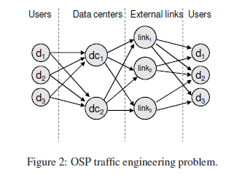
Problem Formulation
Notes:
Excess functionality requires expensive hardware and highly skilled personnel for its operation, making it a very inefficient solution

Slide 11
Entact Key Techniques

Slide 12
Challenges
To measure in real time the performance and cost of routing traffic to a destination prefix.
To use that cost-performance information in finding a TE strategy that matches the OSP’s goals.
Notes:
via any one of its many alternative paths that are not currently being used, without actually
redirecting the current traffic to those alternative paths

Slide 13
Computing cost and performance
Measuring performance of individual prefixes:
  Goal: Measure the latency of an alternative path for a prefix with minimal impact on the current traffic
  Existing techniques predict the latency of the current path between two end points in the Internet.
  Route injection technique (to measure the RTT of an alternate path)

Slide 14
Computing cost and performance
Computing performance of a TE strategy:
  weighted average RTT (wRTT ) (∑ vol_{p} *RTT_{p})/∑ vol_{p}
  traffic volume vol_{p} is estimated based on the Netflow data collected in the OSP
Computing cost of a TE strategy
  Actual traffic cost is calculated over a long billing period
  TE scheme needs to operate at intervals of minutes or hours.
  Very complicated to find P95
  Simple computation for total cost ∑_{L} F_{L} (Vol_{L}) over a small interval. Where Vol_{L} = ∑_{p} vol_{p} & F_{L}() is the pricing function of the link L. (pseudo cost)

Slide 15
Computing optimal TE strategies
Searching for optimal strategy curve
  A strategy is optimal if no other strategy has both lower wRTT and lower cost
  Curve connecting all the optimal strategies forms an optimal strategy curve on the plane
  let f_{kij} be the fraction of traffic to d_{k} that traverses path(dc_{i}, link_{j}) and rtt_{kji} be the RTT

Slide 16
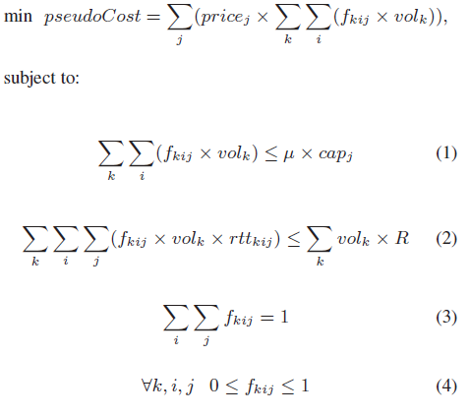
Computing optimal TE strategies

Slide 17
Computing optimal TE strategies
Selecting a desirable optimal strategy
  Simple Strategies
    Minimum cost for a given performance
    Minimum wRTT for a given cost budget
  Complex Strategy
    Additional unit cost (K) the OSP is willing to bear for a unit decrease in wRTT
  Desirable strategy for a given K
    Turning Point: Slope of the curve becomes higher than K when going from right to left
    Utility of a strategy (Pseudocost + K*RTT)
    Assumes traffic to a prefix can be split arbitrarily across multiple paths

Slide 18
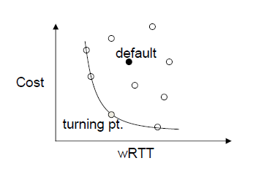
Computing optimal TE strategies

Slide 19
Computing optimal TE strategies
Finding a practical strategy
  Traffic to a prefix can only take one alternative path at a time
  Integer Linear Programming (ILP) problem is NP-hard
  Sort Paths in order computed using Available Capacity
  Greedily assign the prefixes to paths in the sorted order

Slide 20
Prototype Implementation

Slide 21
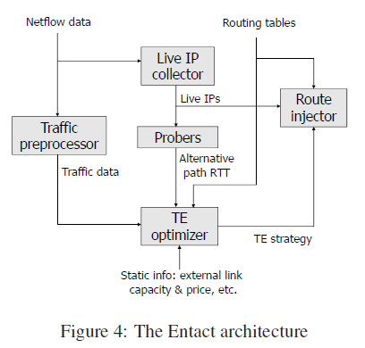
Entact Architecture

Slide 22
Entact Architecture
Inputs of Entact :
  Netflow data from all routers in the OSP network (flows currently traversing the network)
  Routing tables from all routers (current and alternative routes offered by neighbor ISPs)
  Information on link capacities and prices.
Output of Entact is a recommended TE strategy.
Entact divides time into fixed-length windows of size TE_{win}
Output is produced in every window

Slide 23
Measuring path performance
Live IP collector: Responsible for efficiently discovering IP addresses in a prefix that respond to our probes.
  Probe a subset of IP addresses that are found in Netflow data.
  This heuristic prioritizes and orders probes to a 6 small subset of IP addresses that are likely to respond,e.g., *.1 or *.127 addresses.

Slide 24
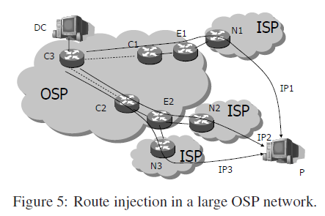
Measuring path performance

Slide 25
Measuring path performance
Route injector
  The route injector is a BGP daemon
  Default BGP route of p follows path(DC,E1 −N1)
  Given an IP address IP2 within p, to measure an alternative path path(DC,E2−N2)we do the following:
    Inject IP2/32 with nexthop as E2 into all the core routers C1, C2, and C3
    Inject IP2/32 with nexthop as N2 into E2.
Notes:
traffic to IP2 will traverse the alternative path that wewant tomeasure,while all traffic to
other IP addresses in p, e.g., IP1, will still follow the default path

Slide 26
Measuring path performance
Probers:
  Located at all data centers in the OSP network
  probe the live IPs along the selected alternative paths to measure their performance
  Median of five RTT samples along each Alternative path.

Slide 27
Computing TE strategy
Based on the path performance data, the prefix traffic volume information.
TE Optimizer:
  Implements the optimization process
  Uses MOSEK
  Converts optimized fractional to an integer strategy

Slide 28
Experimental Setup

Slide 29
Experimental Setup
Microsoft’s global network (MSN)
11 MSN DCs
2K external links
External links per DC-fewer than ten to several hundreds
Assumptions: Services and corresponding user data are replicated at all DCs

Slide 30
Experimental Setup
Targeted destination prefixes
  30K prefixes which account for 90% of the total traffic volume
  N_{ip}, the number of live IP addresses to which the RTTs are measured
  N_{ip} = 4 is sufficient
  discard prefixes with fewer than 4 live IP addresses -- leaves15K prefixes
  discard prefixes that are deemed multi-location, leaves 6K prefixes
Notes:
a prefix to be at a single location if the
difference between the RTTs to any pair of IP addresses in it is under 5ms.

Slide 31
Experimental Setup
Quantifying performance and cost
  Cost:
    record the traffic volume to each prefix
    Compute the traffic volume on each external link in each 5-minute interval
    Compute P95 over the entire Window
  Performance
    compute the wRTT for each 5-minute interval and take the weighted average across the entire evaluation period.

Slide 32
Results

Slide 33
Results
Benefits of TE optimization
  Four TE strategies:
    The default,
    Entact₁₀ (K = 10)
    Lowest- Cost (minimizing cost with K = 0)
    BestPerf (minimizing wRTT with K = inf)
  20-minute TE Window, 4 alternative routes from each DC
  Entact₁₀ reduces the default cost by 40% without inflating wRTT

Slide 34
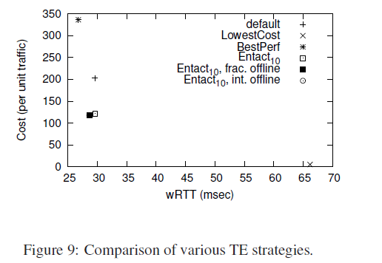
Results

Slide 35
Results
Effects of DC selection
  Larger number of DCs - more alternative paths for TE optimization - improvement over the default strategy - Incur greater overhead in RTT measurement and TE optimization.
  Selecting closest two DCs for each prefix sufficient.

Slide 36
Results
Effects of alternative routes (m)
  A larger m - more flexibility in TE optimization - incur greater overhead in terms of route injec- tion, optimization, and RTT measurement.
  Experiments suggest that 2 to 3 alternative routes are sufficient.

Slide 37
Results
Effects of TE window
  wRTT, cost, and utility of Entact₁₀ under different TE window sizes from 20 minutes to 4 hours is examined.
  TE_{win} = 1 hour is appropriate

Slide 38
Conclusions
Entact can help this OSP reduce the traffic cost by 40% without compromising per- formance

Slide 39
Questions?
THANK YOU

