Slide 1
Virtualizing Networking and Security in the Cloud
D. Basak et. Al. , VMWare Inc
Presented By - Jay

Slide 2
Abstract
Paper focuses on virtualizing network security functions and running them in a distributed way across slices of x86 blades.

Slide 3
Keywords
Netsec :: Network security
VDC :: Virtual Data Center
vShield Firewall
vShield Edge
SVA :: Secure Virtual Appliance ?
Win2K8 : Windows 2008 Server
RHEL :: Red Hat Enterprise Linux
Netperf :: Network performance measuring tool

Slide 4
Introduction
Number of virtual servers deployed have overtaken the number of physical servers.
Setting up a new physical data center may take from days to weeks.
Easy way out is to set up a virtual data center by renting from public or private cloud providers.
How do we provide security in such scenarios?

Slide 5
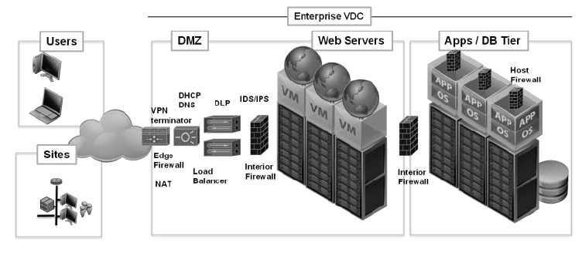
Virtual Data Center - VDC
Virtual Data Center

Slide 6
Challenges
Security
  To ensure security we need functions like Firewalls, NAT, Intrusion Prevention and Intrusion Detection, VPN etc.
Other Infrastructure requirements
  DNS
  DHCP
  Load Balancing

Slide 7
Limitations of Physical SECURITY devices
BLIND SPOTS
Cannot inspect virtual traffic between the virtual machines hence leading to Blind spots.
A physical device dedicated to every server on every blade of the virtual server array will lead to plethora of such devices and it will be hard to maintain them.

Slide 8
Limitations of Physical SECURITY devices
SPEED OF ANALYSIS
Firewalls do a higher level of packet inspection and this logic cannot be converted into hardware.
Hence these devices are considerably slower than the routers and switches where the algorithms are hard coded into chips.

Slide 9
Limitations of Physical SECURITY devices
MOORE’s LAW
Physical Security devices have to go through far more stringent checks than the blades used for hosting virtual servers and because of this reason, these devices haven’t been able to keep up in the pace of development with the virtual infrastructure.
http://en.wikipedia.org/wiki/Moore%27s_law
ftp://download.intel.com/museum/Moores_Law/Articles-Press_Releases/Gordon_Moore_1965_Article.pdf

Slide 10
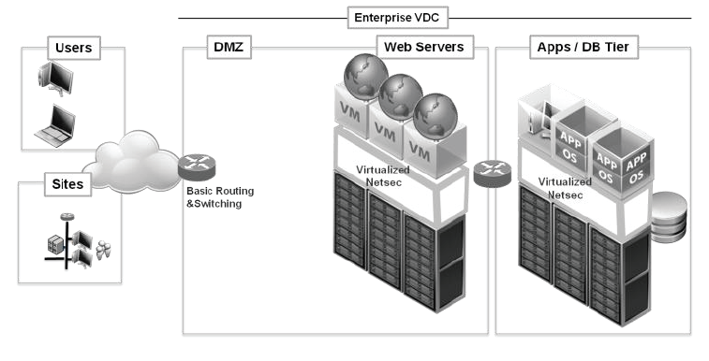
Virtualized netsec

Slide 11
Advantages
Natural scale out.
No separate physical appliances.
Enjoy benefits of Moore’s law.
No Blind spots.
Closer to Virtual machine.

Slide 12
vShield Firewall
& vshield edge
vShield Firewall : Virtual Firewall
vShield Edge : Virtualized Perimeter Appliance

Slide 13
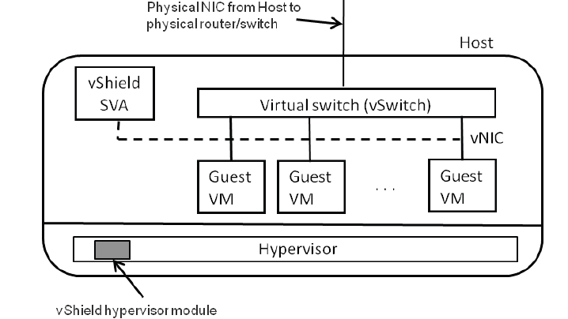
vShield firewall

Slide 14
vShield Firewall
Consists of 2 components
Hypervisor
SVA : Pre installed, pre configured Virtual Machine with a hardened O/S.
  I guess SVA stands for Secure Virtual Appliance
Hypervisor places a packet filter between the vNIC and vSwitch. This allows it to redirect packets to SVA for filtering.

Slide 15
Comparison to physical firewall
Physical firewall appliance needs to purchased, rack mounted, initialized, configured, allocated IP and set up. Physical presence is required. To increase capacity, the process needs to be repeated again.
In case of vShield Firewall, everything can be done remotely and programmatically without need for physical presence.

Slide 16
vShield Manager
This appliance provides centralized policy distribution and administration.
It allows administrators to programmatically create, deploy, upgrade and delete vShield firewalls.
Manager itself should be scalable and distributed so that it should not become a bottleneck itself.

Slide 17
vMotion
vMotion stands for live migration of a virtual machine to share the compute resources and/or address host failures.
vShield firewall is stateful and for it to be vMotion capable, it should be able to move with the virtual machine on to the new host. The state of the firewall should move when the vm moves.

Slide 18
vMotion requirements
vShield firewall is deployed on all hosts that allow vMotion.
vShield firewall Manager should dispatch the firewall rules on to the new host.
vShield firewall should participate in the vMotion so that the state gets transferred.

Slide 19
Sva contraints
Restricted Permissions
  Move/Delete only via vManager
Pinning to a Host
  SVA should not move on its own.
Distributed Power Management
  Low Resource usage leads to power down of vms. This requires power down of VSA also after all vms it is inspecting have been shut off.
High Availability
  To prevent against failures, high availability is required.

Slide 20
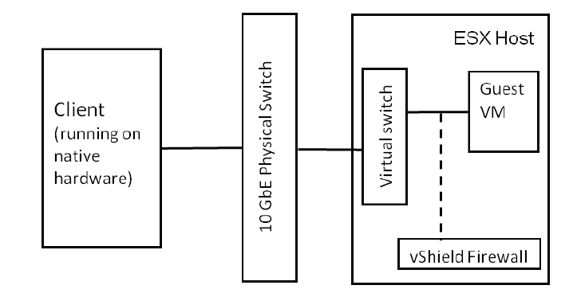
Performance
Layout

Slide 21
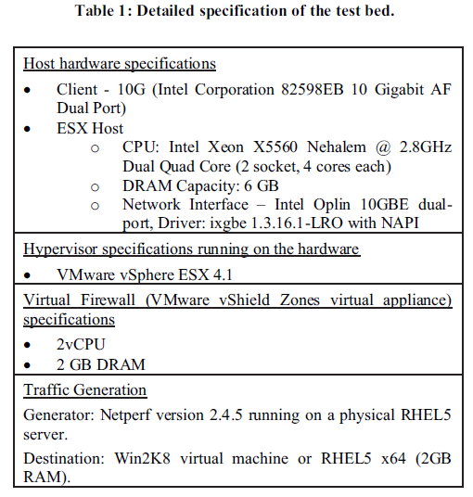
performance
Specifications

Slide 22
Performance
Experiment Details
Netperf TCP_Stream was used.
Three Case Scenarios
No vShield firewall
vShield firewall with 0 rules
vShield firewall with 5000 rules
http://linux.die.net/man/1/netperf
http://www.netperf.org/netperf/training/Netperf.html

Slide 23
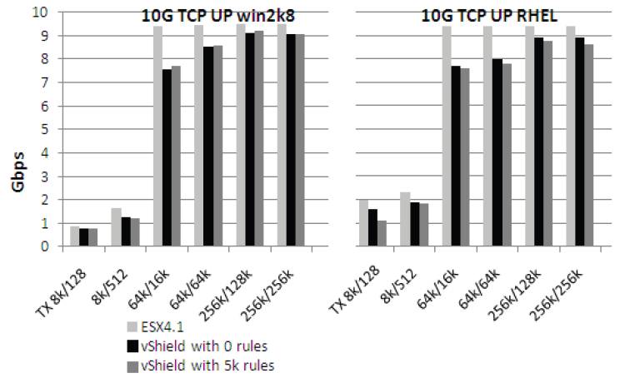
performance
Results

Slide 24
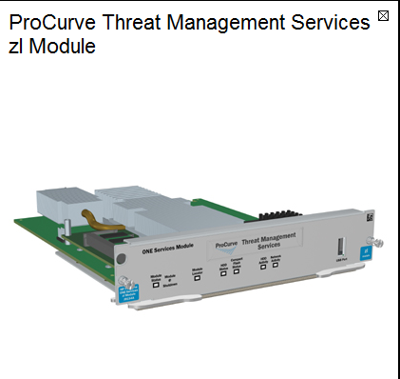
Secure virtual data center
Netsec functions on the blades of switches, routers:

Slide 25
Challenges with approach
Service modules not designed specifically for virtual networks but more for enterprise systems.
Large fault domain as the blade failure can lead to no netsec availability for the entire switch.
Requires complex network management and VLAN configuration and is limited by current VLAN limitation of the switches.

Slide 26
vShield Edge
vShield Edge SVA provides network edge security and gateway services to the virtual machines in the port group.
It provides for the following services:
DHCP
VPN
NAT
Load Balancing

Slide 27
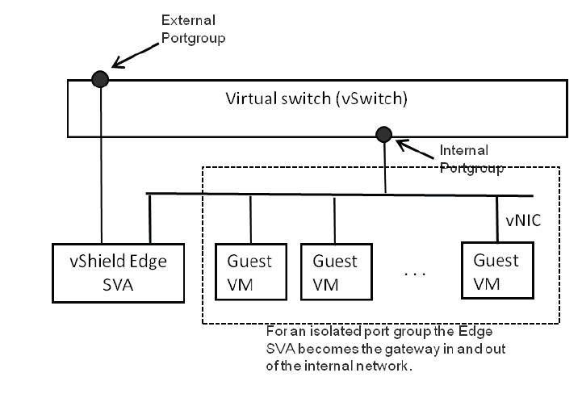
Vshield edge

Slide 28
deployment
VM Clone operation to create a new appliance.
Connect its external interface to uplink.
Connect its internal interface to isolated port group.
Configure IP for external interface
Configure IP for internal interface
vMotion capable

Slide 29
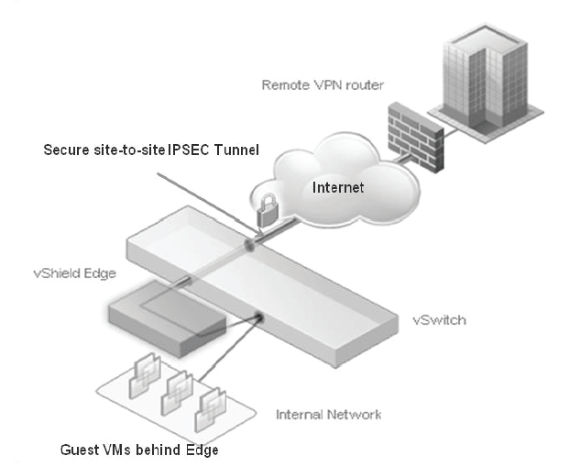
deployment

Slide 30
Services available
Firewall
NAT
DHCP
DNS
Search Domains
VPN

Slide 31
VDC setup TESTs
Step 1 : Create an isolated internal portgroup on vSwitch. Clone and deploy a vShield Edge.
Step 2 : Configure Edge Services
  DHCP
  NAT (100 – 50 static and 50 dynamic)
  Firewall Rules (100)
  Site to Site VPN Tunnel
Step 3 : Add a new guest Win XP machine to VDC.

Slide 32
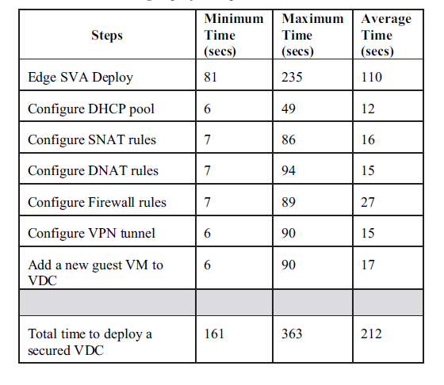
VDC SETUP REsULTS

Slide 33
Common attacks
& Response
ICMP Filtering : To guard against DOS attacks. Only allow ECHO, ECHO reply and TTL
Bogon Filtering : Filter out IPS not allocated.
Directed Broadcast : Ability to drop smurf attacks.
IP Source Routing : Disallow source routing.
Half Open Connections : Disallow to avoid resource exhaustion.
Ping Floods : Disable to deny DOS attacks.

Slide 34
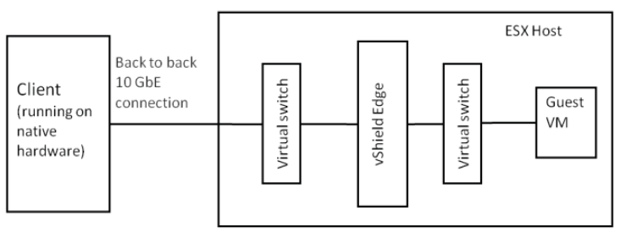
PERFORMANCE
Setup

Slide 35
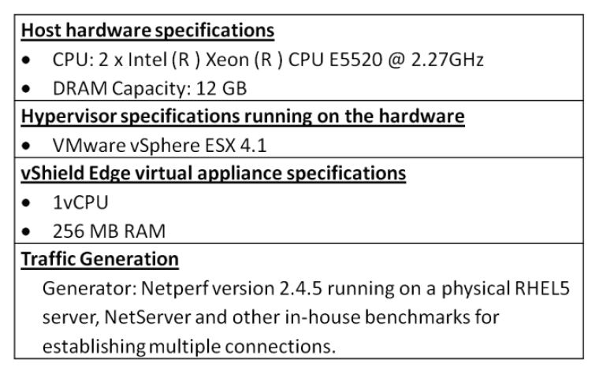
specs

Slide 36
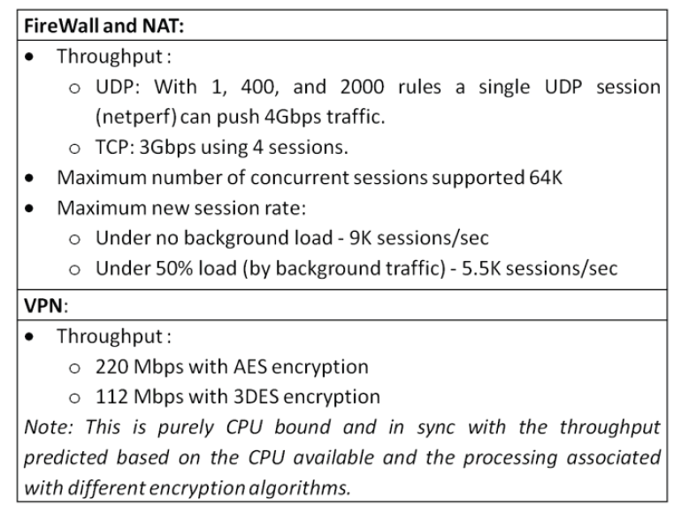
results

Slide 37
Virtual > Physical security
vShield Firewall has no blind spots.
MAC and IP Spoofing is not allowed because vShield Firewall has the vNIC MAC and IP addresses.
Provides prevention against DHCP IP Address allocation starvation.
Save Physical infrastructure against rogue VMs.
Ability to quarantine VMs.

Slide 38
Conclusions and future work
Can scale up.
Is similar in performance to physical infrastructure.
Ability to outperform the physical infrastructure.
Future work:
Move antivirus and local firewall to SVAs.

Slide 39
Questions / Comments
Paper introducing VMWare functionality.

