Slide 1
Nectar: Automatic Management of Data and Computation in Data Centers
Pradeep Kumar Gunda, Lenin Ravindranath, Chandramohan A. Thekkath, Yuan Yu, and Li Zhuang
Presented by: Hien Nguyen

Slide 2
Outline
Introduction
Related work
System design overview
Implementation details
Experimental evaluation
Discussion and conclusions

Slide 3
Introduction
Major challenges in realizing the full potential of data-intensive distributed computing within data centers:
  a large fraction of computations in a data center are redundant
  many datasets are obsolete or seldom used
  wasting vast amounts of resources in a data center.
Notes:
Recent advances in distributed execution engines and high-level anguage support have greatly simplified the development of large-scale, data-intensive, distributed applications. However,…

Slide 4
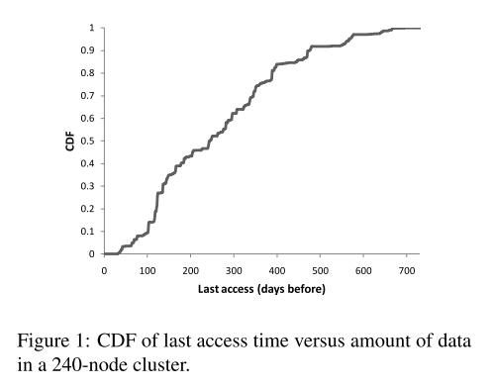
Introduction
wastage storage in 240-node experimental Dryad/DryadLINQ cluster
around 50% of the files are not accessed in the last 250 days
Notes:
the cumulative distribution function (CDF), or just distribution function, describes the probability that a real-valued random variable X with a given probability distribution will be found at a value less than or equal to x

Slide 5
Introduction
Execution statistics of 25 production clusters running data-parallel apps:
  on one such cluster, over 7000 hours/day of redundant computation can be eliminated by caching intermediate results.
  equivalent to shutting off 300 machines daily.
  cumulatively, over all clusters, this figure is over 35,000 hours per day.

Slide 6
Introduction
Nectar: a system that manages the execution environment of a data center and is designed to address these problems:
  Automatically caches computation results.
  Automatically manages data: storage, retrieval, garbage collection.
  Maintaining the dependency of data and programs.

Slide 7
Introduction
Computations running on a Nectar-managed data center are LINQ programs: comprises a set of operators to manipulate datasets of .NET objects.
All of these operators are functional: they transform input datasets to new output datasets.

Slide 8
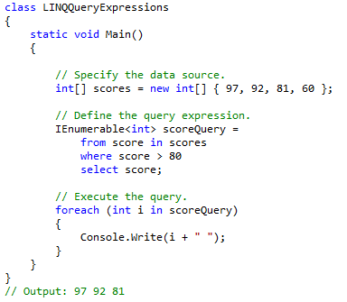
Introduction
LINQ example

Slide 9
Introduction
Data stored in a Nectar-managed data center:
  Primary: created once and accessed many times, referenced by conventional pathnames.
  Derived: results produced by computations running on primary and other derived datasets, all access mediated by Nectar, referred by simple pathnames containing a simple indirection (like UNIX symbolic link) to the actual LINQ programs that produce them.

Slide 10
Introduction
A Nectar-managed data center offers:
  Efficient space utilization: storage, retrieval, and eviction of the results of all computations.
  Reuse of shared sub-computations: automatically caches the results of sub-computations.
  Incremental computations: caching enables reusing results of old data, only compute incrementally for newly arriving data.
  Ease of content management: derived datasets uniquely named by LINQ expressions, and automatically managed by Nectar

Slide 11
Related work
Inspiration from the Vesta system: primary and derived data. But difference in app domains
DryadInc: early attempt to eliminate redundant computations via caching. Caching approach is quite similar to Nectar. However, too general and low-level for the system we wanted to build.

Slide 12
Related work
Stateful bulk processing system and Comet : mainly focus on the same problem of addressing incremental computation . However, Nectar:
  automatically manages data and computation
  transparent to users
  sharing sub-computation does not require submitting jobs at the same time.

Slide 13
System design overview
DryadLINQ: a simple, powerful, and elegant programming environment for writing large scale data parallel applications running on large PC clusters:
  Dryad provides reliable, distributed computing for large-scale data parallel applications.
  LINQ enables developers to write and debug apps in a SQL-like query language, relying on .NET library and using Visual Studio.

Slide 14
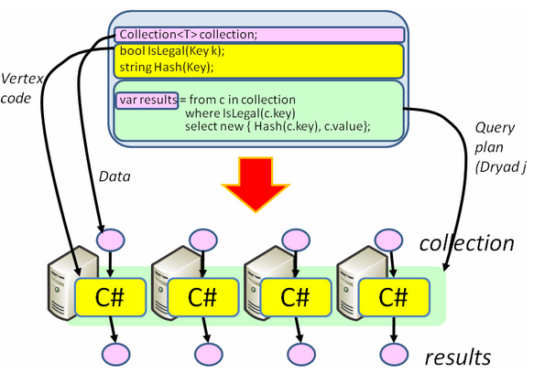
System design overview

Slide 15
System design overview
DryadLINQ translates LINQ programs into distributed Dryad computations:
  C# and LINQ data objects become distributed partitioned files.
  LINQ queries become distributed Dryad jobs.
  C# methods become code running on the vertices of a Dryad job.

Slide 16
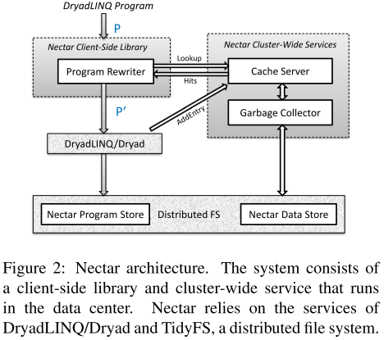
System design overview

Slide 17
System design overview
DryadLinQ program’s input and output are expected to be streams:
  consists of an ordered sequence of extents, each each stores a sequence of object of some data type
  require that streams be append-only: new contents are added by either appending to the last extent or adding a new extent

Slide 18
System design overview
Nectar uses fault-tolerant, distributed file system called TidyFS which maintains two namespaces:
  Program store: keeps all DryadLINQ programs that have ever executed successfully.
  Data store is used to store all derived streams generated by DryadLINQ programs.

Slide 19
System design overview
Nectar cache server provides cache hits to the program rewriter on the client side.
Any stream in the data store that is not referenced by any cache entry is deleted permanently by the garbage collector.
Programs in the program store are never deleted and are used to recreate a deleted derived stream if needed.

Slide 20
System design overview
Client-side libarary: 3 main components
  Cache Key Calculation
  Rewriter
  Cost Estimator

Slide 21
System design overview
Cache Key Calculation
  A computation is uniquely identified by its program and inputs.
  Use the Rabin fingerprint of the program and the input datasets as the cache key for a computation.
  The fingerprint of a DryadLINQ program must be able to detect any changes to the code the program depends on:
    implement a static dependency analyzer to compute the transitive closure of all the code that are reachable from the program.
    fingerprint is then formed using all the reachable code.

Slide 22
System design overview
Rewriter: support 3 rewriting scenarios
  Common sub-expressions
  Incremental query plans: have P(D1), now compute P(D1+D2): finds an operator C such that P (D1 + D2) = C(P (D1), D2)
  Incremental query plans for sliding windows: same program is repeatedly run on the following sequence of inputs:
    D 1 = d 1 + d 2 + ... + d n ,
    D 2 = d 2 + d 3 + ... + d n+1 ,
    D 3 = d 3 + d 4 + ... + d n+2 ,

Slide 23
System design overview
Cost Estimator:
  choose an optimal cache hit to rewrite the program.
  using execution statistics collected and saved in the cache server from past executions.

Slide 24
System design overview
Datacenter-Wide Service
  Cache Service: bookkeeping information about DryadLINQ programs and the location of their results
    serving the cache lookup requests by the Nectar rewriter
    deleting the cache entries of the least value.
  Garbage collector:
    identify datasets unreachable from any cache entry and delete them.
    use a lease to protect newly created derived datasets

Slide 25
Implementation details
Caching Computations
  Cache and Programs
  The Rewriting Algorithm
  Cache Insertion Policy
Managing Derived Data
  Data Store for Derived Data
  Garbage Collection

Slide 26

Implementation details
Cache and Programs
  Cache entry:
  as the primary key: can uniquely determine the result of the computation
  Fingerprint of the inputs: based on the actual content of the datasets
  Fingerprintf of the program: static dependency analyzer to capture all the dependency of an expression.

Slide 27
Implementation details
Cache and Programs (cont.)
  Statistics information kept in the cache entry is used by the rewriter to find an optimal execution plan, contains information such as the cumulative execution time.
  Supporting operations:
    Lookup
    Inquire
    AddEntry

Slide 28
Implementation details
The Rewriting Algorithm
  For a given expression: may get cache hits on any possible sub-expression and subset of the input dataset
    considering all of them in the rewriting is not tractable
    only consider cache hits on prefix sub-expression on segments of the input dataset
    i.e: D.Where(P).Select(F): only consider cache hits for the sub-expressions S.Where(P) and S.Where(P).Select(F) for all subsequence of extents in D.

Slide 29
Implementation details
Rewriting algorithm: GroupBy-Select example
  var groups = source.GroupBy(KeySelect);
  var reduced = groups.Select(Reduce);

Slide 30
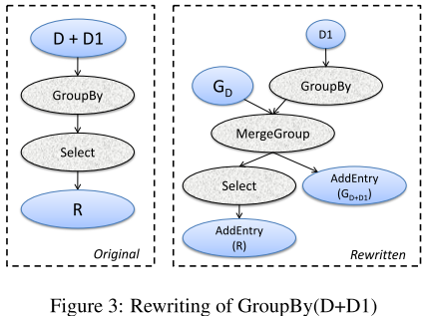
Implementation details

Slide 31
Implementation details
Rewriting algorithm: start from the largest prefix sub-expression (root of the expression)
  Step 1: probe the cache server to obtain all the possible hits
  Step 2: find the best hits
  Step 2: choose a subset of hits.

Slide 32
Implementation details
Cache Insertion Policy: consider every prefix sub-expression to be a candidate for caching
  always creates a cache entry for the final result of a computation as we get it for free
  For sub-expression candidates, cache only when predicted to be useful in the future:
    Based on previous statistics
    Based on runtime information

Slide 33
Implementation details
Data Store for Derived Data: stores all derived datasets in a data store inside a distributed, fault-tolerand file system.
  actual location of a derived dataset is completely opaque to programmers
  Accessing an existing derived dataset must go through the cache server.
  New derived datasets can only be created as results of computations.

Slide 34
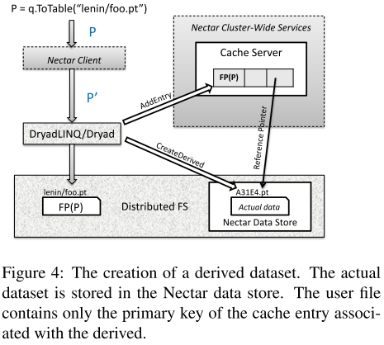
Implementation details

Slide 35
Implementation details
Garbage Collection: automatically deletes the derived datasets that are considered to be least useful in the future.
  cache server deletes entries that determined to have the least value.
  The datasets referred to by these deleted cache entries will then be considered garbage.
  eviction policy is based on the cost-to-benefit ratio:
  Give newly created cache entries a chance to demonstrate their usefulness: use leases.

Slide 36
Experimental evaluation
Production Clusters: use logs from 25 different clusters to evaluate the usefulness of Nectar
  Benefits from Caching: 20% to 65% jobs in a cluster benefits from caching. 30% jobs in 17 clusters had a cache hit, on an average more than 35% jobs benefited from caching.

Slide 37
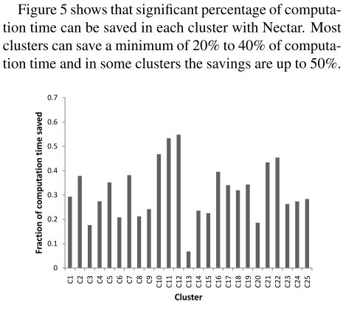
Experimental evaluation

Slide 38
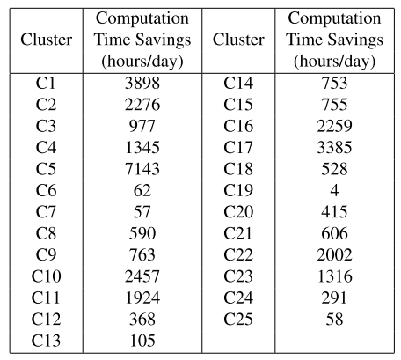
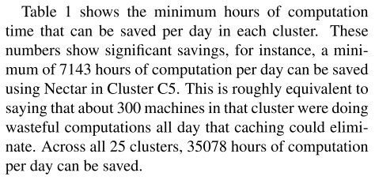
Experimental evaluation

Slide 39
Experimental evaluation
Production Clusters (cont.)
  Ease of Program Development:
    automatically supports incremental computation and programmers do not need to code them explicitly
    debugging time significantly improved due to cache hits

Slide 40
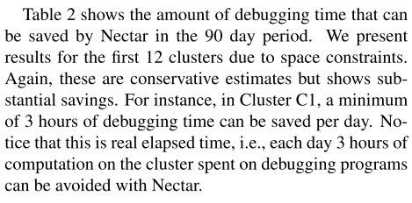
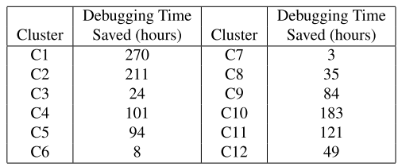
Experimental evaluation

Slide 41
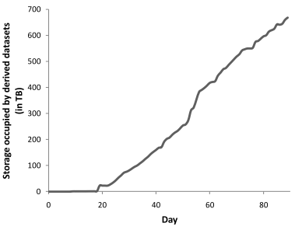
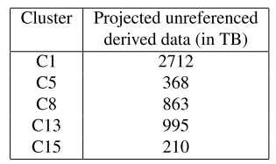
Experimental evaluation
Production Clusters (cont.)
  Managing Storage:
  Production clusters create large amount of derived datasets and if not properly managed can create significant storage pressure.

Slide 42
Experimental evaluation
System Deployment Experience
  Each machine in our 240-node research cluster has two dual-core 2.6GHz AMD Opteron 2218 HE CPUs, 16GB RAM, four 750GB SATA drives, and runs Windows Server 2003 operating system.
  Datasets
    WordDoc Dataset
    ClickLog Dataset
    SkyServer Dataset

Slide 43
Experimental evaluation
System Deployment Experience (cont.)
  Sub-computation Evaluation: 4 programs
    WordAnalysis parses the dataset to generate the number of occurrences of each word and the number of documents that it appears in.
    TopWord looks for the top ten most commonly used words in all documents.
    MostDoc looks for the top ten words appearing in the largest number of documents.
    TopWordRatio finds the percentage of occurrences of the top ten mostly used word among allwords.

Slide 44
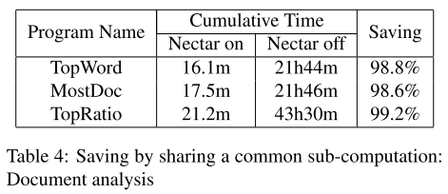
Experimental evaluation

Slide 45
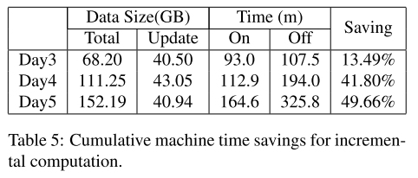
Experimental evaluation
System Deployment Experience (cont.)
  Incremental Computation:

Slide 46
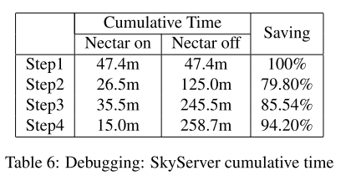
Experimental evaluation
System Deployment Experience (cont.)
  Debugging Experience: Sky Server

Slide 47
Discussion and conclusions
The most popular comment from our users is that the system makes program debugging much more interactive and fun.
Most of the Nectar developers, use Nectar to develop Nectar on a daily basis, and found a big increase in productivity.
Nectar is a complex distributed systems with multiple interacting policies. Devising the right policies and fine-tuning their parameters to find the righ tradeoffs are essential to make the system work in practice.

