Slide 1
Security and Privacy in Mobile Computing
Heavily borrowed from:
Traian Marius Truta, Overview of Statistical Disclosure Control and Privacy Preserving Data Mining
Ling Liu, From Data Privacy to Location Privacy: Models and Algorithms
Adam Smith, Pinning Down Privacy -- Defining Privacy in Statistical Databases

Slide 2
Outline
Security issues in mobile computing
Basic concepts in data privacy
  K-anonymity
  I-diversity
  t-Closeness
  Differential Privacy
Location privacy

Slide 3
Security Challenges in Mobile Computing
Mobile computing spans: host, networking, data
Host security
  Virus, malware, spyware
  Bose et al, Behavioral detection of malware on mobile handsets
  Enck et al, TaintDroid: An Information-Flow Tracking System for Realtime Privacy Monitoring on Smartphones
  Portokalidis et al, Paranoid Android: versatile protection for smartphones
Infrastructure security
  Authentication, encryption
  Tippenhauer et al, Attacks on public WLAN-based positioning systems
  Kalamandeen et al, Ensemble: Cooperative Proximity-Based Authentication
Data privacy
  In addition to leakage of user sensitive data at the device level, unique issues related to participatory sensing and location services
  Ahmadi, Privacy-aware Regression Modeling of Participaory Sensing Data

Slide 4
Pervasive Data
Public domain data
  Health-care datasets
    Clinical studies, hospital discharge databases …
  Genetic datasets
    $1000 genome, HapMap, deCode …
  Demographic datasets
    U.S. Census Bureau, sociology studies …
  Search logs, recommender systems, social networks, blogs …
    AOL search data, social networks of blogging sites, Netflix movie ratings, Amazon …
Personal data
  Location
  …

Slide 5
Overview of Data Privacy
Individuals
Submit
Collect
Data
Confidentiality
of Individuals
Disclosure Risk /
Anonymity Properties
Data Owner
Sanitizing
Process
Preserve
Data Utility
Information Loss
Release
Receive
Sanitized Data
Researcher
Intruder

Slide 6
Types of Disclosure
Initial Microdata
Masked Microdata
Name | SSN | Age | Zip | Diagnosis | Income
Alice | 123456789 | 44 | 48202 | AIDS | 17,000
Bob | 323232323 | 44 | 48202 | AIDS | 68,000
Charley | 232345656 | 44 | 48201 | Asthma | 80,000
Dave | 333333333 | 55 | 48310 | Asthma | 55,000
Eva | 666666666 | 55 | 48310 | Diabetes | 23,000
Age | Zip | Diagnosis | Income
44 | 48202 | AIDS | 17,000
44 | 48202 | AIDS | 68,000
44 | 48201 | Asthma | 80,000
55 | 48310 | Asthma | 55,000
55 | 48310 | Diabetes | 23,000
Data Owner

Slide 7
Types of Disclosure
Initial Microdata
Masked Microdata
Name | SSN | Age | Zip | Diagnosis | Income
Alice | 123456789 | 44 | 48202 | AIDS | 17,000
Bob | 323232323 | 44 | 48202 | AIDS | 68,000
Charley | 232345656 | 44 | 48201 | Asthma | 80,000
Dave | 333333333 | 55 | 48310 | Asthma | 55,000
Eva | 666666666 | 55 | 48310 | Diabetes | 23,000
Age | Zip | Diagnosis | Income
44 | 48202 | AIDS | 17,000
44 | 48202 | AIDS | 68,000
44 | 48201 | Asthma | 80,000
55 | 48310 | Asthma | 55,000
55 | 48310 | Diabetes | 23,000
Data Owner
External Information
Name | SSN | Age | Zip
Alice | 123456789 | 44 | 48202
Charley | 232345656 | 44 | 48201
Dave | 333333333 | 55 | 48310
Intruder

Slide 8
Types of Disclosure
Initial Microdata
Masked Microdata
Name | SSN | Age | Zip | Diagnosis | Income
Alice | 123456789 | 44 | 48202 | AIDS | 17,000
Bob | 323232323 | 44 | 48202 | AIDS | 68,000
Charley | 232345656 | 44 | 48201 | Asthma | 80,000
Dave | 333333333 | 55 | 48310 | Asthma | 55,000
Eva | 666666666 | 55 | 48310 | Diabetes | 23,000
Age | Zip | Diagnosis | Income
44 | 48202 | AIDS | 17,000
44 | 48202 | AIDS | 68,000
44 | 48201 | Asthma | 80,000
55 | 48310 | Asthma | 55,000
55 | 48310 | Diabetes | 23,000
Data Owner
External Information
Identity Disclosure:
Charlie is the third record
Name | SSN | Age | Zip
Alice | 123456789 | 44 | 48202
Charley | 232345656 | 44 | 48201
Dave | 333333333 | 55 | 48310
Attribute Disclosure:
Alice has AIDS
Intruder

Slide 9
Types of Disclosure
Initial Microdata
Masked Microdata
Name | SSN | Age | Zip | Diagnosis | Income
Alice | 123456789 | 44 | 48202 | AIDS | 17,000
Bob | 323232323 | 44 | 48202 | AIDS | 68,000
Charley | 232345656 | 44 | 48201 | Asthma | 80,000
Dave | 333333333 | 55 | 48310 | Asthma | 55,000
Eva | 666666666 | 55 | 48310 | Diabetes | 23,000
Age | Zip | Diagnosis | Income
44 | 482 | AIDS | 17,000
44 | 482 | AIDS | 68,000
44 | 482 | Asthma | 80,000
55 | 483 | Asthma | 55,000
55 | 483 | Diabetes | 23,000
Data Owner
External Information
Identity Disclosure:
Charlie is the third record
Name | SSN | Age | Zip
Alice | 123456789 | 44 | 48202
Charley | 232345656 | 44 | 48201
Dave | 333333333 | 55 | 48310
Attribute Disclosure:
Alice has AIDS
Intruder

Slide 10
Types of disclosure
Identity disclosure - identification of an entity (person, institution).
Attribute disclosure - the intruder finds something new about the target person.

Slide 11
Attribute Classification
I₁, I₂,..., I_{m} – identifier attributes
  Ex: Name and SSN
  Found in IM only
  Information that leads to a specific entity
K₁, K₂,.…, K_{p} – key or quasi-identifier attributes
  Ex: Zip Code and Age
  Found in IM and MM
  May be known by an intruder
S₁, S₂,.…, S_{q} – confidential or sensitive attributes
  Ex: Principal Diagnosis and Annual Income
  Found in IM and MM
  Assumed to be unknown to an intruder

Slide 12
Outline
Security issues in mobile computing
Basic concepts in data privacy
  K-anonymity
  I-diversity
  t-Closeness
  Differential Privacy
Location privacy

Slide 13
How can we formalize “privacy”?
Different people mean different things
Pin it down mathematically?
Goal #1: Rigor
  Prove clear theorems about privacy
    Few exist in literature
  Make clear (and refutable) conjectures
  Sleep better at night
Goal #2: Interesting science
  (New) Computational phenomenon
  Algorithmic problems
  Statistical problems

Slide 14
Why not use crypto definitions?
Attempt #1:
  Defn: For every entry i, no information about x_{i} is leaked
  (as if encrypted)
  Problem: no information at all is revealed!
  Tradeoff privacy vs utility
Attempt #2:
  Agree on summary statistics f(DB) that are safe
  Defn: No information about DB except f(DB)
  Problem: how to decide that f is safe?
  (Also: how do you figure out what f is? --Yosi)
C
C
C
C
C
C

Slide 15
Straw man #1: Exact Disclosure
x₁
x₂
query 1
x₃
San
answer 1
DB=


x_{n-1}
query T
x_{n}
answer T
Adversary A
¢
¢
¢
random coins
Defn: safe if adversary cannot learn any entry exactly
  leads to nice (but hard) combinatorial problems
  Does not preclude learning value with 99% certainty or narrowing down to a small interval
Historically:
  Focus: auditing interactive queries
  Difficulty: understanding relationships between queries
  E.g. two queries with small difference

Slide 16
Straw man #2: Learning the distribution
Assume x₁,…,x_{n} are drawn i.i.d. from unknown distribution
Defn: San is safe if it only reveals distribution
Implied approach:
  learn the distribution
  release description of distrib
  or re-sample points from distrib
Problem: tautology trap
  estimate of distrib. depends on data… why is it safe?

Slide 17
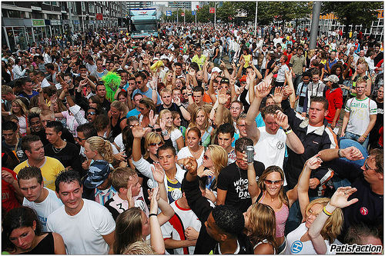
Blending into a Crowd
Intuition: I am safe in a group of k or more
  k varies (3… 6… 100… 10,000 ?)
Many variations on theme:
  Adv. wants predicate g such that
  0 < #{ i | g(x_{i})=true} < k
  g is called a breach of privacy
Why?
  Fundamental:
    R. Gavison: “protection from being brought to the attention of others”
  Rare property helps me re-identify someone
  Implicit: information about a large group is public
    e.g. liver problems more prevalent among diabetics
Notes:
Picture?

Slide 18
K-Anonymity Definitions
QI-cluster – all the tuples with identical combination of quasi-identifier attribute values in that microdata.
K-anonymity property for a masked microdata (MM) is satisfied if every QI-cluster in MM contains k or more tuples.

Slide 19
K-Anonymity Example
RecID | Age | Zip | Sex | Illness
1 | 50 | 41076 | Female | AIDS
2 | 30 | 41099 | Male | Diabetes
3 | 30 | 41099 | Male | AIDS
4 | 20 | 41076 | Male | Asthma
5 | 20 | 41076 | Male | Asthma
6 | 50 | 41076 | Female | Diabetes
7 | 50 | 41076 | Female | Tuberculosis
KA = { Age, Zip, Sex }
cl₁ = {1, 6, 7}; cl₂ = {2, 3}; cl₃ = {4, 5}

Slide 20
Domain and Value Generalization Hierarchies
Z₂ = {*****}
*****
482**
410**
Z₁ = {482**, 410**}
Z₀ = {48201, 41075, 41076, 41088, 41099}
48201
41075
41076
41088
41099
S₁ = {*}
*
male
female
S₀ = {male, female}
[Samarati 2001, Sweeney 2002]

Slide 21
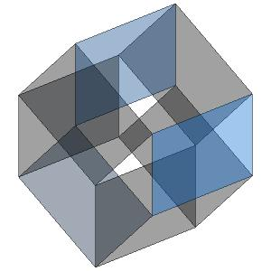
Curse of Dimensionality
[Aggarwal VLDB ‘05]
Generalization fundamentally relies on spatial locality
  Each record must have k close neighbors
Real-world datasets are very sparse
  Many attributes (dimensions)
    Netflix Prize dataset: 17,000 dimensions
    Amazon customer records: several million dimensions
  “Nearest neighbor” is very far
Projection to low dimensions loses info ⇒
  k-anonymized datasets are useless
    (not entirely true)

Slide 22
Limitation of K-Anonymity
k-Anonymity does not provide privacy if
  Sensitive values in an equivalence class lack diversity
  The attacker has background knowledge
Homogeneity Attack
A 3-anonymous patient table
Zipcode | Age | Disease
476** | 2* | Heart Disease
476** | 2* | Heart Disease
476** | 2* | Heart Disease
4790* | ≥40 | Flu
4790* | ≥40 | Heart Disease
4790* | ≥40 | Cancer
476** | 3* | Heart Disease
476** | 3* | Cancer
476** | 3* | Cancer
Bob
Zipcode | Age
47678 | 27
Background Knowledge Attack
Carl
Zipcode | Age
47673 | 36

Slide 23
l-Diversity
Distinct l-diversity
  Each equivalence class has at least l well-represented sensitive values.
  Limitation:
    Doesn’t prevent the probabilistic inference attacks
    Ex: In one equivalent class, there are ten tuples. In the “Disease” area, one of them is “Cancer”, one is “Heart Disease” and the remaining eight are “Flu”. This satisfies 3-diversity, but the attacker can still affirm that the target person’s disease is “Flu” with the accuracy of 70%.
Notes:
To address these problems, Machanavajjhala introduced the idea of l-Diversity
This lead to two stronger notion of l-diversity

Slide 24
l-Diversity
Entropy l-diversity
  Each equivalence class not only must have enough different sensitive values, but also the different sensitive values must be distributed evenly enough.
  The entropy of the distribution of sensitive values in each equivalence class is at least log(l).
  Sometimes this maybe too restrictive. When some values are very common, the entropy of the entire table may be very low. This leads to the less conservative notion of l-diversity.
Recursive (c,l)-diversity
  The most frequent value does not appear too frequently.
  r₁<c(r_{l}+r_{l+1}+…+r_{m}).

Slide 25
Limitations of l-Diversity
attribute disclosure not completely prevented.
Skewness Attack [Li 2007]
Two sensitive values
  HIV positive (1%) and HIV negative (99%).
Serious privacy risk
  Consider an equivalence class that contains an large number of positive records compared to negative records.
l-diversity does not differentiate
  Equivalence class 1: 49 positive + 1 negative.
  Equivalence class 2: 1 positive + 49 negative.
Overall distribution of sensitive values not considered.

Slide 26
Limitations of l-Diversity
attribute disclosure not completely prevented.
Similarity Attack [Li 2007]
A 3-diverse patient table
Zipcode | Age | Salary | Disease
476** | 2* | 20K | Gastric Ulcer
476** | 2* | 30K | Gastritis
476** | 2* | 40K | Stomach Cancer
4790* | ≥40 | 50K | Gastritis
4790* | ≥40 | 100K | Flu
4790* | ≥40 | 70K | Bronchitis
476** | 3* | 60K | Bronchitis
476** | 3* | 80K | Pneumonia
476** | 3* | 90K | Stomach Cancer
Bob
Zip | Age
47678 | 27
Conclusion
Bob’s salary is in [20k,40k], which is relative low.
Bob has some stomach-related disease.
Semantic meanings of sensitive values not considered.

Slide 27

t-Closeness: A New Privacy Measure
Rationale
A completely generalized microdata
Age | Zipcode | …… | Gender | Disease
* | * | …… | * | Flu
* | * | …… | * | Heart Disease
* | * | …… | * | Cancer
. . . | . . . | …… …… …… | . . . | . . .
* | * | …… | * | Gastritis
Belief | Knowledge
B₀
External
Knowledge
B₁
Overall distribution Q of sensitive values
[Li 2007]

Slide 28
t-Closeness: A New Privacy Measure
Rationale
A released microdata
Age | Zipcode | …… | Gender | Disease
2* | 479** | …… | Male | Flu
2* | 479** | …… | Male | Heart Disease
2* | 479** | …… | Male | Cancer
. . . | . . . | …… …… …… | . . . | . . .
≥50 | 4766* | …… | * | Gastritis
Belief | Knowledge
B₀
External
Knowledge
B₁
Overall distribution Q of sensitive values
B₂
Distribution P_{i} of sensitive values in each equi-class
[Li 2007]

Slide 29
t-Closeness: A New Privacy Measure
Rationale
Observations
  Q should be public.
  Knowledge gain in two parts:
    Whole population (from B₀ to B₁).
    Specific individuals (from B₁ to B₂).
  We bound knowledge gain between B₁ and B₂ instead.
Principle
  The distance between Q and P_{i} should be bounded by a threshold t.
Belief | Knowledge
B₀
External
Knowledge
B₁
Overall distribution Q of sensitive values
B₂
Distribution P_{i} of sensitive values in each equi-class
[Li 2007]

Slide 30
Preventing Attribute Disclosure
Various ways to capture
“no particular value should be revealed”
Differential Criterion:
  “Whatever is learned would be learned regardless of whether or not person i participates”
Satisfied by indistinguishability
  Also implies protection from re-identification?
Two interpretations:
  A given release won’t make privacy worse
  Rational respondent will answer if there is some gain
Can we preserve enough utility?

Slide 31
Disclosure Control Techniques
Remove Identifiers
Global and Local Recoding
Local Suppression
Sampling
Microaggregation
Simulation
Adding Noise
Rounding
Data Swapping
Etc.

Slide 32
Disclosure Control Techniques
Different disclosure control techniques are applied to the following initial microdata:
RecID | Name | SSN | Age | State | Diagnosis | Income | Billing
1 | John Wayne | 123456789 | 44 | MI | AIDS | 45,500 | 1,200
2 | Mary Gore | 323232323 | 44 | MI | Asthma | 37,900 | 2,500
3 | John Banks | 232345656 | 55 | MI | AIDS | 67,000 | 3,000
4 | Jesse Casey | 333333333 | 44 | MI | Asthma | 21,000 | 1,000
5 | Jack Stone | 444444444 | 55 | MI | Asthma | 90,000 | 900
6 | Mike Kopi | 666666666 | 45 | MI | Diabetes | 48,000 | 750
7 | Angela Simms | 777777777 | 25 | IN | Diabetes | 49,000 | 1,200
8 | Nike Wood | 888888888 | 35 | MI | AIDS | 66,000 | 2,200
9 | Mikhail Aaron | 999999999 | 55 | MI | AIDS | 69,000 | 4,200
10 | Sam Pall | 100000000 | 45 | MI | Tuberculosis | 34,000 | 3,100

Slide 33
Remove Identifiers
Identifiers such as Names, SSN etc. are removed.
RecID | Age | State | Diagnosis | Income | Billing
1 | 44 | MI | AIDS | 45,500 | 1,200
2 | 44 | MI | Asthma | 37,900 | 2,500
3 | 55 | MI | AIDS | 67,000 | 3,000
4 | 44 | MI | Asthma | 21,000 | 1,000
5 | 55 | MI | Asthma | 90,000 | 900
6 | 45 | MI | Diabetes | 48,000 | 750
7 | 25 | IN | Diabetes | 49,000 | 1,200
8 | 35 | MI | AIDS | 66,000 | 2,200
9 | 55 | MI | AIDS | 69,000 | 4,200
10 | 45 | MI | Tuberculosis | 34,000 | 3,100

Slide 34
Sampling
Sampling is the disclosure control method in which only a subset of records is released.
If n is the number of elements in initial microdata and t the released number of elements we call sf = t / n the sampling factor.
Simple random sampling is more frequently used. In this technique, each individual is chosen entirely by chance and each member of the population has an equal chance of being included in the sample.
RecID | Age | State | Diagnosis | Income | Billing
5 | 55 | MI | Asthma | 90,000 | 900
4 | 44 | MI | Asthma | 21,000 | 1,000
8 | 35 | MI | AIDS | 66,000 | 2,200
9 | 55 | MI | AIDS | 69,000 | 4,200
7 | 25 | IN | Diabetes | 49,000 | 1,200

Slide 35
Microaggregation
Order records from the initial microdata by an attribute, create groups of consecutive values, replace those values by the group average .
Microaggregation for attribute Income and minimum size 3.
The total sum for all Income values remains the same.
RecID | Age | State | Diagnosis | Income | Billing
2 | 44 | MI | Asthma | 30,967 | 2,500
4 | 44 | MI | Asthma | 30,967 | 1,000
10 | 45 | MI | Tuberculosis | 30,967 | 3,100
1 | 44 | MI | AIDS | 47,500 | 1,200
6 | 45 | MI | Diabetes | 47,500 | 750
7 | 25 | IN | Diabetes | 47,500 | 1,200
3 | 55 | MI | AIDS | 73,000 | 3,000
5 | 55 | MI | Asthma | 73,000 | 900
8 | 35 | MI | AIDS | 73,000 | 2,200
9 | 55 | MI | AIDS | 73,000 | 4,200

Slide 36
Data Swapping
In this disclosure method a sequence of so-called elementary swaps is applied to a microdata.
An elementary swap consists of two actions:
  A random selection of two records i and j from the microdata.
  A swap (interchange) of the values of the attribute being swapped for records i and j.
RecID | Age | State | Diagnosis | Income | Billing
1 | 44 | MI | AIDS | 48,000 | 1,200
2 | 44 | MI | Asthma | 37,900 | 2,500
3 | 55 | MI | AIDS | 67,000 | 3,000
4 | 44 | MI | Asthma | 21,000 | 1,000
5 | 55 | MI | Asthma | 90,000 | 900
6 | 45 | MI | Diabetes | 45,500 | 750
7 | 25 | IN | Diabetes | 49,000 | 1,200
8 | 35 | MI | AIDS | 66,000 | 2,200
9 | 55 | MI | AIDS | 69,000 | 4,200
10 | 45 | MI | Tuberculosis | 34,000 | 3,100

Slide 37
What is Privacy
“If the release of statistics S makes it possible to determine the value [of private information] more accurately than is possible without access to S, a disclosure has taken place.” [Dalenius]

Slide 38
An impossibility result
An abstract schema:
  Define a privacy breach
  D distributions on databases
  there exists adversaries A, A’ such that
  Pr( A(San) = breach ) – Pr( A’() = breach )) ≥Δ
Theorem: [Dwork-Naor]
  For reasonable “breach”, if San(DB) contains information about DB then some adversary breaks this definition
Example:
  Adv. knows Alice is 2 inches shorter than average Lithuanian
    but how tall are Lithuanians?
  With sanitized database, probability of guessing height goes up
  Theorem: this is unavoidable

Slide 39
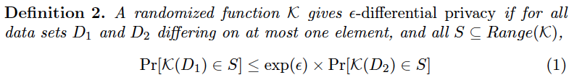
Differential Privacy
Since auxiliary information is difficult to quantify, consider whether the risk for an individual participating in a dataset
  If there is little risk, then one shall be truthful as well

Slide 40
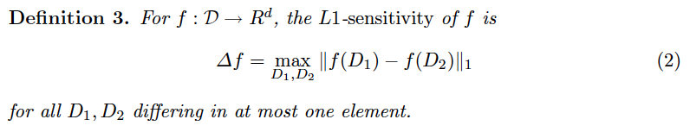
How to Achieve Differential Privacy
Computes f(x) and add noise with a scaled symmetric exponential distribution with variance σ² satisfying

Slide 41
Outline
Security issues in mobile computing
Basic concepts in data privacy
  K-anonymity
  I-diversity
  t-Closeness
  Differential Privacy
Location privacy

Slide 42
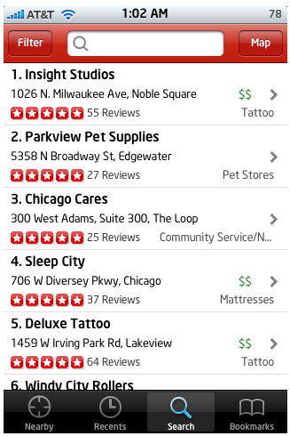
Location Based Services
Resource and information services based on the location of a principal
  Input: location of a mobile client + information service request
  Output: deliver location dependent information and service to the client on the move

Slide 43
LBS example
Location-based emergency services & traffic Monitoring
  Range query: How many cars on the highway 85 north
  Shortest path query: What is the estimated time of travel to my destination
  Nearest-neighbor query: Give me the location of 5 nearest Toyota maintenance stores?
Location finder:
  Range query: Where are the gas stations within five miles of my location
  Nearest-neighbor query: Where is nearest movie theater

Slide 44
Privacy Threats
Communication privacy threats
  Sender anonymity
Location inference threats
  Precise location tracking
  Successive position updates can be linked together, even if identifiers are removed from location updates
  Observation identification
  If external observation is available, it can be used to link a position update to an identity
Restricted space identification
  A known location owned by identity relationship can link an update to an identity

Slide 45
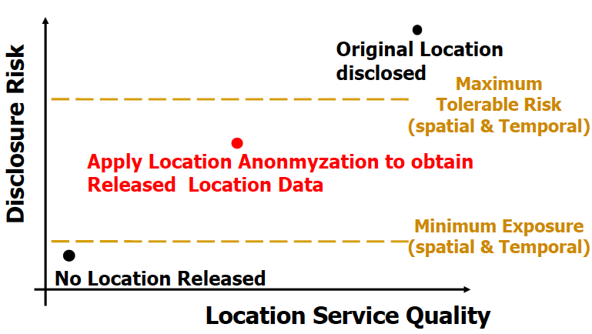
Challenges
Users have different preferences in privacy
Tradeoff between utility and privacy
  “How can Netflix make quality suggestions to you w/o knowing your preference?”

Slide 46
K-Anonymity in Location Privacy
For each location query, K or more users are the same location
Approaches:
  Spatial Cloaking
  Spatio-temporal Cloaking
  Geometric Transformation

Slide 47
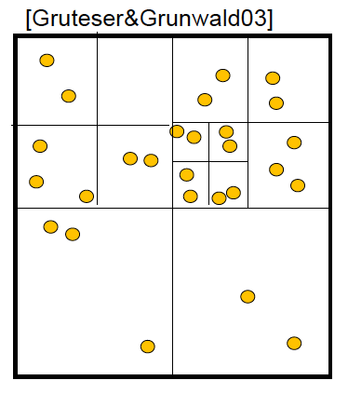
Spatial Cloaking

Slide 48
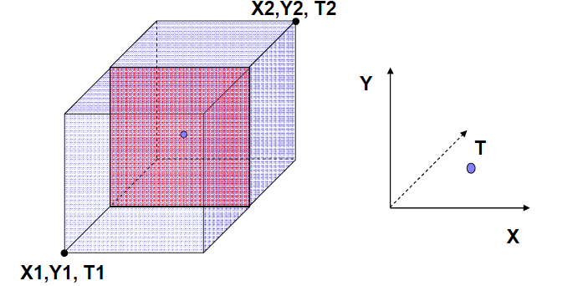
Spatial-Temporal Cloaking
Spatial Cloaking First and followed by Temporal Cloaking

Slide 49
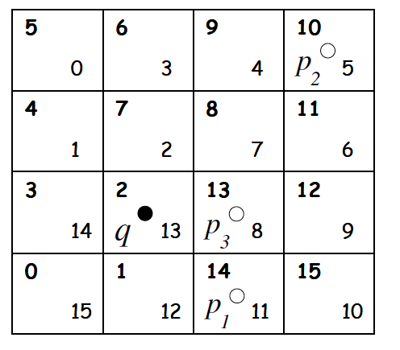
  Geometric Transformation
Problems: distance metrics not preserved

Slide 50
Conclusion
Security and privacy in mobile computing is an active area of research
Unique problems arise from
  Location services
  Participatory sensing
What is lacking
  Fundamentals on the tradeoff between utility and privacy
  Frameworks/systems that provide auditability, configurability and service guarantees

