Slide 1
Privacy-aware Regression Modeling of Participatory Sensing Data
Hossein Ahmadi, Nam Pham, Raghu Ganti, Tarek Abdelzaher, Suman Nath, Jiawei Han
Pallavi Arora

Slide 2
Outline
Introduction
Problem Formulation
  Linear regression
Privacy Filter
Application Server
  Model Construction
Privacy Analysis
Case Study
Discussion
Related Work
Conclusion

Slide 3
Introduction
Crowdsource aka Participatory Sensing
Predict Statistics or Extrapolate from collected data approach in paper
Private data Public model
Private Data Samples
Population density + Eco-friendly behavior→ Pollution
Model (Public)
Predict Pollution elsewhere.

Slide 4

Linear Regression
Analyzes relationship between two variables, X and y
Error (Zero mean const variance)
Output Input Regression Coefficients
Given X and y estimate β.
Regression Model
  Data (combination of X and y) →Model (β)
  Given X and β predict y.

Slide 5
Example
Private Public
Usage of electricity + Time of year → Energy consumption (Model)
Given usage pattern predict energy consumption.
Help users save on energy cost.
How much gas a vehicle will spend on a given route?
How much energy a household will save if they installed motion-activated light controls?
How much weight a 300lb person might lose if engaged in a particular diet and exercise routine?

Slide 6
Sharing private data
Ensure anonymity
  Security mechanism → users modify data, Perturbation
  Irrecoverably alter data → Approach in paper.

Slide 7
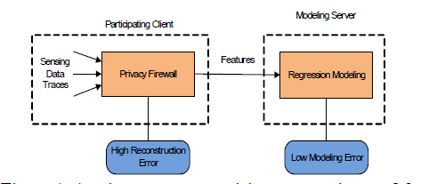
Problem Formulation

Slide 8
Problem Formulation
Data (time series) → output variables (e.g., household energy consumption)+ input variables (good predictors of output).
Data → Neutral Features
Reconstruction
  Compute private data from features.
  Higher reconstruction error higher privacy.

Slide 9
Assumptions
The model relating user inputs to the outputs is public.
Each data sample collected by an individual is private and may not be revealed.
The models used in the service are linear in coefficients.
The time-series data can be packed into uncorrelated data samples by aggregation (over time for example).

Slide 10
Design Goals
Minimize the modeling error
  Accuracy = No Alteration Accuracy.
  Perfect modeling
Maximize the reconstruction (breach) error
  Perfect Neutrality
    Information with shared data = information w/o shared data

Slide 11
Privacy Filter
Data Segmentation
  Aggregation over time to remove correlation
    Sum/average.
  Length of time interval → a day? a month?
    Large enough to remove correlation.
    Result in accurate prediction.
    Usable by participatory sensing application.
    Depends on application.

Slide 12

Segmentation
Segmentation
  n data points with d input values.
  Time independent data.
  yi to denote the value of the output attribute in the i^{th} segment
  x_{ij} to denote the value of j^{th} input of segment i
  Estimate y_{i} using
Does not prevent privacy ☹☹
  appliance usage + temperature inside a house each month show whether a residence is occupied or not in a particular month.

Slide 13

Neutral Features
Input variable
Output variable
Predictor variable and denote
Model of system

Slide 14

Neutral Features
Neutral Features → correlations of data
Size of data independent of number of samples n.
Large n larger privacy.
Constant O(n²)
Vector of length k O(kn²)
Matrix of size k*k O(k²n²)

Slide 15

The Application Server
Construct regression model
Least Square Estimator (LSE)
Let u₁, . . . ,u_{m} be the m users of the participatory sensing application and provide
Let

Slide 16
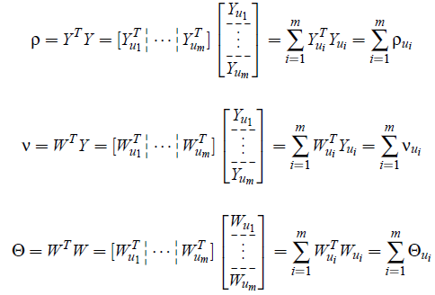
The Application Server
Define

Slide 17


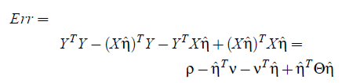
The Application Server
Model coefficients
  Only uses the neutral features….YEAH☺
  Exact model construction.
Regression Error
Error using neutral features

Slide 18


Privacy Analysis
Reconstructed data
Reconstruction Error
Reconstruction Error of mean values
Effective reconstruction
  If reconstruction err < 1
  Privacy Enabling Transformations
    If reconstruction err > 1
Variance of reconstructed data
Segmented data

Slide 19
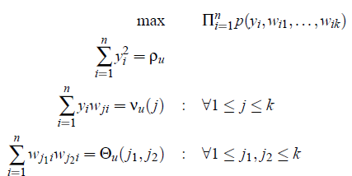
Privacy Enabling Properties
Optimal Reconstruction
  find the values Y_{u} and W_{u} that produce the given transformed matrices ρ_{u}, ν_{u}, Θ_{u} while maximizing the joint probability of observing such values.
  Probability of observing values (known to attacker)

Slide 20

Inaccuracy and Inefficiency of Reconstruction
Constraints and data points
If data points < constraints → 100% reconstruction→ 0% privacy
If n→ infinity, Optimal solution →
→ difficult to construct private data.
Constraints ≠ Affine non- convex optimization NP hard Exponential time in number of variables.

Slide 21
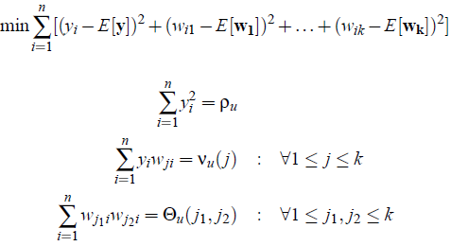
Conditions to Protect Privacy
Assumption Maximum likelihood is obtained if solution is close to the expected value also n is known.
KNITRO non-linear solver.

Slide 22
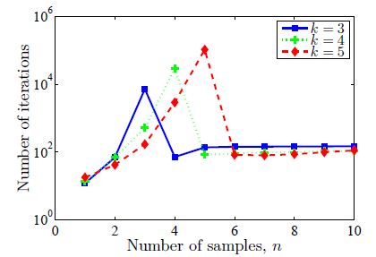
Simulation
Best value of n?? Number of constraints = number of variables
n < k single feasible solution
n > k high reconstruction error

Slide 23
Correlation
Vertical correlation
  correlation among different attributes
Horizontal correlation
  correlation within a single attribute

Slide 24
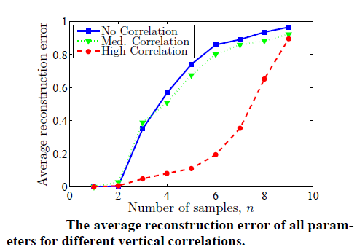
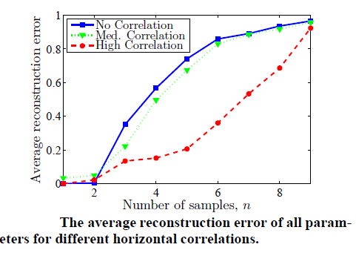
Conjecture: If n > 2k error → 1.

Slide 25
Case Study
Predict fuel efficient route
Compare
  White noise Perturbation technique
  Proposed method

Slide 26
Case Study
Client
  C++
  Data trace file
    Location trace from GPS
  Configuration file
    Unique application ID
    Segmentation interval
    Segmentation attributes(e.g. time)
      Euclidean distance between values
    Predictor function map X → W.
    Feature Matrices
      Transferred as XML to server
Server
  C++
  List of models with
  unique application ID
  Create aggregation
  matrices

Slide 27
Case Study
Data
  16 users (different cars), different cars, 3 months
  Geo-tagged engine sensor measurement
  650 segments each ~ 2miles.
  Input
    w₁ = m(ST +v TL)
      m and v Mass and Velocity of vehicle
      ST Number of stop signs
      TL Number of traffic lights
    w₂ = m v²
    w₃ = m
    w₄ = Av² A frontal area of car
  Output
    Fuel consumption

Slide 28
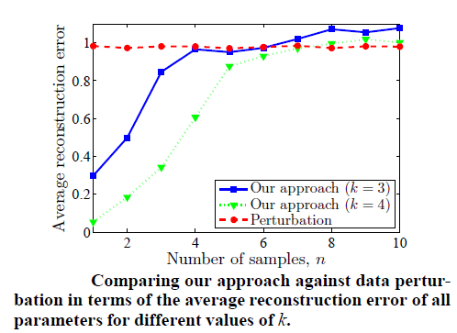
Case Study
Reconstruction error

Slide 29
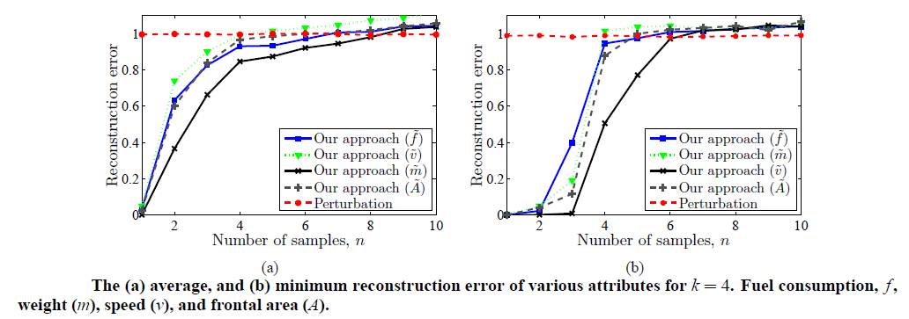
Case Study
Dependence on number of samples
High error for n > 2k

Slide 30
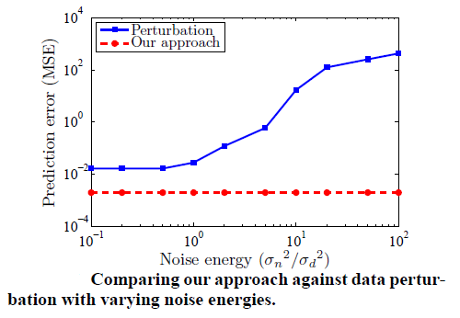
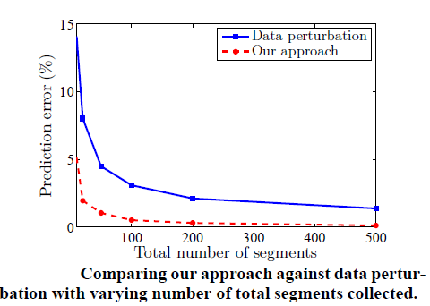
Case Study

Slide 31
Related work
Randomization
  Perturbation
  Differential Privacy
  Error in modeling
k-anonymity
  Loss of useful information
Distributed privacy preservation
  Horizontal or vertical partition → aggregate features
  Fine grained control to user to prevent his privacy.
Cryptographic techniques
  Homographic encryption
  Computationally expensive
  Limited scope

Slide 32
Conclusion
Regression model same as from private data.
Derive a safe number of samples.
Study privacy.
Neutral features →high Reconstruction error .
Quantification of privacy does not capture all privacy breaches
  Distribution of original data is narrow
  Higher correlation → easy reconstruction.
Can not guarantee privacy in theory.

