Slide 1
xShare: Supporting Impromptu Sharing of Mobile Phones
Yunxin Liu, Ahmad Rahmati,
Yuanhe Huang, Hyukjae Jang,
Lin Zhong, Yongguang Zhang,
Shensheng Zhang
Pallavi Arora

Slide 2
Outline
Motivation
Previous works
Understanding Phone Sharing
Designing
Challenges
Implementation
Evaluation

Slide 3
Motivation
It is often necessary or desirable to share our phones.
Reasons
  Lend for calling, texting
  Share music, photos, games etc.
  Show cool apps.
  Access to information for under-privleged.

Slide 4
Motivation
Concerns
  Private Data
  excessive exhaustible or billable resources, such as battery and cellular minutes.
Dealing with concerns
  Refrain from sharing
  Keep the phone in sight
  Prepare your phone by deleting, moving private data.

Slide 5
Motivation
Current prevention
  password or PIN code for accessing the entire phone (all or none).
  VMware have recently announced upcoming VM solutions for mobile platforms.
  Windows CE Kiosk Mode.
    http://msdn.microsoft.com/en-us/library/aa446914.aspx
Drawbacks
  mobile devices are processor and energy constrained
  additional overhead of VM solutions

Slide 6
Previous Work
media sharing : desirable but not well supported by the existing technologies.
Intel’s Ubiquity project: lightweight computer with high-density data storage capability, web server to push content to the connected device through a web browser.

Slide 7
Windows CE kiosk mode
Use in specialized devices
  Restrict all the application barring a few.
  Disable games and other entertainment programs
  ATM, a point of service
Existing Windows CE
  Windows Shell
    Start button, Taskbar
  Thin Client Shell
    directly into WBT/RDP shell
  Command Shell
    boots into command processor

Slide 8
Windows CE kiosk mode
Requirements
  customized Windows CE image
  lengthy reboot
No protection of data

Slide 9
Previous Work
Enabling Context aware and Privacy-Conscious User Data Sharing.
Houdini framework
  context-aware and privacy-conscious user data sharing.
Privacy-Conscious Personalization
  the requestee static data
  the requestee dynamic data
  the requester context
  the requestee preferences
Notes:
(i.e., who is requesting, what devices they are using)
for when her data should be revealed, to whom, and with what filtering or interpretation.
Enabling Contextaware
and Privacy-Conscious User Data Sharing

Slide 10
Examples
Enhanced Find Friends
  iLocator
  infer a user’s context using a combination of static and dynamic data
  serious privacy concerns
Presence and Selective Reach-Me
  Provide requesters information about presence across all the devices associated with the person,
  suggest the best device(s) for communicating
  share this information only with authorized requesters

Slide 11
Building rule set
user sets relevant parameters
user sets preferences that are transformed into rules and data that can be interpreted by the rules engine
system automatically learns preferences that are transformed into rules and data that can be interpreted by the rules engine.

Slide 12
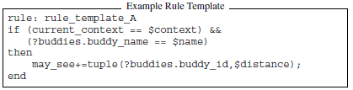
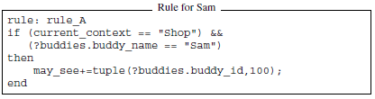
Rules

Slide 13
Understanding Phone Sharing
Interviews in four countries
  Nature of Sharing
      What applications
      With Whom
      Where
      Why
      Who is the initiator
  Privacy Concerns
      Classified user data
      Existing Protection Inadequate
      How owners deal with concerns

Slide 14
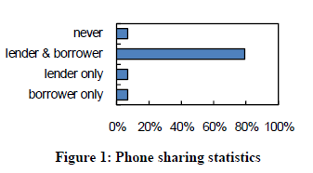
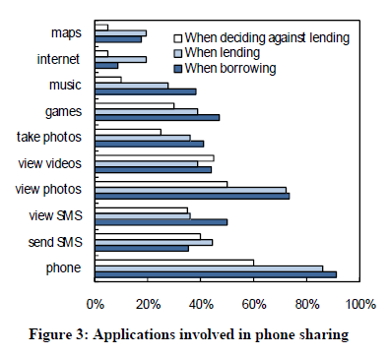
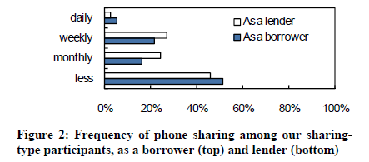
Understanding Phone Sharing
60 participants from China, Iran, Korea and USA

Slide 15
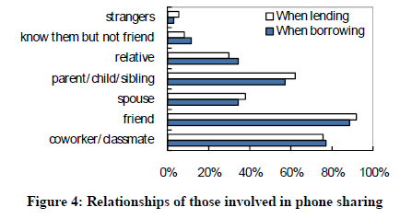
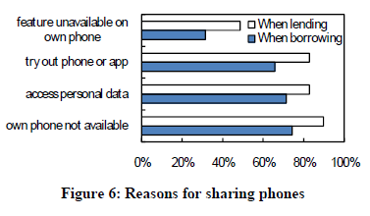
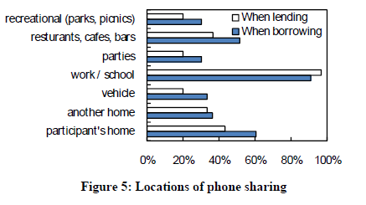
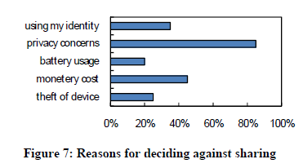
Understanding Phone Sharing

Slide 16
Understanding Phone Sharing
    Four month field trial
  Windows Mobile phone in Pecan Park, a low-income urban community in Houston
  Fourteen teenagers
  Active sharing initially
  Impromptu
  Application driven and data-driven

Slide 17
Threat Model
Impromptu policy creation
Access control
  individual applications, data files and folders, and system resources
Resource accounting
  exhaustible system resources and pay-by-use services
Borrower data reconciliation
  accept or reject

Slide 18
Design
Normal and Shared mode
UI for owner to specify sharing policy
Create virtual environment enforcing policies.
Authentication to go back to normal mode.
Accept or reject changes of shared mode.

Slide 19
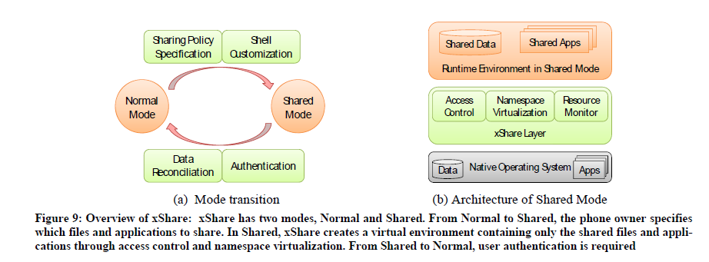
Design

Slide 20
File based access control
Application-independent solution.
Symbian, Linux, Windows Mobile, iPhone OS, Blackberry, and Palm use files as abstraction for both data and applications.
Unix-style mobile OS provide some access control for the file system.
Rebuilding the ROM image not required.

Slide 21
Design Considerations
Automatically selects applications for the selected files.
Initially not shared
profiles to enable frequently used sharing policies
Quick Share
  Share only the open file or application.
Prompt for changes in shared mode
  Default for modify is reject and new is accept.

Slide 22
Challenges
In-Memory Services and Applications
  terminates corresponding processes before entering Shared Mode
  Some applications cannot be terminated properly
Identifying Files for Application Sharing
  configuration files and DLLs
  allows access to all the files in the same folder as the corresponding executable

Slide 23
Virtual Environment
Namespace Virtualization
  renaming resources
Change Separation
  changes cannot affect the system in Normal Mode
Hiding Non-shared Files
  namespace virtualization hides non-shared resources from shared applications

Slide 24
Implementation for Windows Mobile
Intercept system APIs at the kernel-level.
  Implicit System APIs
  Handle-Based System APIs
Load Interception DLL
  setting the callback function to LoadLibrary() and its parameter as the name of a DLL
Access Control Implementation

Slide 25
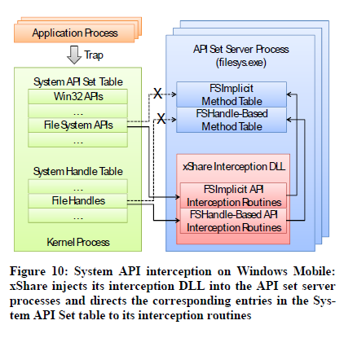
Implicit and Handle based System APIs
Globally registered and dispatched through the system API table.

Slide 26
Namespace Virtualization
File System Virtualization
  track changes, maintain correct states, ensure a consistent appearance
  intercept 18 file-system APIs
  virtual link technique
Change Separation through Path Mapping
  prefix changes with “\xShare\Root”
  virtual link file mapping physical path to intermediate path
  virtual recycle bin

Slide 27
Namespace Virtualization
Hiding Non-shared Files
  interception routine CreateFile() returns ERROR_FILE_NOT_FOUND
  intercept FindFirstFile() and FindNextFile()
Registry Virtualization
  virtualizes registry access to track the changes and separate them from Normal Mode
  Intercept 10 APIs

Slide 28
Virtualization
C:\Users\MyData\data.txt
\xShare\Root\C:\Users\MyData\data.txt
C:\xShare\Root\Users\MyData\data.txt.vlink

Slide 29
Tightly coupled services
Ex. Messaging
  These services cannot be stopped
  Backup the data read by these services
  Delete the original file
When the service/application is used in shared mode, data is not visible!
Restore the backed up file when returning to normal mode

Slide 30
Evaluation: Overhead
No overhead when running in normal mode
xShare interception layer requires 90KB of memory
CreateFile() takes relatively more time; but absolute time is still negligible

Slide 31
Evaluation: Latency
Switching to shared mode takes about 5.8 seconds
Switching back to normal mode takes about 3 seconds

Slide 32
Evaluation: Energy consumption
File I/O operations consume more energy in shared mode
Audio/Video playback do not show any measurable differences.
  Because reading files does not have any overhead

Slide 33
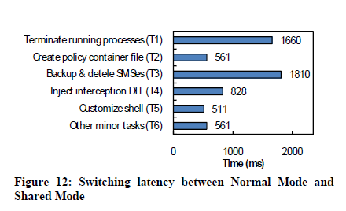
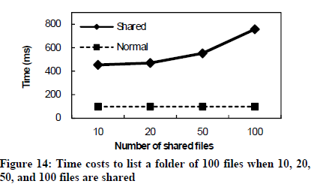
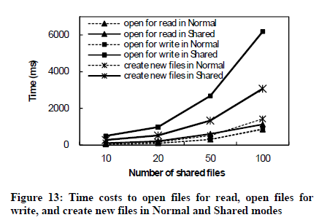
Evaluation

Slide 34
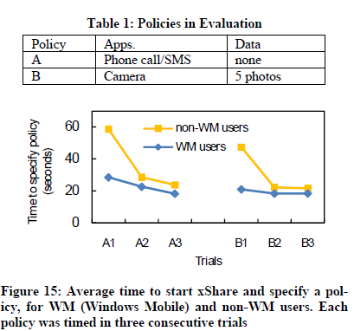

Slide 35
Video

Slide 36
Conclusions
Light weight protection against unauthorized access by borrowers
Not intended to protect data against theft
Interesting statistics to show that users actually care about privacy
API Interception and Virtualization used to sandbox applications and data

